Slide 1


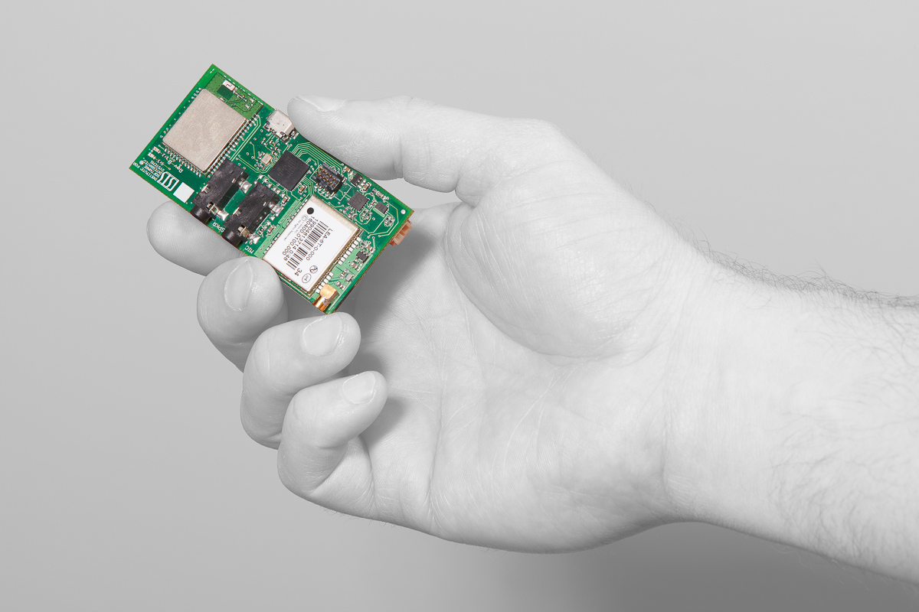

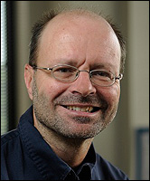


Will Hedgecock
CEO
Akos Ledeczi
CTO
Peter Volgyesi
Hardware Architect
Miklos Maroti
Professional-grade
positioning for location-aware applications…within inches
Mathematician

Slide 2
Will Hedgecock
CEO
Akos Ledeczi
CTO
Peter Volgyesi
Hardware Architect
Miklos Maroti
Professional-grade
positioning for location-aware applications…within inches
Mathematician
Notes:
Our product is a low-cost solution for providing high-accuracy locations in three dimensions, anywhere on Earth.

Slide 3
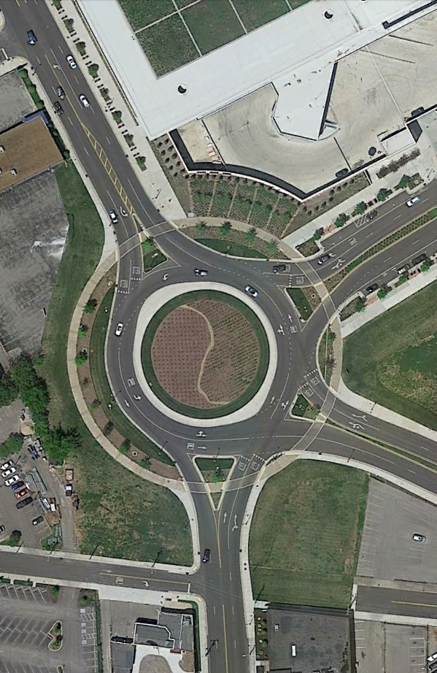

Slide 4
Notes:
Whereas ordinary GPS can provide location information down to 10 or 20 meters of accuracy, our solution can consistently achieve sub-meter, oftentimes centimeter-scale, accuracies.

Slide 5
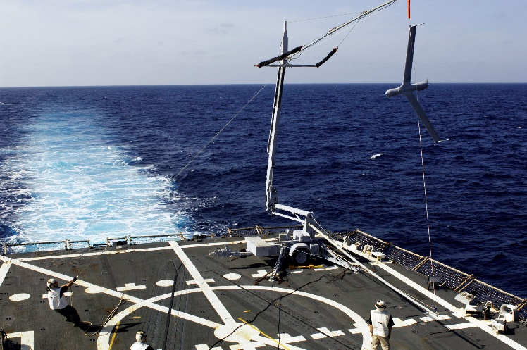
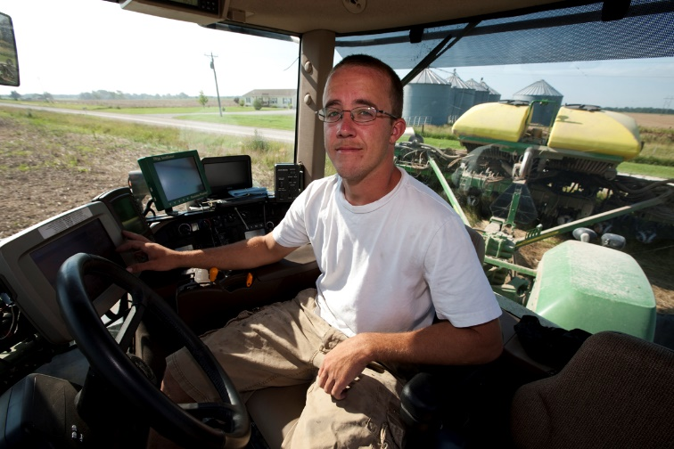
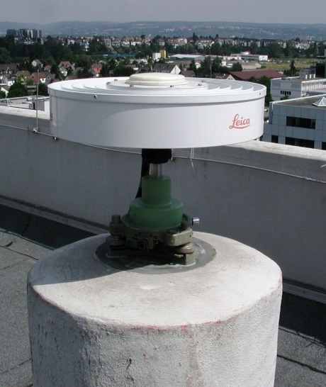

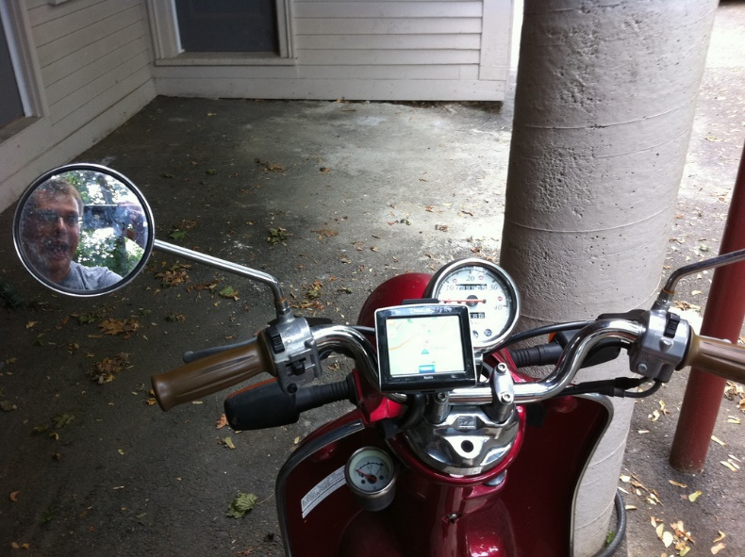
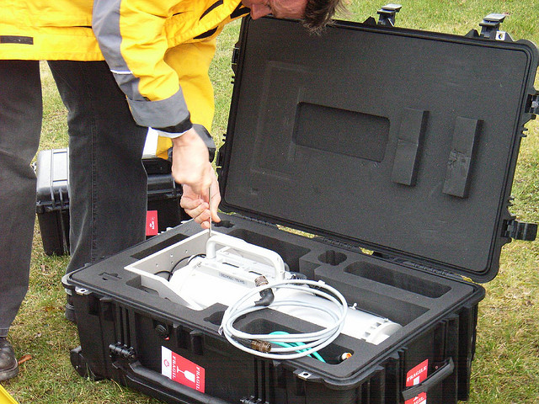
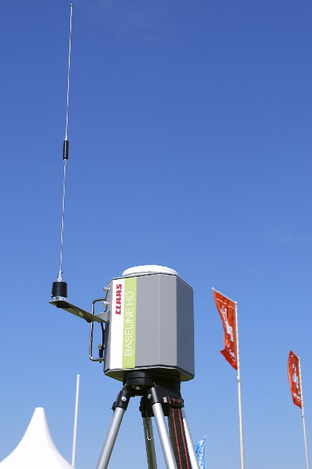
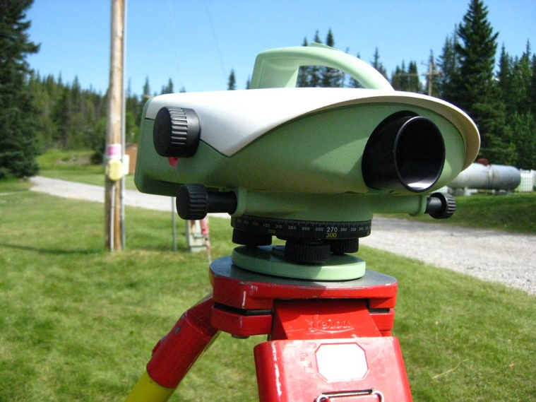
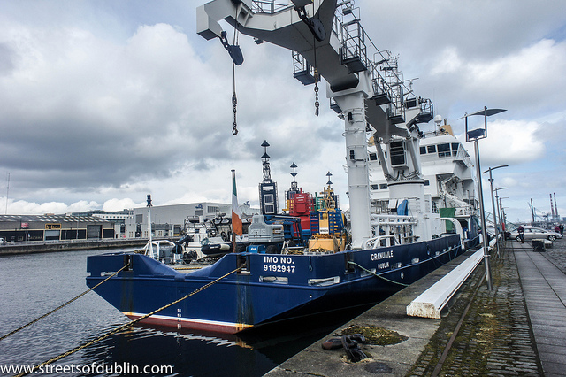
Notes:
Most Other GPS technologies that offer these levels of accuracy are either prohibitively expensive or require long stationary setup and calibration times, making them suboptimal for ad-hoc, instantaneous, or always-on applications.

Slide 6
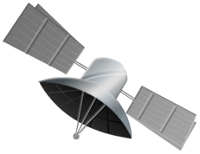

Notes:
Our technology makes use of the raw GPS satellite signals from two or more low-cost, off-the-shelf GPS receivers, sharing data between them and manipulating this data in a novel, patent-pending methodology to provide highly accurate, 3D position vectors between any two receivers in realtime.

Slide 7
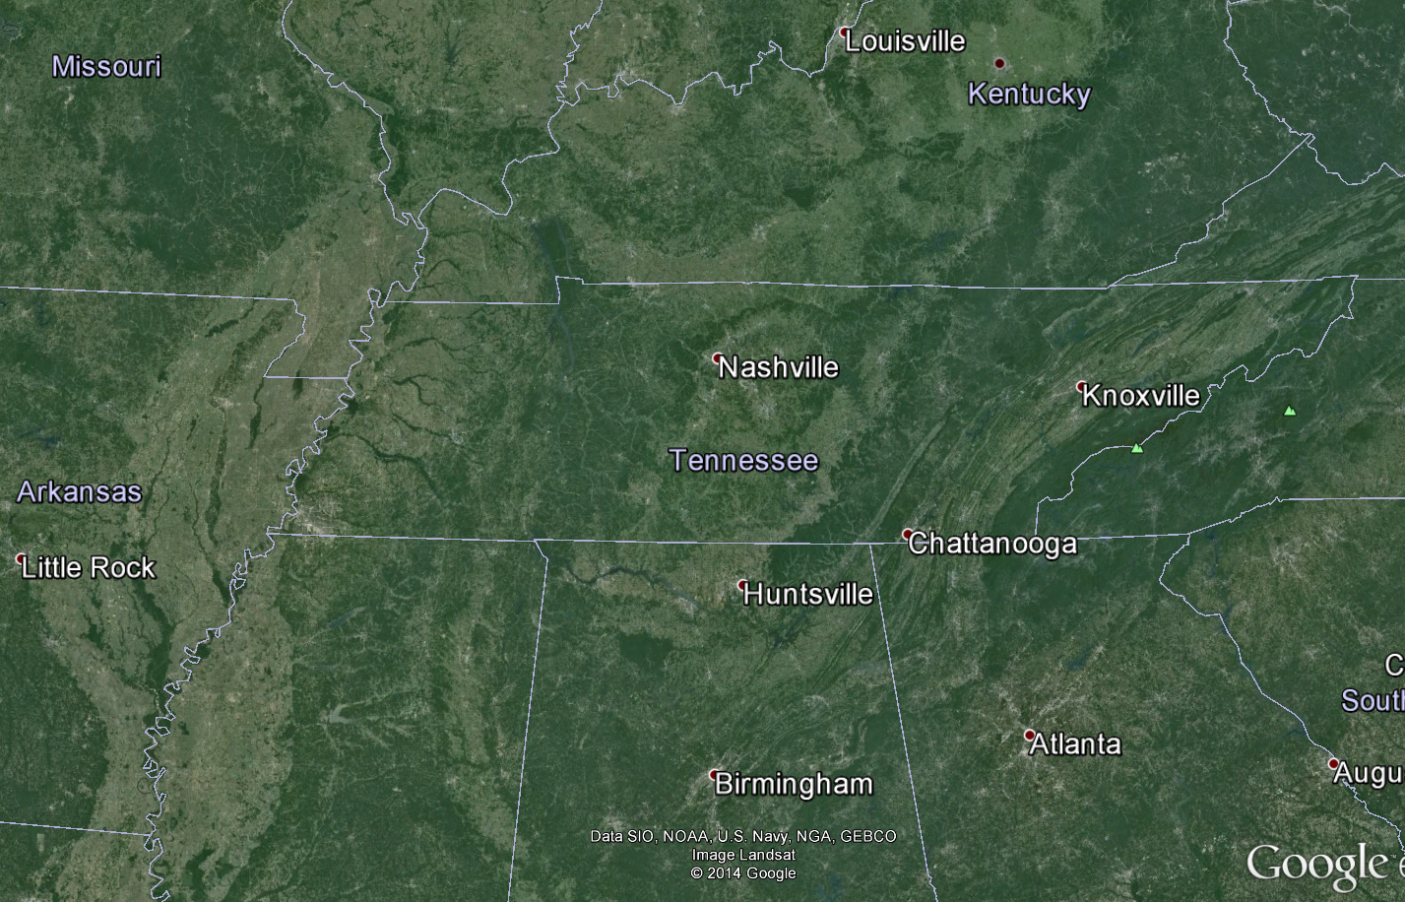

Notes:
If absolute coordinates are required, a single receiver can be fixed at a known position and used to localize any number of receivers around it within a 100 kilometer radius.

Slide 8


Notes:
It is our belief that this technology will bridge the gap between cost and accuracy for location-aware and location-dependent applications. So what exactly would an application that needs this kind of technology look like?

Slide 9
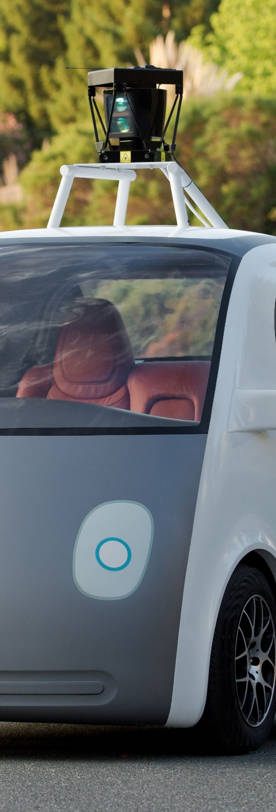


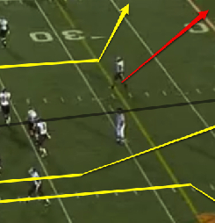

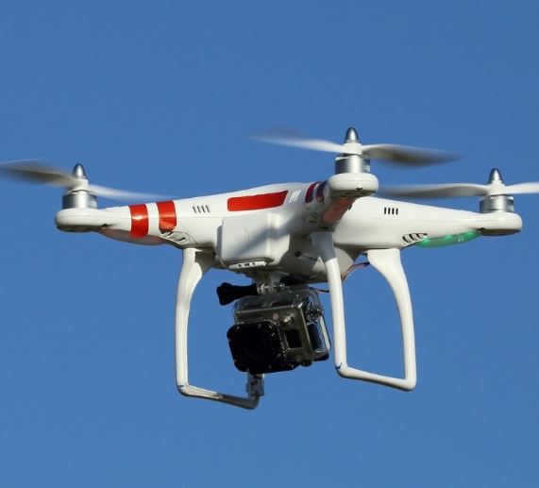
Notes:
Well all sorts of existing and emerging technologies rely on precision locations...including self-driving cars, golf green-reading apps, motorsports timing and scoring, training tools for football players and other team sports, DIY surveying, outdoor asset tracking, drone navigation, and so on and so on

Slide 10














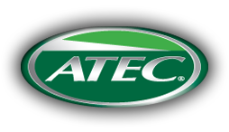

Unmanned Aerial Vehicles (UAV)
$13B Market
Adventure Sports
Enthusiasts
Automation and
Collision Avoidance
$1B Market
$24B Market
Construction and
Land Surveying
Sports Training
and Analysis
$7B Market
$2.3B Market
Notes:
Just as a frame of reference, here is a little diagram outlining several of the broad markets I just spoke about, showing both their total market sizes last year as well as some of the major players in each market. As you can see, there’s a lot of room for growth in any number of market verticals here. In reality, we actual got the idea to commercialize this technology based on a substantial amount of interest that was expressed to us from external sources who had either heard about our research or read our papers.

Slide 11

Notes:
It was a really fast turnaround for us…we actually approached the CTTC in the beginning of April, got put in touch with a lot of great resources, and formally founded a company in June. The name of that company is Fazecast, Inc., a TN Corporation, and the technology we are trying to commercialize is called PinPtr.

Slide 12
Momentum
April 2014:
Won Vanderbilt CTTC
FlashPitch Competition
August 2014:
NSF I-Corps Program
Grant Awarded
February 2014:
PCT Patent
Application Filed
May 2014:
Acceptance into Jumpstart
Foundry 2014 Cohort
September 2014:
Won Spark Nashville
Pitch Competition
October 2014:
NSF I-Corps Program
Began
June 2014:
Fazecast, Inc.
founded
March 2014:
Successful defense
of PhD dissertation
May 2014:
Invitation to apply for
NSF I-Corps Program
September 2014:
Google Faculty
Award Received
Notes:
So far, we’ve been extremely fortunate in our contacts, our funding, the programs we’ve been accepted into, and the trajectory of the company. Here’s a little timeline outlining what we’ve done so far…starting with filing a patent application for our technology in February
License Option Agreement

Slide 13
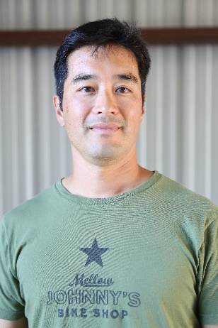
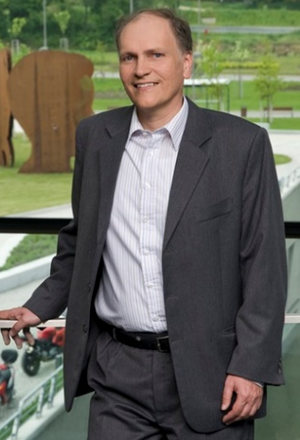


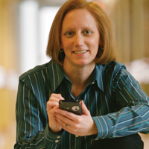
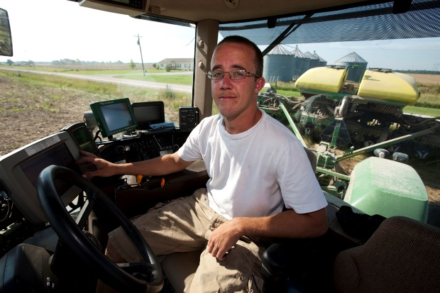
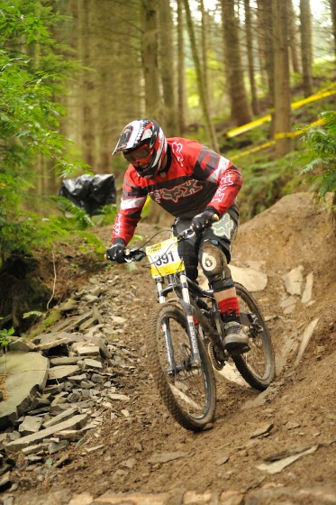

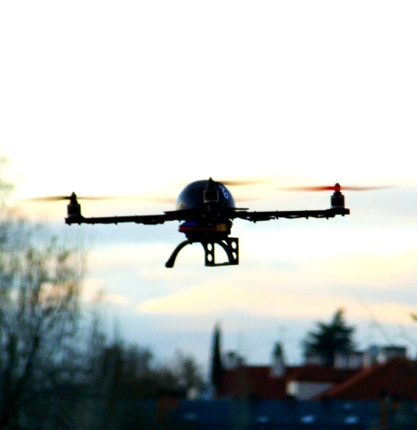
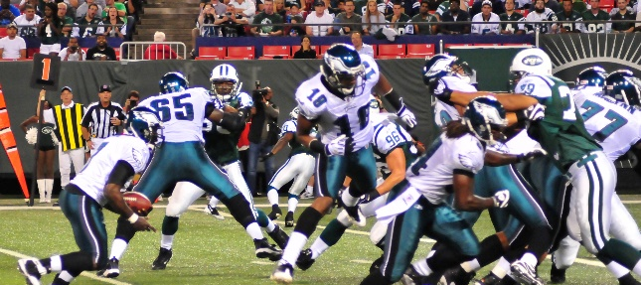
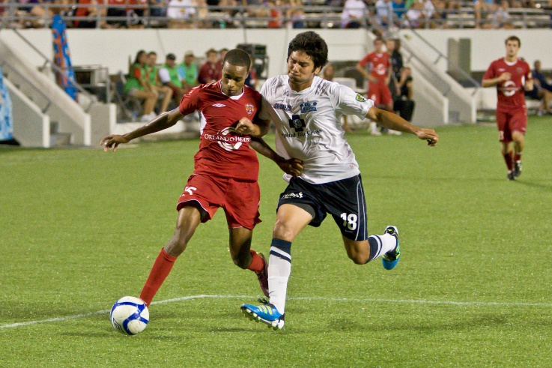

Notes:
Through the two curriculum-based programs, JSF and I-Corps, we talked to almost 200 potential customers in literally every possible market vertical we could think of from rock climbers to surfers to drone manufacturers to football coaches

Slide 14
“Accuracy…
is addictive!”
-Charles Toth
Notes:
One of the biggest underlying themes we got from most of our contacts and interviews was best summed up by interviewee Charles Toth who said that “accuracy…is addictive!” We also learned how much we don't know about certain market segments and how important market partners with domain-specific knowledge will be as we progress.

Slide 15





esA Concepts, LLC
Notes:
As such, we've identified three different companies who are interested in partnering with us initially as our first customers and real-world test cases for our technology. Those companies include i40 International, a marine-based cargo handling company, esA Concepts, a company developing training and analytics tools for teaching team sports like football, rugby, etc, and MotorsportsReg, a leading motorsports and auto racing timing, scoring, and entertainment company looking to completely remake the way that auto-racing is tracked, timed, and scored.
And that's just to scratch the surface...a partnership with even just one or two of these companies would grant us the opportunity to quickly enter the marketplace without having to deal with any market-specific domain knowledge, and to get enough development, feedback, and revenue to expand into additional markets in the near future.
Which speaking of, we already have ideas and have talked to additional people in areas that, for us, would be longer term but perhaps even more lucrative opportunities, including: SplitSecnd, a collision-detection and emergency-response company, the US Geological Survey, and even collegiate football teams, starting of course with our very own Vandy Football team...but that's a ways down the road.
The main thing at this time that our initial partners are looking for, and not just them, but really every company and person we've talked to who has a serious interest in being or becoming a customer: they all need something tangible at this point. Call it a prototype, an MVP, a working demo...whatever the name...that's the most pressing issue on the table at the moment. We've been sitting at about 90% completion of an MVP for about six months now, but with all of the business training and programs, it's kind of stagnated. So the timeline for us this year is spending the next two or so months strictly on finishing up prototype development such that we can have something easy to set up, test, and demonstrate to customers whenever they need it. We also need to get to that point so that we can start divvying up development to different people without walking all over each others' toes.

Slide 16



Notes:
Additionally, we're looking at other non-equity based funding opportunities such as doing a Kickstarter campaign in the spring, applying for NSF Accelerating Innovation Research, or AIR, Technology Transfer funding (which is $200,000), and applying for an SBIR grant. Given our current funding, burn rate, and activities, we’re not currently raising equity-based capital, and we’re also not taking salaries out of the company; however, once we get our MVP up and running and start doing field tests and application-specific development, we’ll most likely need to start raising, but again, until we get to that time and see what funding we’ve gotten from these guys and what we need, we really can’t tell what our requirements will be. The thing we do know about funding is that our primary initial expenses will come from actually manufacturing our inventory and hiring developers. And then the second big spend we’ll have will be for PR, marketing, and accounting.

Slide 17
Notes:
That was an overview, happy to answer any questions or go into further detail

Slide 18
Additional Material
Notes:
“Here was our original idea…”

Slide 19
Partnership Information and Hypotheses
Types of Partners
Market-Specific Consortiums
Market-Leading Businesses
Manufacturers/OEMs
Who Might They Be?
American Mountain Guides Association
Exum Mountain Guides
Unmanned Aerial Vehicle Systems International (UAVSI)
MotorsportsReg
Google
I4o International
Garmin
SplitSecnd

Slide 20
Partnership Information and Hypotheses
Why Will They Partner?
Market-Specific Consortiums will partner because we can enhance the safety of its members at little or no cost to them
Market-Leading Businesses will partner because:
  Our Value Propositions prove advantageous over existing solutions
  Our solution may give them an unfair advantage over their competition
  We are a low-cost alternative to existing solutions
  We can topple existing monopolies
What are the Risks?
We will not be able to provide the accuracy our partners require in a consistent and reliable manner
Our solution will not work in adverse GPS environments (Safety issues)
The time commitment required by each partner will be a drain on our resources, making us unable to focus on the general solution
Our growth will become too rapid for us to sustain it

Slide 21
Partnership Information and Hypotheses
Benefits of an Exclusive Partnership
For us:
Massively increased customer base
Less cost involved in PR and marketing
Increased reputation by proxy
Domain-specific expertise without hiring additional personnel
For them:
Leg up on the competition
Built-in IP protection
Additional/better product offerings

Slide 22
Pricing Tactic Hypotheses
Razor/Razor-Blade where the Razor is the hardware and the Razor Blade is the IP. Pricing tactics for each component are as follows:
Hardware
Cost + Markup
(to keep low-cost value proposition strong AND since there's no IP)
(The cost to us is Volume-Based, therefore will appear volume-based to buyer)
IP
Value-Based with a Competition-Based Upper Limit
Data Access
Value-Based

Slide 23
Hardware sold at nominal markup
Software valued at $540/hardware unit
Transactional
Activation-Based
Contract-Based
10% bulk discount
Pay at time of direct sale
Retail model
Less loss for unsold goods
Pay at time of indirect sale
Service reseller model
Lower cost of sale
End-user pays directly
Cell phone/Sirius XM model
Secondary Revenue: Data Tracking and Analytics
Notes:
In order to keep our low-cost value proposition strong, we plan to offer our hardware devices at low markups to manufacturers and OEMs. Our primary revenue will come from sales and usage of our cloud software which we value at $15 per month per device. We project each device to have a lifespan of 3 years, giving us a software lifetime value of $540 per hardware unit. We plan to offer our business customers three options to pay that fee based on their own financial needs, including a lump-sum transaction fee, a service-reseller-based fee, and a contract-based fee, similar to a cell phone or Sirius XM model. Finally, we plan to generate additional revenue by selling data tracking and analytics back to the manufacturers so that they can get a sense for how, when, and where their devices are being used.

Slide 24







High
Accuracy
Low Cost
Application
Agnostic
Cooperative
Notes:
Now the competitive landscape for our technology is quite sparse at the moment since the need for precision localization solutions is growing faster than the research to support it. The main takeaway from our market research has been that competitors can either do positioning at very low cost but very low accuracy (like the standard GPS in your smartphone) or they can do precise application-specific positioning at extremely high cost (companies like UAV Navigation), and then there are companies that lie somewhere in between, making a tradeoff between cost and accuracy. PinPtr stands alone in that we don't make a that tradeoff. We provide both extremely low costs and application-agnostic precise positioning, meaning we are well-positioned to move into any and all of those market verticals requiring high-precision localization without spending excessive time and money on additional R&D.

