Slide 1


Institute for Software Integrated Systems
Vanderbilt University
Accurate Real-Time
Relative Localization Using Single-Frequency GPS
Will Hedgecock
Miklos Maroti
Akos Ledeczi
Peter Volgyesi
Rueben Banalagay
ACM SenSys ‘14, November 4, 2014

Slide 2
Motivation
Many mobile sensing applications rely on highly-accurate sensor node locations in which ONLY the relative positions of the nodes are required
GPS provides absolute coordinates anywhere in the world, but sub-meter accuracy is unobtainable without military-grade or prohibitively-expensive differential GPS units
GPS has became cheaper and less power hungry in recent years
  Still not accurate enough for many precision applications, including:
  Land surveying, precision agriculture
  Coordinated movement of UAVs and UGVs
  Driverless cars: collision avoidance, platoon formation when there is no LOS
  Etc.
Promising work in the form of Differential GPS and RTK
Need a method to bridge the gap between cost and accuracy

Slide 3
Outline
Motivation
Related and Previous Work
Theoretical Approach
Experimental Implementation
Results
Future Work and Conclusions
Motivation
Related and Previous Work
Theoretical Approach
Experimental Implementation
Results
Future Work and Conclusions
“High-Accuracy Differential Tracking of Low-Cost GPS Receivers”
W. Hedgecock, M. Maroti, J. Sallai, P. Volgyesi, and A. Ledeczi
ACM MobiSys ‘13, Taipei, Taiwan

Slide 4
Previous Work
Requirements
Centimeter-precision tracking accuracy for a scalable network of nodes
No stationary calibration or data collection phase
No explicit reference station or hub
Our Approach
Use GPS satellites to provide relative tracking information for a cooperating network of sensor nodes via raw data sharing and pairwise node localization

Slide 5
Related Work
Real-Time Kinematic (RTK) Navigation
“RTK uses measurements of the phase of the signal′s carrier wave, rather than the information content of the signal, and relies on a single reference station to provide real-time corrections, providing up to centimeter-level accuracy”
--Wikipedia
“RTK uses measurements of the phase of the signal′s carrier wave, rather than the information content of the signal, and relies on a single reference station to provide real-time corrections, providing up to centimeter-level accuracy”
--Wikipedia
“RTK uses measurements of the phase of the signal′s carrier wave, rather than the information content of the signal, and relies on a single reference station to provide real-time corrections, providing up to centimeter-level accuracy”
--Wikipedia
Centimeter-precision accuracy for a scalable network of nodes
No stationary calibration or data collection phase
No explicit reference station or hub

Slide 6
Previous Work
Characterize and correct for previously unexplored or ignored sources of error specific to the two-receiver localization case
Extend well-known observation models to include between-epoch data without requiring a reference satellite
Use the new observation model in a GPS tracking algorithm to enable robust relative dead reckoning through a significant period of time

Slide 7
Previous Work
We only solved half of the problem
Initial baseline determination and re-initialization upon loss of satellite locks

Slide 8
Outline
Motivation
Related and Previous Work
Theoretical Approach
Experimental Implementation
Results
Future Work and Conclusions
Motivation
Related and Previous Work
Theoretical Approach
Experimental Implementation
Results
Future Work and Conclusions

Slide 9
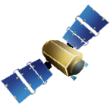

GPS Carrier Phase
Satellite orbit
Reported carrier
phase measurements
Constant ambiguity
value
=
Accumulated Doppler
Shift
Full carrier
range
Satellite lock
acquired
Satellite distance
at time of lock

Slide 10
Carrier Phase Double Difference

Slide 11
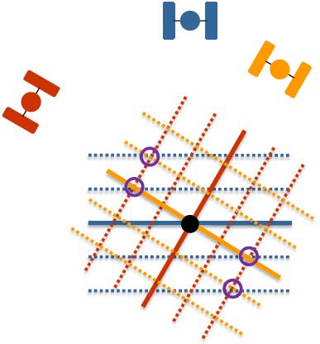
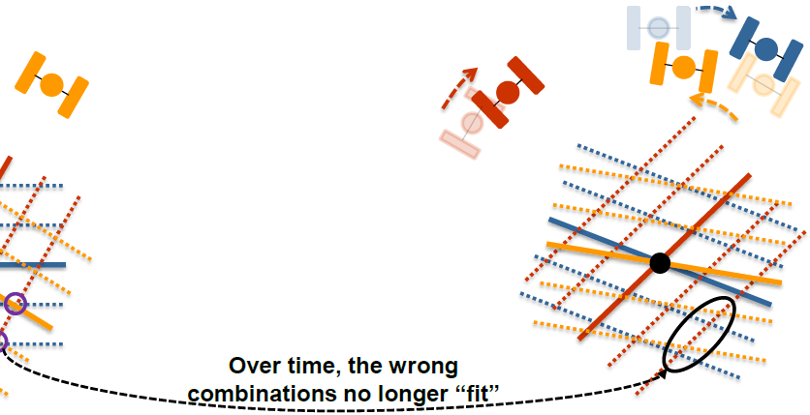
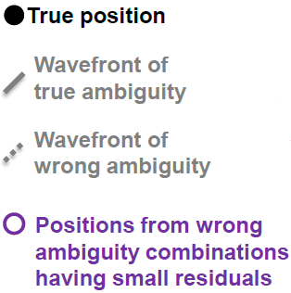
Carrier Phase Double Difference
*Adapted from Dr. Mark Petovello’s ION GNSS 2013 Presentation: “RTK GNSS Positioning”

Slide 12
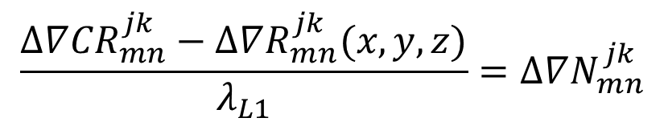

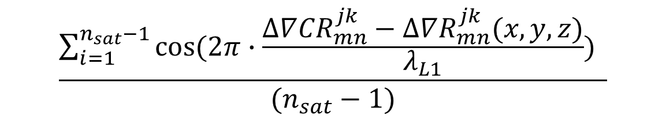
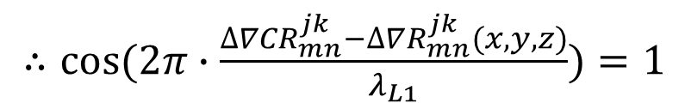
Ambiguity Function Method
$$\frac{∆∇{CR}_{mn}^{jk}−∆∇R_{mn}^{jk}(x,y,z)}{λ_{L1}}=∆∇N_{mn}^{jk}$$
Integer
$∴cos⁡(2π∙\frac{∆∇{CR}_{mn}^{jk}−∆∇R_{mn}^{jk}(x,y,z)}{λ_{L1}})=1$
$$\frac{\sum_{i=1}^{n_{sat}−1}{cos⁡(2π∙\frac{∆∇{CR}_{mn}^{jk}−∆∇R_{mn}^{jk}(x,y,z)}{λ_{L1}})} }{(n_{sat}−1)}$$
$$=AF(x,y,z)$$
Immune to carrier phase cycle slips!

Slide 13
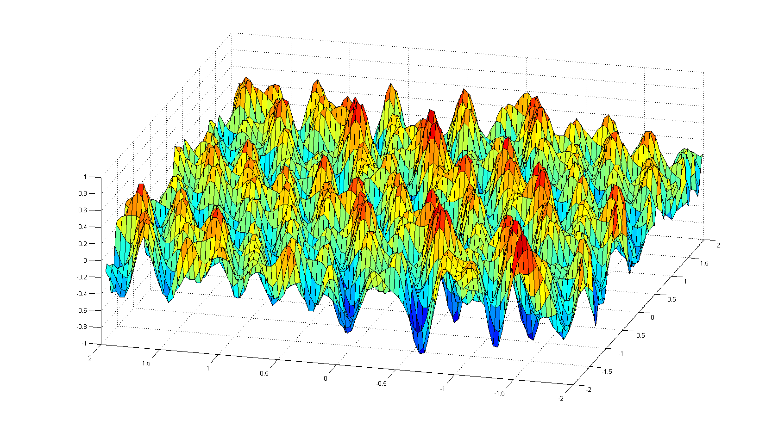
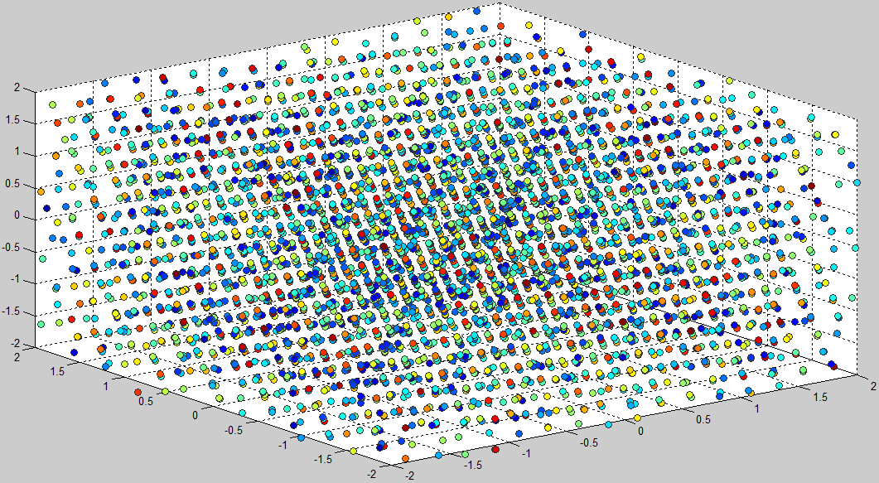
AFV Peak Tracking Solution
Use Ambiguity Function Method as evaluation criterion in an AFV Peak Tracking (APT) Algorithm
View search grid as a 3D heat map where the AF value at each point represents its fitness as a potential baseline candidate
2D
3D

Slide 14
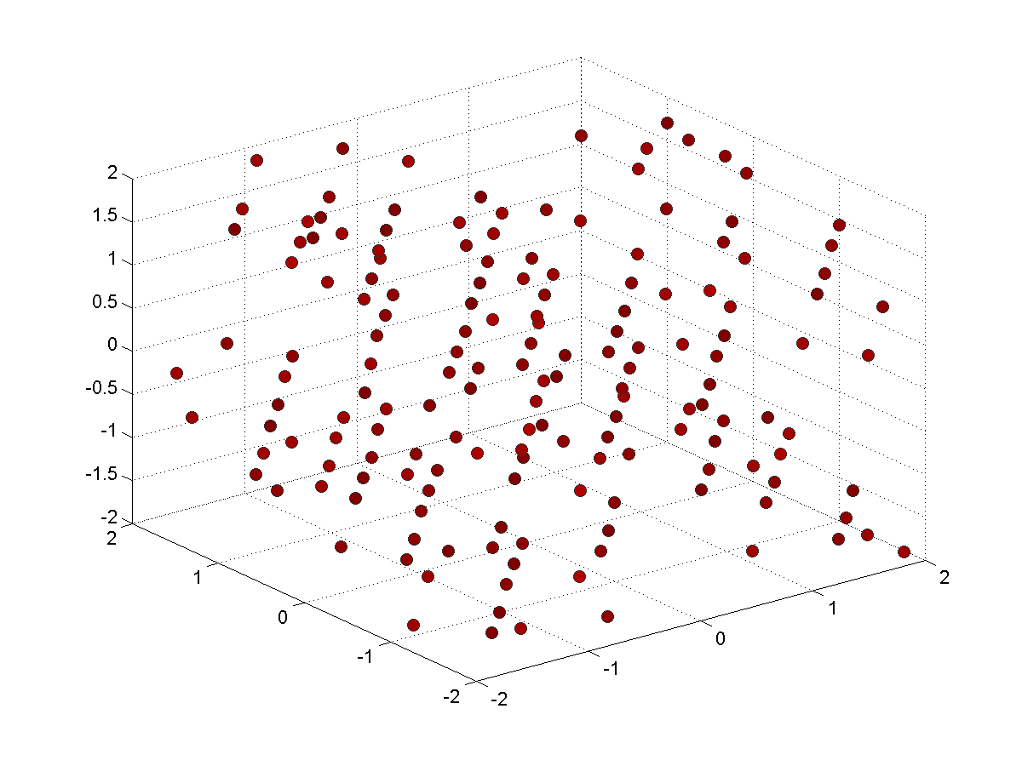
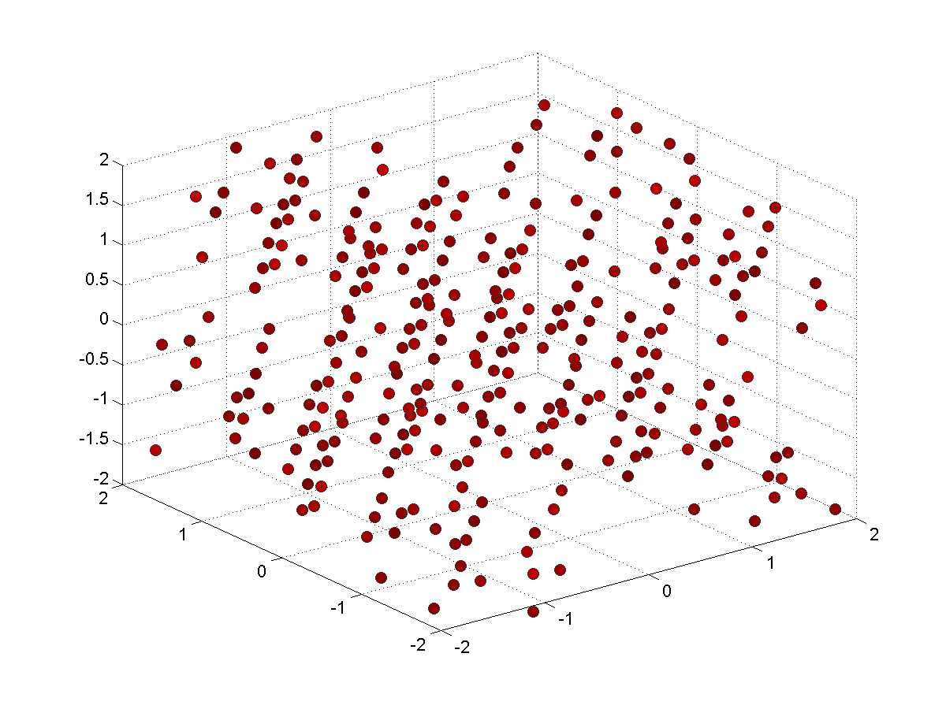
AFV Peak Tracking Solution
Use Ambiguity Function Method as evaluation criterion in an AFV Peak Tracking (APT) Algorithm
Filter peaks based on the worst-case AF value possible given the search resolution, carrier wavelength, and maximum noise/error per measurement

Slide 15
AFV Peak Tracking Solution
Where does peak “tracking” come into play?
Peaks are only identified once (per initialization)
At each time step, update every identified baseline peak according to tracking result
  Ensures that peaks appear to remain ‘stationary’
Re-evaluate Ambiguity Function Value at updated peak location
Hill climb by steepest ascent to local peak maximum
  Overcomes small tracking inaccuracies
Results in complete mapping of updated peak locations and Ambiguity Function Values
Filter updated peak locations based on worst-case AF value until only one peak remains
  Can use fixed ambiguities from previous epoch as a sanity check

Slide 16
AFV Peak Tracking Solution
Combine multiple observation epochs in a Peak Tracking and Filtering algorithm to solve for relative baselines
✓
Immune to cycle slips
Reference satellites do not matter because the actual fixed values of the ambiguities do not matter
Changing reference satellites every epoch may actually help mitigate unmodeled errors like multipath
✓
✓

Slide 17
Outline
Motivation
Related and Previous Work
Theoretical Approach
Experimental Implementation
Results
Future Work and Conclusions
Motivation
Related and Previous Work
Theoretical Approach
Experimental Implementation
Results
Future Work and Conclusions

Slide 18
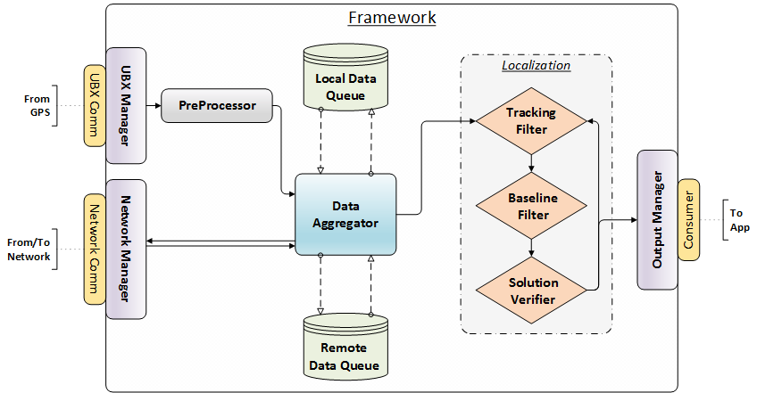
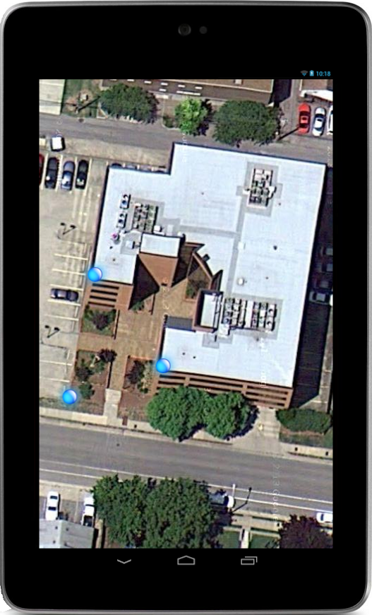
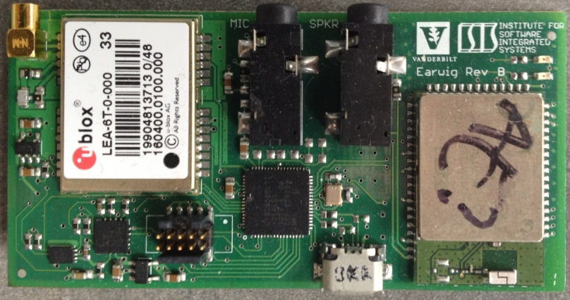
Prototype Architecture
HTC One Phones
Nexus 7 Tablets

Slide 19
Outline
Motivation
Related and Previous Work
Theoretical Approach
Experimental Implementation
Results
Future Work and Conclusions
Motivation
Related and Previous Work
Theoretical Approach
Experimental Implementation
Results
Future Work and Conclusions

Slide 20
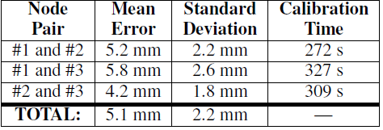
Results
Static Baselines
  Co-located: CORRECT peak determined after 382 seconds
  5-cm Separation: CORRECT peak determined after 367 seconds
  9-ft Separation: CORRECT peak determined after 200 Seconds
  380-ft Separation: CORRECT peak determined after 167 Seconds
  Peak lock never lost after correct determination
Stationary Running Track Experiment

Slide 21
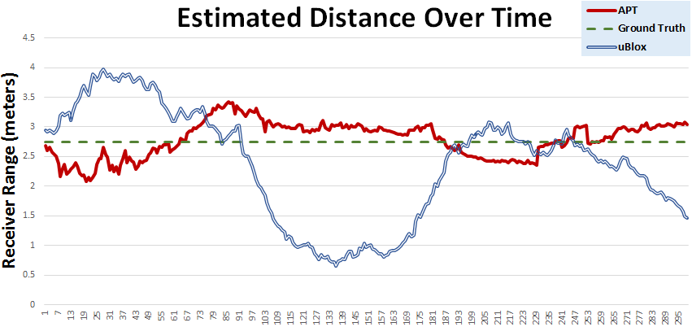
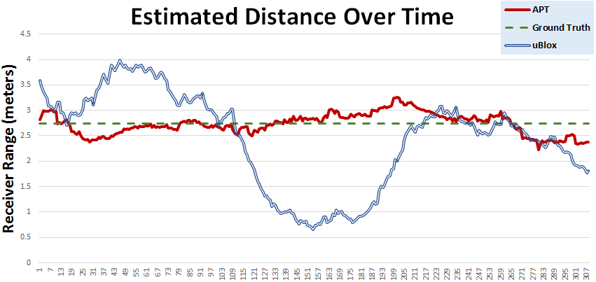
Results
Low-Dynamic Kinematic Short Baselines
Mean: 26.2cm
St. Dev: 15.3cm
Reference:
Mean: 16.9cm
St. Dev: 12.3cm
Direct:
Notes:
Mean for ublox was 89cm

Slide 22
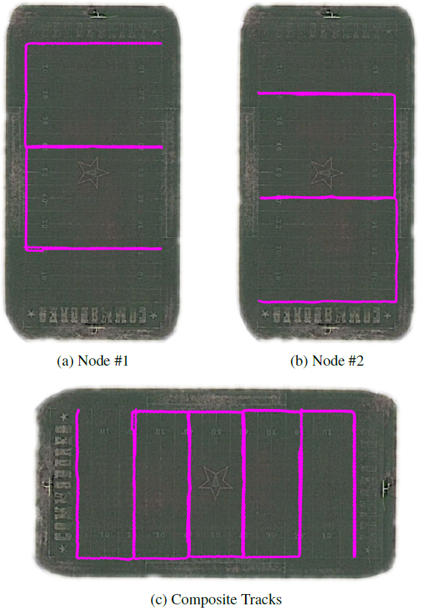
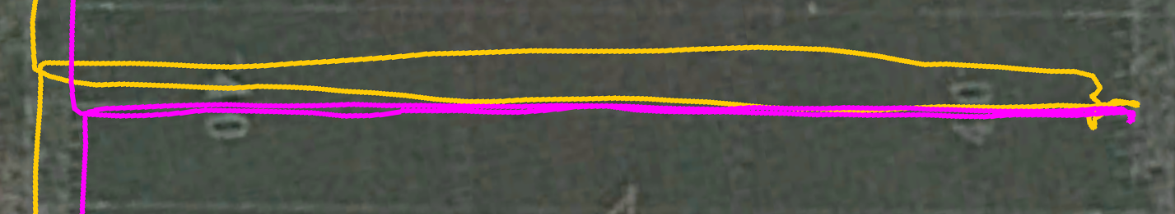
Results
Low-Dynamic Kinematic Longer Baselines

Slide 23
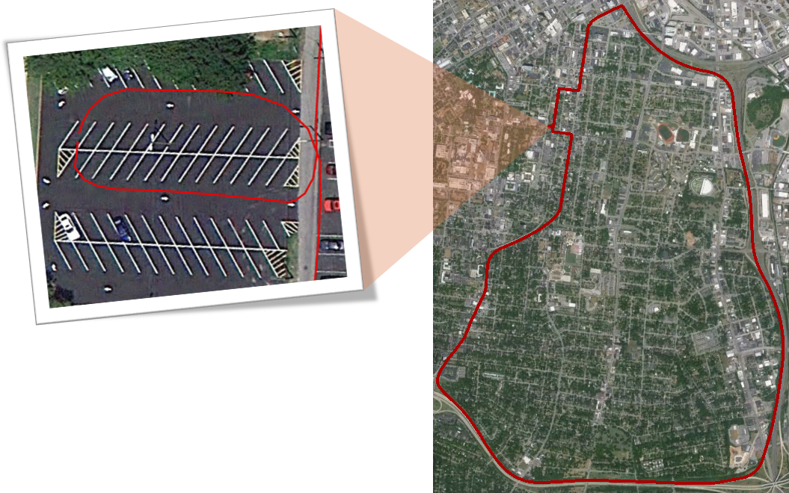
Results
High-Dynamic Kinematic Baselines

Slide 24
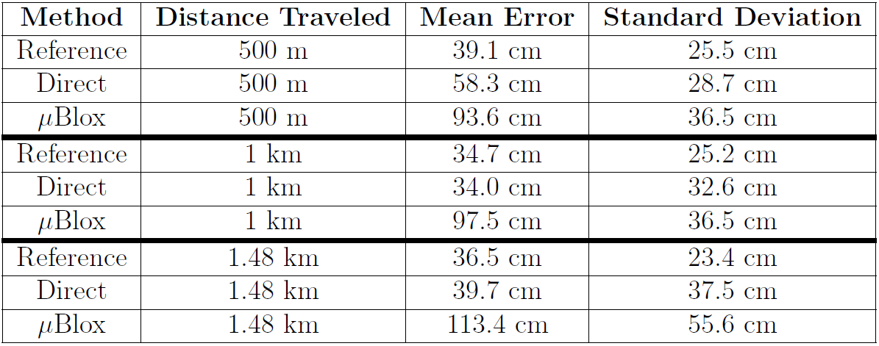
Results
High-Dynamic Kinematic Baselines

Slide 25
Outline
Motivation
Related and Previous Work
Theoretical Approach
Experimental Implementation
Results
Future Work and Conclusions
Motivation
Related and Previous Work
Theoretical Approach
Experimental Implementation
Results
Future Work and Conclusions

Slide 26



Future Work
Low-Dynamic Kinematic Baselines
Nodes 1 and 2
Nodes 1 and 3
Nodes 2 and 3

Slide 27
Future Work
Success of initial peak identification is highly dependent on the search cube size and location
  Determine better initial baseline estimates before carrying out search
  Develop “smarter” peak searching algorithm for faster execution and larger search space sizes
Increase robustness of technique in difficult GPS environments such as highly-dense tree cover and urban canyons
Research better ways of removing short-term tracking bias
  Enable fewer real-time re-initializations and erroneous peak locks
Carry out network-wide localization step to increase overall system accuracy using overdetermined system of relative location vectors

Slide 28
Institute for Software Integrated Systems
Vanderbilt University
Questions?
“Accurate Real-Time Relative Localization Using Single-Frequency GPS”
Supported by the National Science Foundation, Google, and the European Social Fund
Will Hedgecock
Miklos Maroti
Akos Ledeczi
Peter Volgyesi
Rueben Banalagay
ACM SenSys ‘14, November 4, 2014

