Slide 1


Slide 2
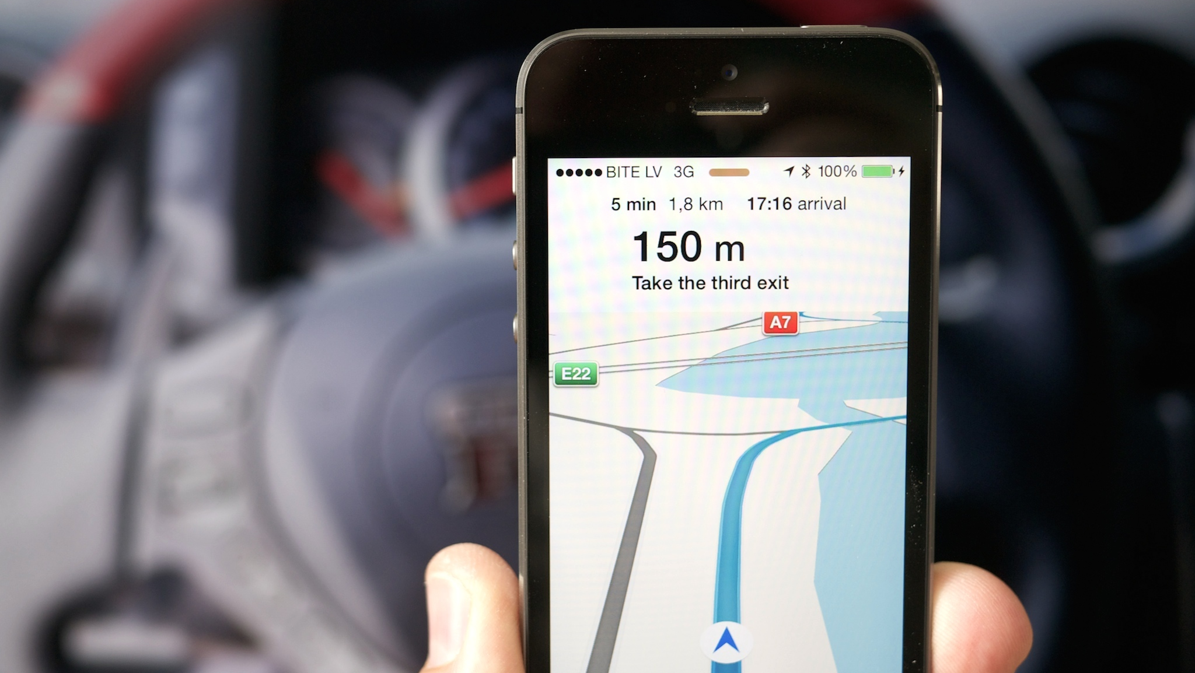

Slide 3
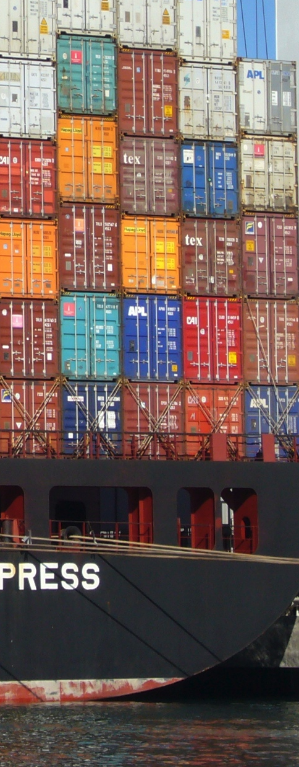
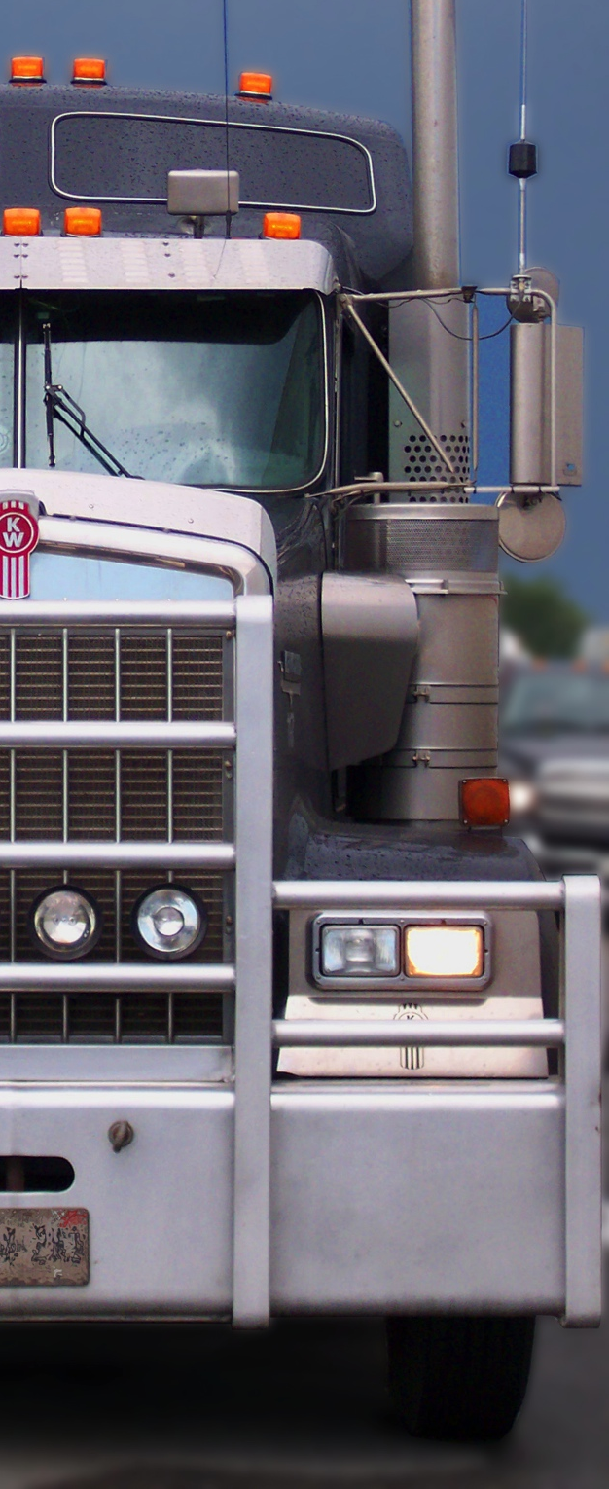
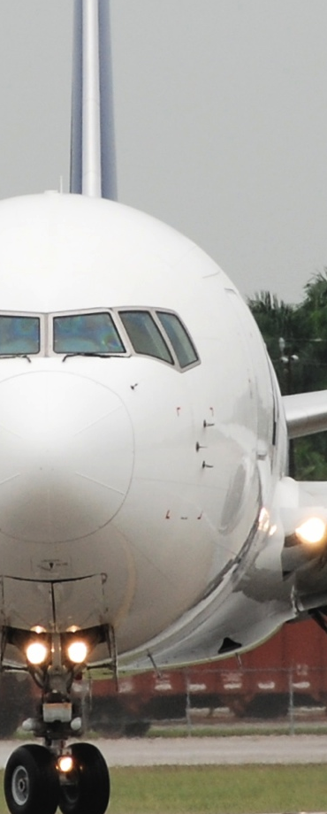
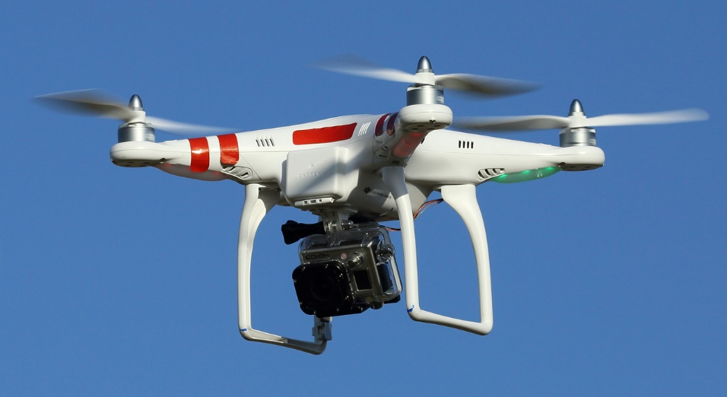

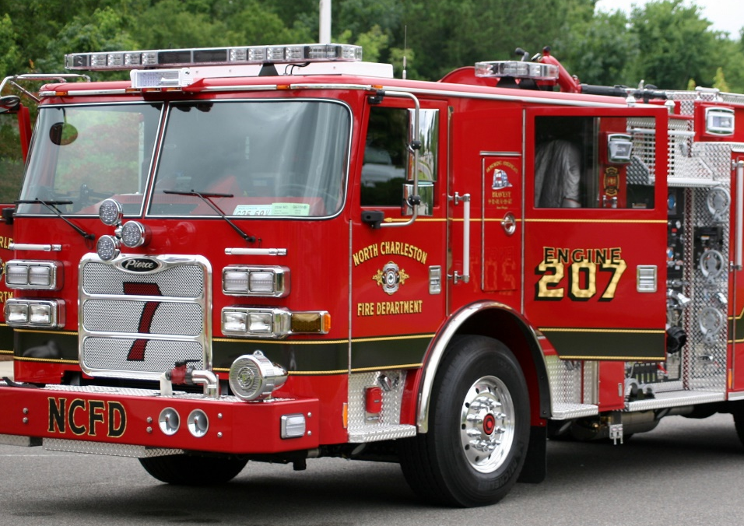

Slide 4
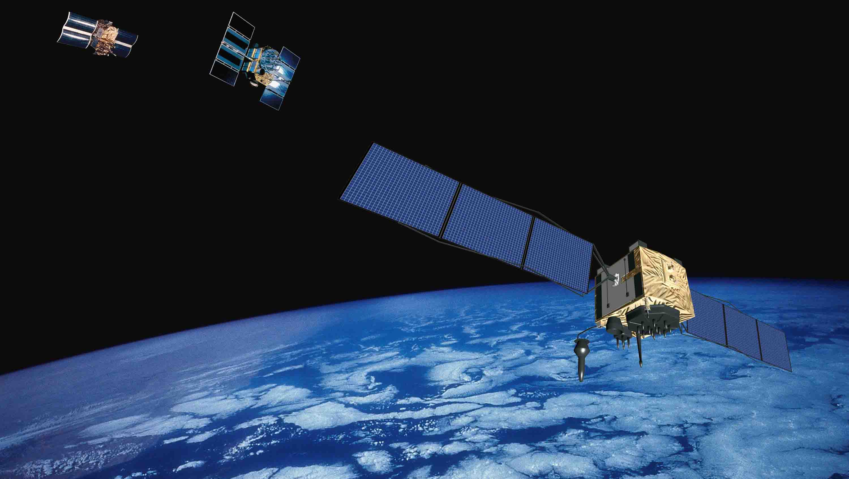

Slide 5


Slide 7






Slide 9
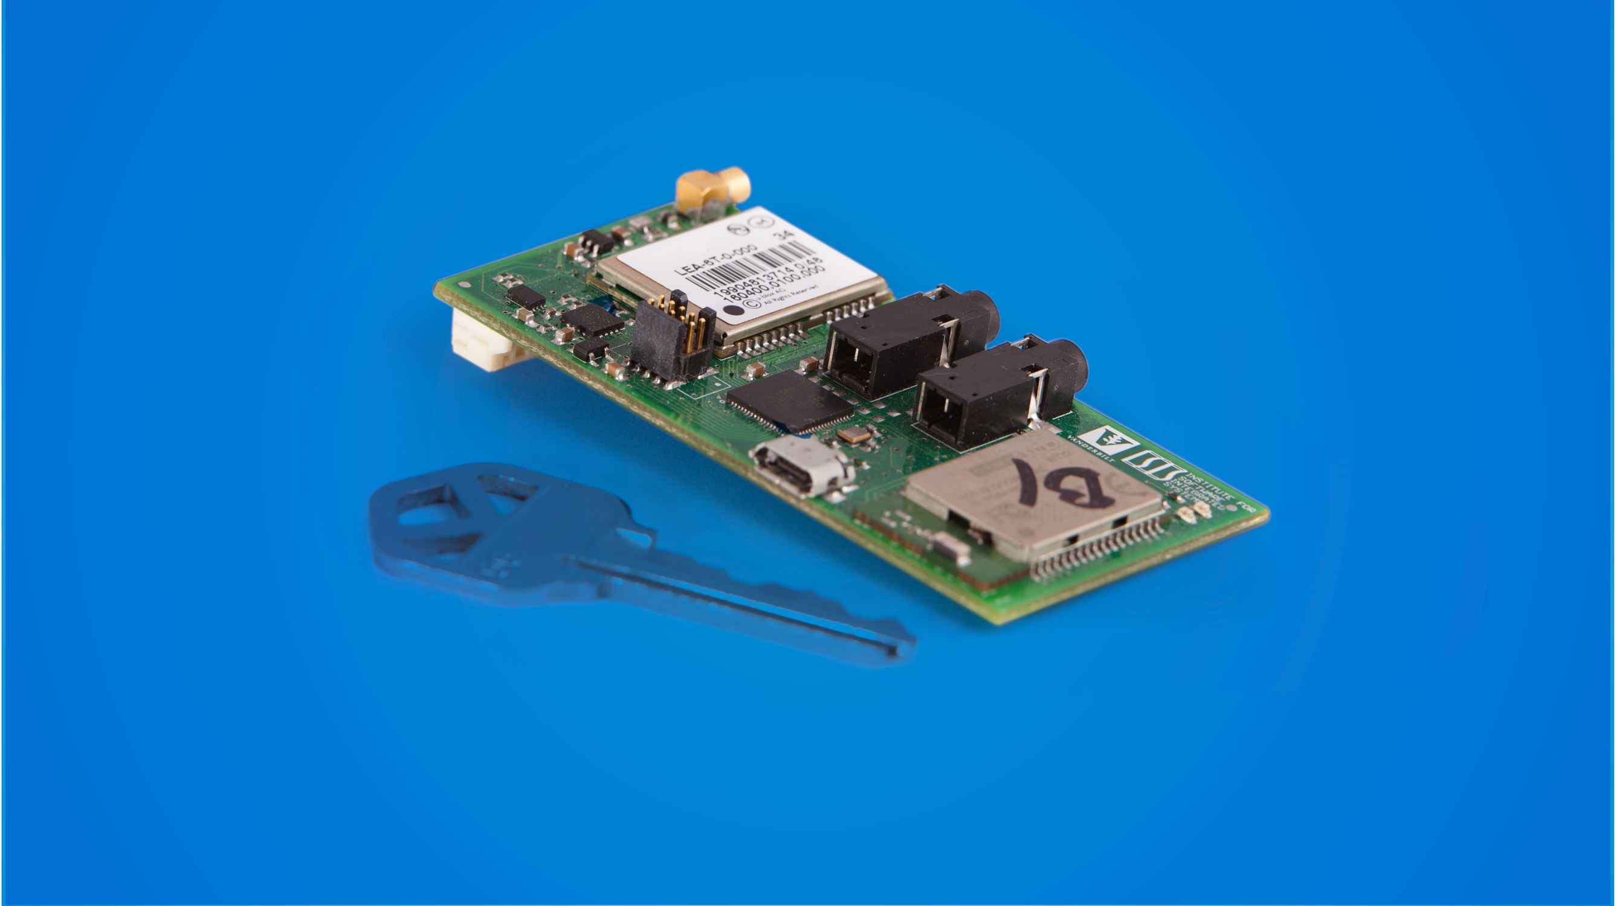

Slide 10



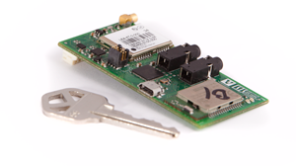

Slide 11
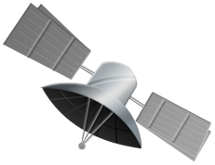


Slide 12
















Slide 13
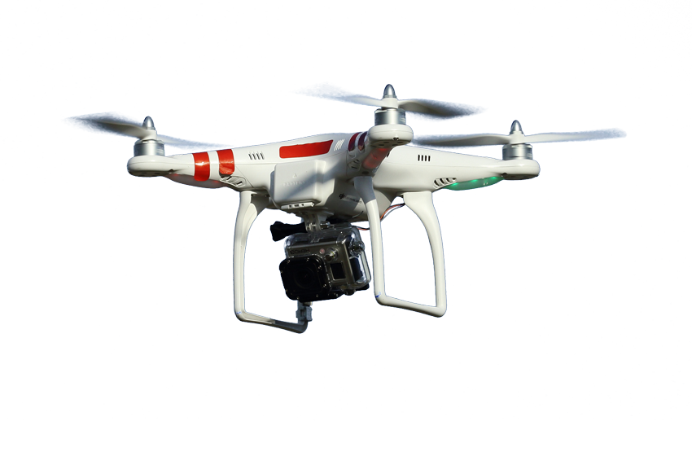




Slide 14








Slide 19
 | 2014 | 2015 | 2016 | 2017
Active Units | 0 | 447 | 3295 | 7367
Revenue | $0 | $303k | $2.3M | $5.2M
EBITDA | - | ($715k) | ($520k) | $1.2M
% Gross Margin | - | 54% | 58% | 59%

Slide 21

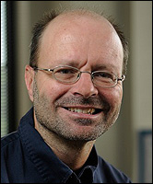



Slide 22







