Slide 1


Institute for Software Integrated Systems
Vanderbilt University
Precise Real-Time Relative Localization Using Single-Frequency GPS
Will Hedgecock
Ph.D. Candidate
Dissertation Defense
March 4, 2014

Slide 2
Outline
Motivation and Problem Statement
  Overview of GPS Observables
Precise Relative Tracking with GPS
  Technical Methodology
  Dual-Receiver Error Mitigation
  Temporal Observation Model
  Relative Tracking Algorithm
Software Architecture
  Experimental Prototype
  Evaluation and Results
Precise Relative Localization with GPS
  Ambiguity Function Method
  AFV Peak Tracking (APT) Solution
  Evaluation and Results
Future Work and Conclusions

Slide 3
Motivation
Many mobile sensing applications rely on highly-accurate sensor node locations in which ONLY the relative positions of the nodes are required
GPS provides absolute coordinates anywhere in the world, but sub-meter accuracy is unobtainable without military-grade or prohibitively-expensive differential GPS units
GPS has became cheaper and less power hungry in recent years
  Still not accurate enough for many precision applications, including:
  Land surveying, precision agriculture
  Coordinated movement of UAVs and UGVs
  Driverless cars: collision avoidance, platoon formation when there is no LOS
  Etc.
Differential GPS and RTK have various disadvantages
Need a method to bridge the gap between cost and accuracy

Slide 4
Problem Statement
Requirements
Centimeter-precision accuracy for a scalable network of nodes
No stationary calibration or data collection phase
No explicit reference station or hub
Our Approach
Use GPS satellites to provide relative position information for a cooperating network of sensor nodes via raw data sharing and pairwise node tracking and localization

Slide 5

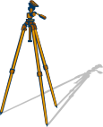
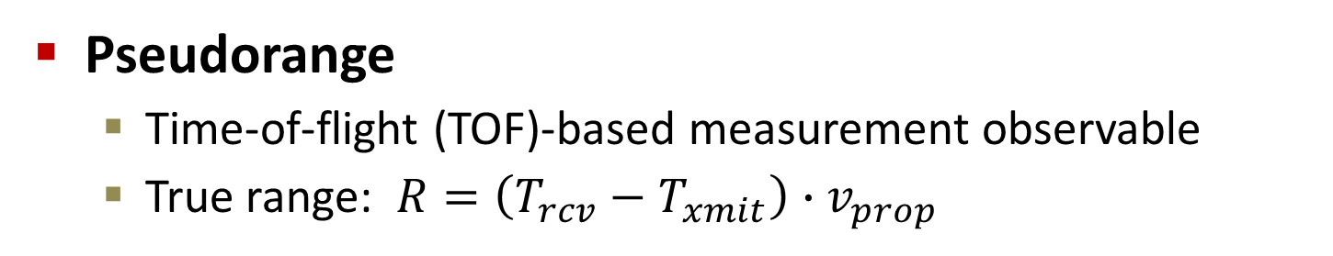
GPS Observable Overview
Pseudorange
  Time-of-flight (TOF)-based measurement observable
  True range: $R=\left(T_{rcv}−T_{xmit}\right)∙v_{prop}$
Pseudorange
Error
True Range
$$PR=c·\left(T_{rcv}−T_{xmit}\right)+c·t_{bias}+ε$$

Slide 6
GPS Observable Overview
Carrier Phase
Satellite orbit
Reported carrier
phase measurements
Constant ambiguity
value
=
Accumulated Doppler
Shift
Full carrier
range
Satellite lock
acquired
Satellite distance
at time of lock

Slide 7
Related Work
Real-Time Kinematic (RTK) Navigation
“RTK uses measurements of the phase of the signal′s carrier wave, rather than the information content of the signal, and relies on a single reference station to provide real-time corrections, providing up to centimeter-level accuracy”
--Wikipedia
“RTK uses measurements of the phase of the signal′s carrier wave, rather than the information content of the signal, and relies on a single reference station to provide real-time corrections, providing up to centimeter-level accuracy”
--Wikipedia
“RTK uses measurements of the phase of the signal′s carrier wave, rather than the information content of the signal, and relies on a single reference station to provide real-time corrections, providing up to centimeter-level accuracy”
--Wikipedia
Centimeter-precision accuracy for a scalable network of nodes
No stationary calibration or data collection phase
No explicit reference station or hub

Slide 8
Outline
Motivation and Problem Statement
  Overview of GPS Observables
Precise Relative Tracking with GPS
  Technical Methodology
  Dual-Receiver Error Mitigation
  Temporal Observation Model
  Relative Tracking Algorithm
Software Architecture
  Experimental Prototype
  Evaluation and Results
Precise Relative Localization with GPS
  Ambiguity Function Method
  AFV Peak Tracking (APT) Solution
  Evaluation and Results
Future Work and Conclusions
Motivation and Problem Statement
  Overview of GPS Observables
Precise Relative Tracking with GPS
  Technical Methodology
  Dual-Receiver Error Mitigation
  Temporal Observation Model
  Relative Tracking Algorithm
Software Architecture
  Experimental Prototype
  Evaluation and Results
Precise Relative Localization with GPS
  Ambiguity Function Method
  AFV Peak Tracking (APT) Solution
  Evaluation and Results
Future Work and Conclusions

Slide 9
Methodology
Centimeter-precision accuracy
No stationary calibration or data collection phase
No explicit reference station or hub
✓
Problem
Stationary calibration historically required because receiver motion adds at least 3 unknowns per time step
Solution
Use extremely accurate tracking results to mathematically account for relative receiver motions such that the number of unknowns does not grow over time

Slide 10
Methodology
✓
Centimeter-precision accuracy
No stationary calibration or data collection phase
No explicit reference station or hub
✓
Problem
Relative tracking is usually handled by multi-modal filtering techniques (e.g. joint GPS/IMU Kalman filter)
Precise errors specific to the multi-receiver case are often neglected in standard pre-processing algorithms
Solution
Correct observations for sources of error specific to dual-receiver localization, and create new methods for relative node tracking using GPS alone

Slide 11
Methodology
✓
Centimeter-precision accuracy
No stationary calibration or data collection phase
No explicit reference station or hub
✓
✓
Problem
Standard baseline determination techniques use observation models that require either a reference receiver, a reference satellite, or both
Solution
Use local receiver as implicit reference station and create a relative localization procedure that either lacks a reference satellite or overcomes its limitations
Notes:
State why references are bad to have (loss of lock, computation complexity, correlated errors)
Also state that current methods sometimes use “corrections” and we want to directly determine pairwise baselines
Local receiver as implicit reference means no single-point-of-failure and it puts us in a relative frame of reference which is what we already desire

Slide 12
Outline
Motivation and Problem Statement
  Overview of GPS Observables
Precise Relative Tracking with GPS
  Technical Methodology
  Dual-Receiver Error Mitigation
  Temporal Observation Model
  Relative Tracking Algorithm
Software Architecture
  Experimental Prototype
  Evaluation and Results
Precise Relative Localization with GPS
  Ambiguity Function Method
  AFV Peak Tracking (APT) Solution
  Evaluation and Results
Future Work and Conclusions
Motivation and Problem Statement
  Overview of GPS Observables
Precise Relative Tracking with GPS
  Technical Methodology
  Dual-Receiver Error Mitigation
  Temporal Observation Model
  Relative Tracking Algorithm
Software Architecture
  Experimental Prototype
  Evaluation and Results
Precise Relative Localization with GPS
  Ambiguity Function Method
  AFV Peak Tracking (APT) Solution
  Evaluation and Results
Future Work and Conclusions

Slide 13
Dual-Receiver Error Mitigation
Characterize and correct for errors specific to the two-receiver localization case
  Significant uncharacterized error in the geometrical differences arising from measurements taken at slightly different times:
  Range errors in the satellite observations due to physically different signal propagation path lengths
  Inconsistent satellite orbital position estimations
  Differing amounts of Earth rotation experienced during potentially different signal propagation times

Slide 14

Dual-Receiver Error Mitigation

Slide 15
Dual-Receiver Error Mitigation

Slide 16
Dual-Receiver Error Mitigation

Slide 17
Dual-Receiver Error Mitigation

Slide 18
Dual-Receiver Error Mitigation

Slide 19
Dual-Receiver Error Mitigation
Notes:
Solved via full extrapolation of observation data to a common receive epoch and updating the satellite positions to the locations at which they must have been when transmitting the corresponding signal that would have been received at the common epoch

Slide 20
Outline
Motivation and Problem Statement
  Overview of GPS Observables
Precise Relative Tracking with GPS
  Technical Methodology
  Dual-Receiver Error Mitigation
  Temporal Observation Model
  Relative Tracking Algorithm
Software Architecture
  Experimental Prototype
  Evaluation and Results
Precise Relative Localization with GPS
  Ambiguity Function Method
  AFV Peak Tracking (APT) Solution
  Evaluation and Results
Future Work and Conclusions
Motivation and Problem Statement
  Overview of GPS Observables
Precise Relative Tracking with GPS
  Technical Methodology
  Dual-Receiver Error Mitigation
  Temporal Observation Model
  Relative Tracking Algorithm
Software Architecture
  Experimental Prototype
  Evaluation and Results
Precise Relative Localization with GPS
  Ambiguity Function Method
  AFV Peak Tracking (APT) Solution
  Evaluation and Results
Future Work and Conclusions

Slide 21

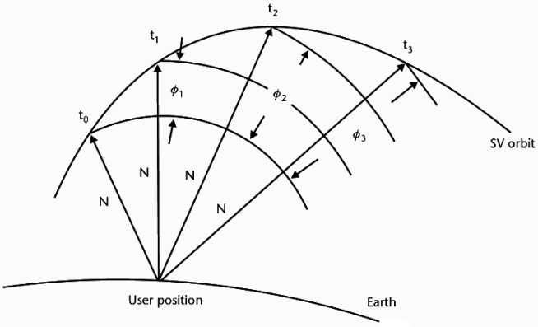

Temporal Observation Model
Extend well-known carrier phase observation model to include temporal data
Kaplan and Hegarty, Understanding GPS: Principles and Applications, 2nd Edition, Artech House, Norwood, MA, 2006.

Slide 22
Outline
Motivation and Problem Statement
  Overview of GPS Observables
Precise Relative Tracking with GPS
  Technical Methodology
  Dual-Receiver Error Mitigation
  Temporal Observation Model
  Relative Tracking Algorithm
Software Architecture
  Experimental Prototype
  Evaluation and Results
Precise Relative Localization with GPS
  Ambiguity Function Method
  AFV Peak Tracking (APT) Solution
  Evaluation and Results
Future Work and Conclusions
Motivation and Problem Statement
  Overview of GPS Observables
Precise Relative Tracking with GPS
  Technical Methodology
  Dual-Receiver Error Mitigation
  Temporal Observation Model
  Relative Tracking Algorithm
Software Architecture
  Experimental Prototype
  Evaluation and Results
Precise Relative Localization with GPS
  Ambiguity Function Method
  AFV Peak Tracking (APT) Solution
  Evaluation and Results
Future Work and Conclusions

Slide 23
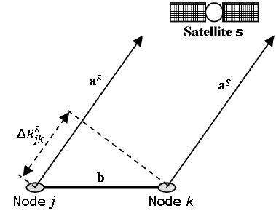
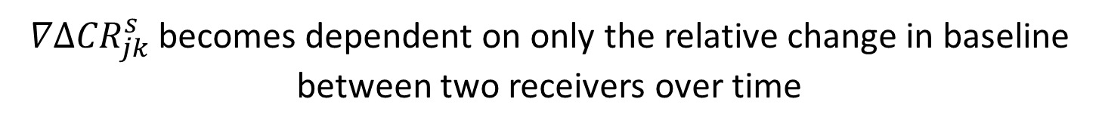
Relative Tracking Algorithm
Use the temporal double-differenced observations in a GPS tracking equation to enable robust relative dead reckoning through a significant period of time
$$∇Δ{CR}_{jk}^{s}\left(∇b_{x},∇b_{y},∇b_{z}\right)=∇R_{jk}^{s}\left(∇b_{x},∇b_{y},∇b_{z}\right)+Δc{\dot{τ}}_{jk}$$
$∇Δ{CR}_{jk}^{s}$ becomes dependent on only the relative change in baseline between two receivers over time
Notes:
First step: function of six coordinate changes
Second step: make function of reference, j
Third step: make everything relative to node j (therefore, subtract j out)

Slide 24
Relative Tracking Algorithm
Use the temporal double-differenced observations in a GPS tracking equation to enable robust relative dead reckoning through a significant period of time
Problem:
Multipath and undetected cycle slips cause drastic tracking errors
  Mathematically difficult to detect or correct
Solution:
Track the relative clock drift term separately
  Error detection via comparison to the estimated clock drift
  Erroneous observation determination via removal of a degree of freedom, recalculation of the tracking result, and analysis of resulting error residuals
X
$$∇Δ{CR}_{jk}^{s}\left(∇b_{x},∇b_{y},∇b_{z}\right)=∇R_{jk}^{s}\left(∇b_{x},∇b_{y},∇b_{z}\right)+Δc{\dot{τ}}_{jk}$$
Notes:
First step: function of six coordinate changes
Second step: make function of reference, j
Third step: make everything relative to node j (therefore, subtract j out)

Slide 25
Outline
Motivation and Problem Statement
  Overview of GPS Observables
Precise Relative Tracking with GPS
  Technical Methodology
  Dual-Receiver Error Mitigation
  Temporal Observation Model
  Relative Tracking Algorithm
Software Architecture
  Experimental Prototype
  Evaluation and Results
Precise Relative Localization with GPS
  Ambiguity Function Method
  AFV Peak Tracking (APT) Solution
  Evaluation and Results
Future Work and Conclusions
Motivation and Problem Statement
  Overview of GPS Observables
Precise Relative Tracking with GPS
  Technical Methodology
  Dual-Receiver Error Mitigation
  Temporal Observation Model
  Relative Tracking Algorithm
Software Architecture
  Experimental Prototype
  Evaluation and Results
Precise Relative Localization with GPS
  Ambiguity Function Method
  AFV Peak Tracking (APT) Solution
  Evaluation and Results
Future Work and Conclusions

Slide 26
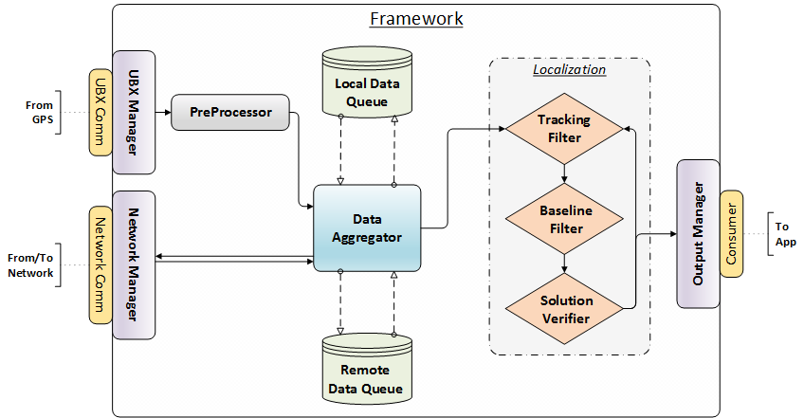
Software Architecture

Slide 27
Software Architecture
UBX Manager

Slide 28
Software Architecture
PreProcessor
Removes erroneous satellite measurements
Disregards satellites with low SNRs
Disregards satellites with low elevations (<15°)
Tries to detect and mark cycle slips

Slide 29
Software Architecture
Network Manager

Slide 30
Software Architecture
Data Aggregator
Constructs “Pairwise Data Unit”
Selects appropriate reference satellite
Calculates all differencing operations

Slide 31
Software Architecture
Tracking Filter
Uses relative tracking algorithm with consecutive GPS epochs
Uses constant-acceleration motion model with non-consecutive GPS epochs

Slide 32
Software Architecture
Output Manager

Slide 33
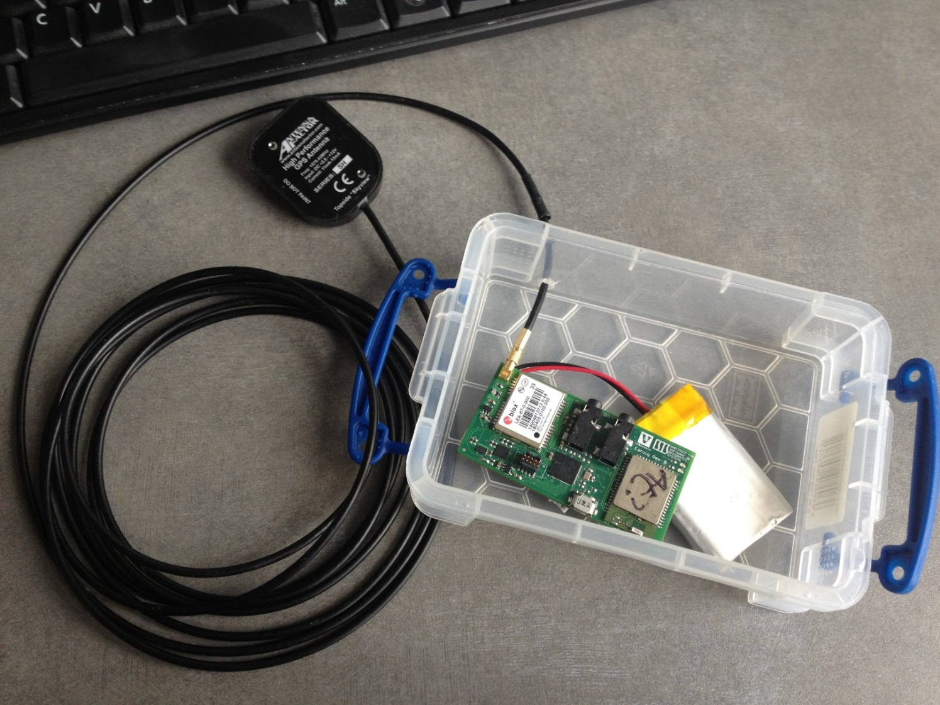
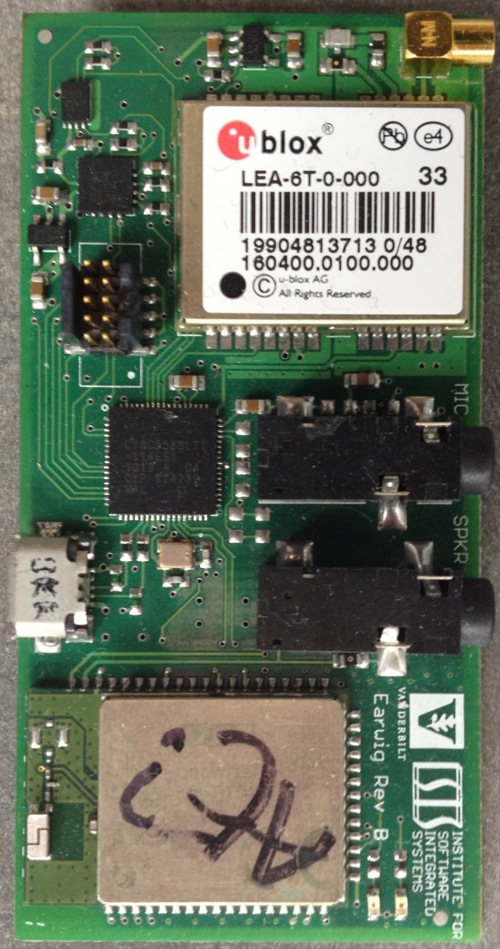
Experimental Prototype
Hardware Architecture

Slide 34
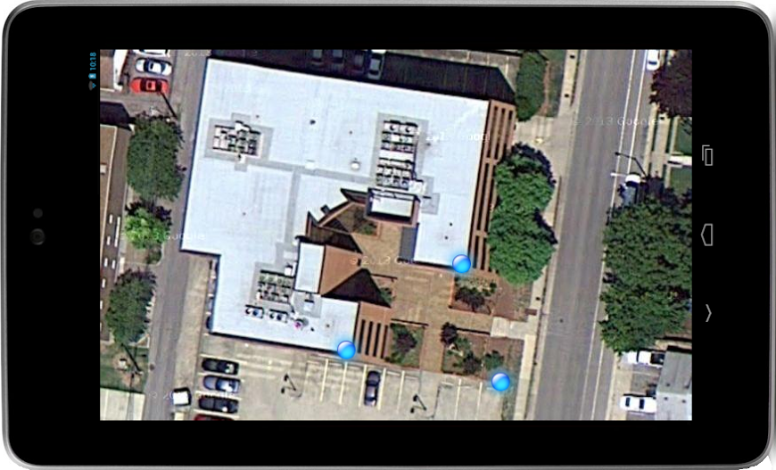
Experimental Prototype
Hardware Architecture
HTC One Phones
Nexus 7 Tablets

Slide 35
Outline
Motivation and Problem Statement
  Overview of GPS Observables
Precise Relative Tracking with GPS
  Technical Methodology
  Dual-Receiver Error Mitigation
  Temporal Observation Model
  Relative Tracking Algorithm
Software Architecture
  Experimental Prototype
  Evaluation and Results
Precise Relative Localization with GPS
  Ambiguity Function Method
  AFV Peak Tracking (APT) Solution
  Evaluation and Results
Future Work and Conclusions
Motivation and Problem Statement
  Overview of GPS Observables
Precise Relative Tracking with GPS
  Technical Methodology
  Dual-Receiver Error Mitigation
  Temporal Observation Model
  Relative Tracking Algorithm
Software Architecture
  Experimental Prototype
  Evaluation and Results
Precise Relative Localization with GPS
  Ambiguity Function Method
  AFV Peak Tracking (APT) Solution
  Evaluation and Results
Future Work and Conclusions

Slide 36
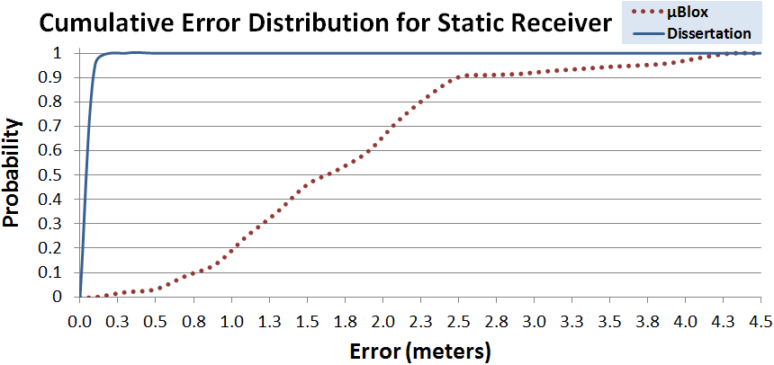
Results
Tracking Algorithm

Slide 37
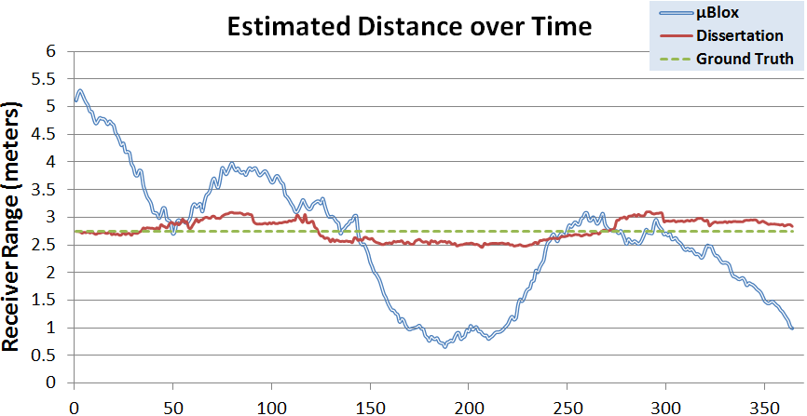
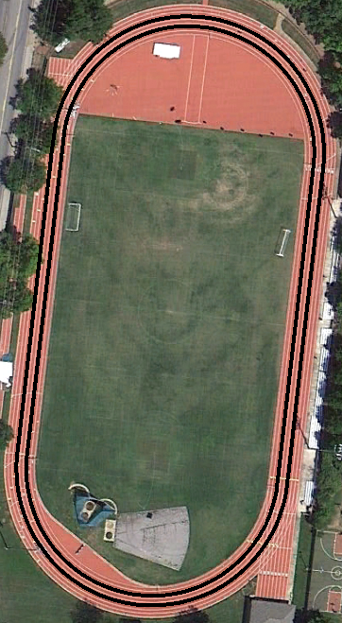
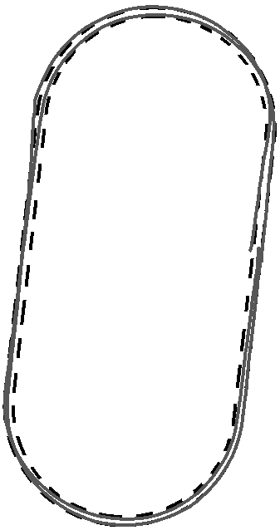
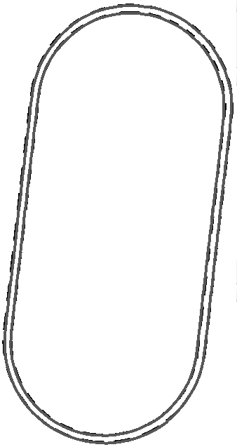
Results
Tracking Algorithm

Slide 38
Results
Tracking Algorithm

Slide 39
Outline
Motivation and Problem Statement
  Overview of GPS Observables
Precise Relative Tracking with GPS
  Technical Methodology
  Dual-Receiver Error Mitigation
  Temporal Observation Model
  Relative Tracking Algorithm
Software Architecture
  Experimental Prototype
  Evaluation and Results
Precise Relative Localization with GPS
  Ambiguity Function Method
  AFV Peak Tracking (APT) Solution
  Evaluation and Results
Future Work and Conclusions
Motivation and Problem Statement
  Overview of GPS Observables
Precise Relative Tracking with GPS
  Technical Methodology
  Dual-Receiver Error Mitigation
  Temporal Observation Model
  Relative Tracking Algorithm
Software Architecture
  Experimental Prototype
  Evaluation and Results
Precise Relative Localization with GPS
  Ambiguity Function Method
  AFV Peak Tracking (APT) Solution
  Evaluation and Results
Future Work and Conclusions

Slide 40
Ambiguity Function Method
Combine multiple observation epochs in a filtering algorithm to solve for relative baselines
At the correct position, the residual distances to the nearest integer ambiguity will be minimized
Ambiguity Function Method (AFM)-based solution

Slide 41
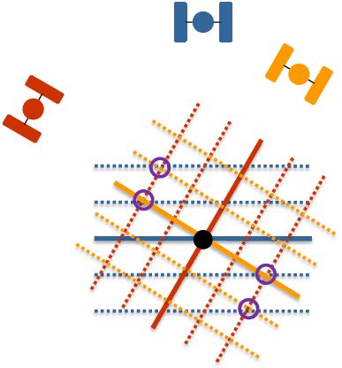
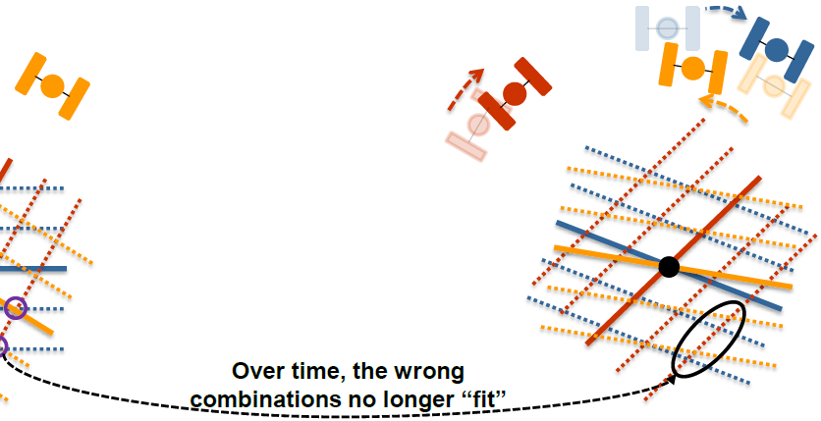
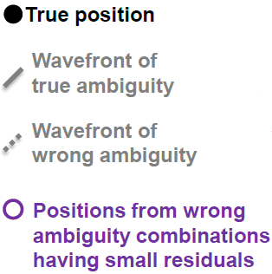
Ambiguity Function Method
*Adapted from Dr. Mark Petovello’s ION GNSS 2013 Presentation: “RTK GNSS Positioning”

Slide 42

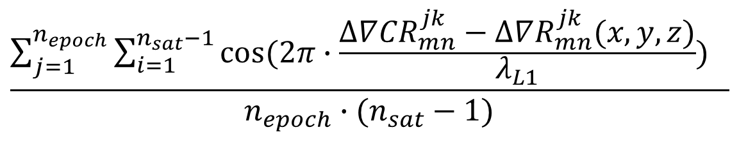
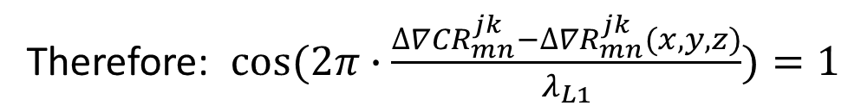
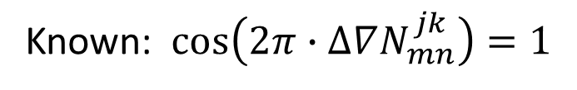
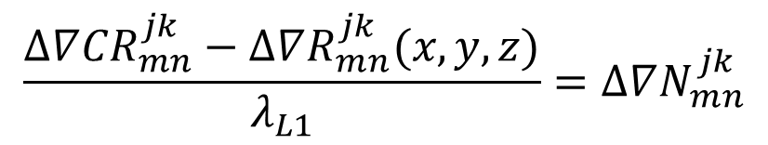
Ambiguity Function Method
$$∆∇{CR}_{mn}^{jk}(x,y,z)=∆∇R_{mn}^{jk}(x,y,z)+∆∇N_{mn}^{jk}λ_{L1}$$
$$\frac{∆∇{CR}_{mn}^{jk}−∆∇R_{mn}^{jk}(x,y,z)}{λ_{L1}}=∆∇N_{mn}^{jk}$$
Known: $\cos\left(2π∙∆∇N_{mn}^{jk}\right)=1$
Therefore: $cos⁡(2π∙\frac{∆∇{CR}_{mn}^{jk}−∆∇R_{mn}^{jk}(x,y,z)}{λ_{L1}})=1$
$$\frac{\sum_{j=1}^{n_{epoch}}{\sum_{i=1}^{n_{sat}−1}{cos⁡(2π∙\frac{∆∇{CR}_{mn}^{jk}−∆∇R_{mn}^{jk}(x,y,z)}{λ_{L1}}) }} }{n_{epoch}∙(n_{sat}−1)}$$
$$=AF(x,y,z)$$
Immune to carrier phase cycle slips!

Slide 43
Outline
Motivation and Problem Statement
  Overview of GPS Observables
Precise Relative Tracking with GPS
  Technical Methodology
  Dual-Receiver Error Mitigation
  Temporal Observation Model
  Relative Tracking Algorithm
Software Architecture
  Experimental Prototype
  Evaluation and Results
Precise Relative Localization with GPS
  Ambiguity Function Method
  AFV Peak Tracking (APT) Solution
  Evaluation and Results
Future Work and Conclusions
Motivation and Problem Statement
  Overview of GPS Observables
Precise Relative Tracking with GPS
  Technical Methodology
  Dual-Receiver Error Mitigation
  Temporal Observation Model
  Relative Tracking Algorithm
Software Architecture
  Experimental Prototype
  Evaluation and Results
Precise Relative Localization with GPS
  Ambiguity Function Method
  AFV Peak Tracking (APT) Solution
  Evaluation and Results
Future Work and Conclusions

Slide 44
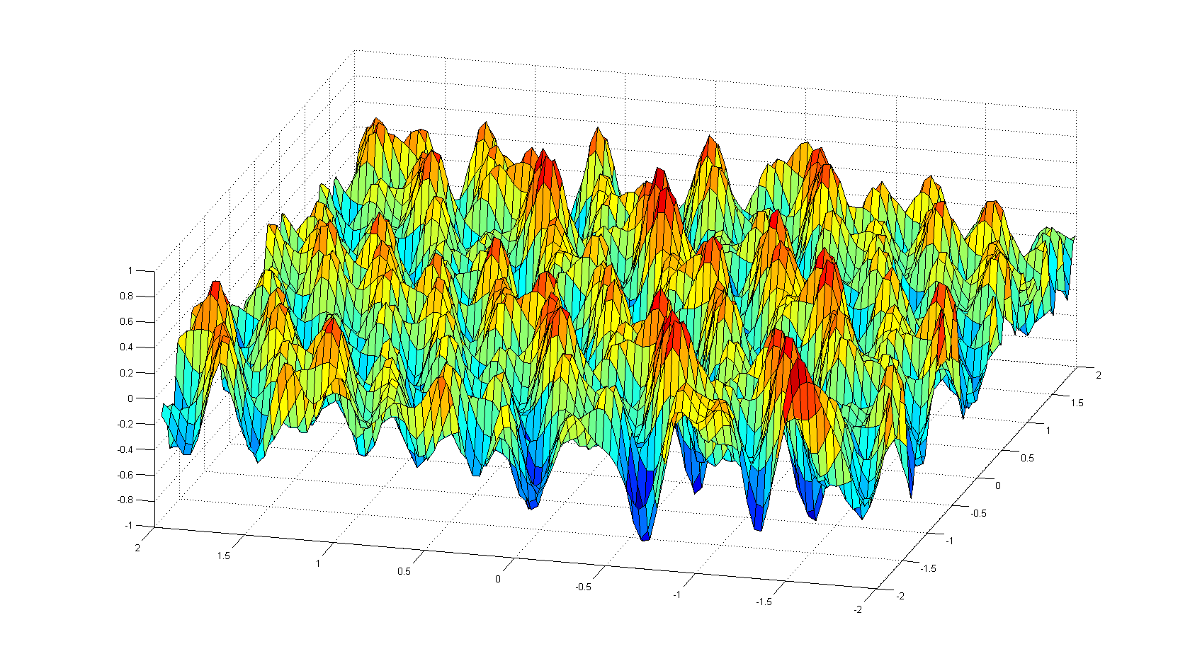
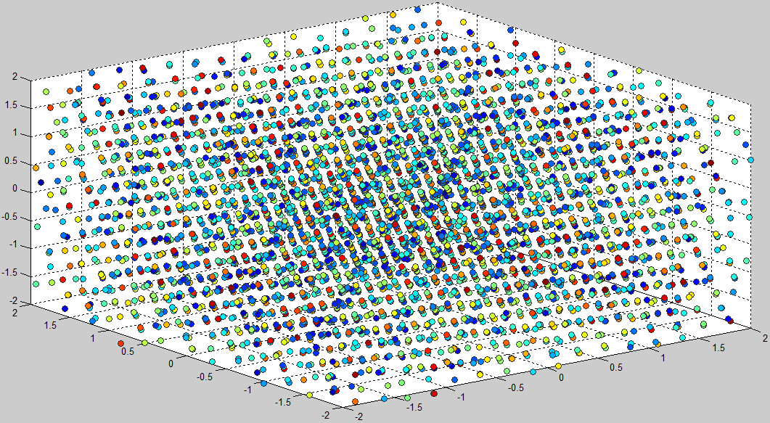
AFV Peak Tracking Solution
Use Ambiguity Function Method as evaluation criterion in an AFV Peak Tracking (APT) Algorithm
View search grid as a 3D heat map where the AF value at each point represents its fitness as a potential baseline candidate
2D
3D

Slide 45
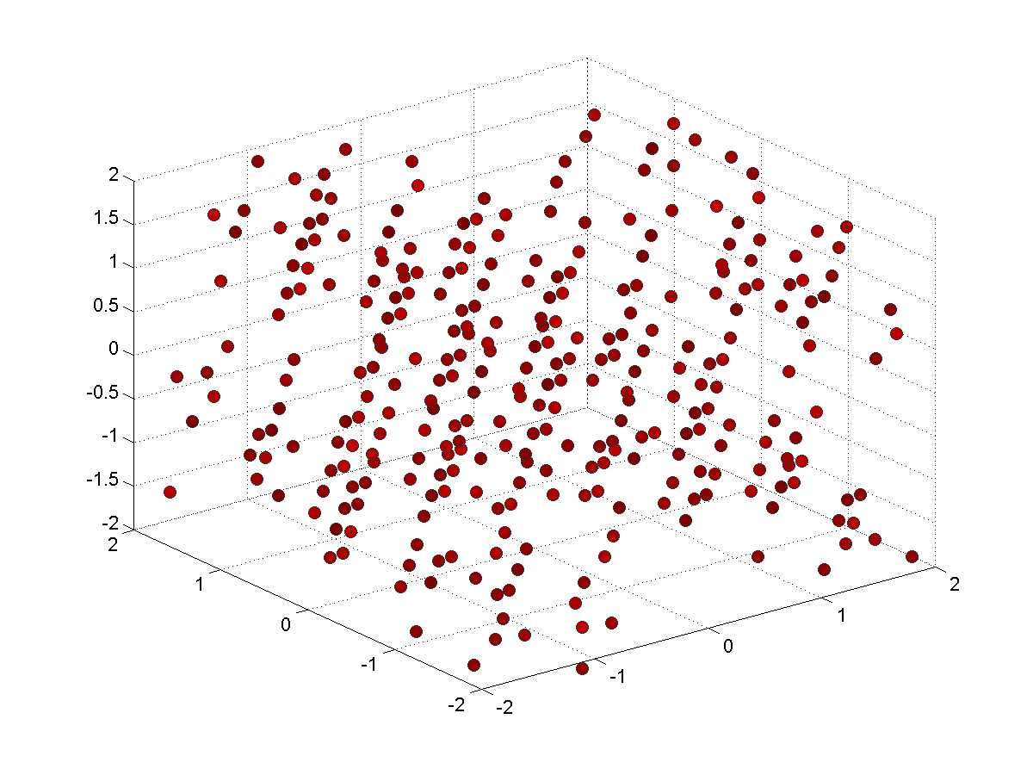
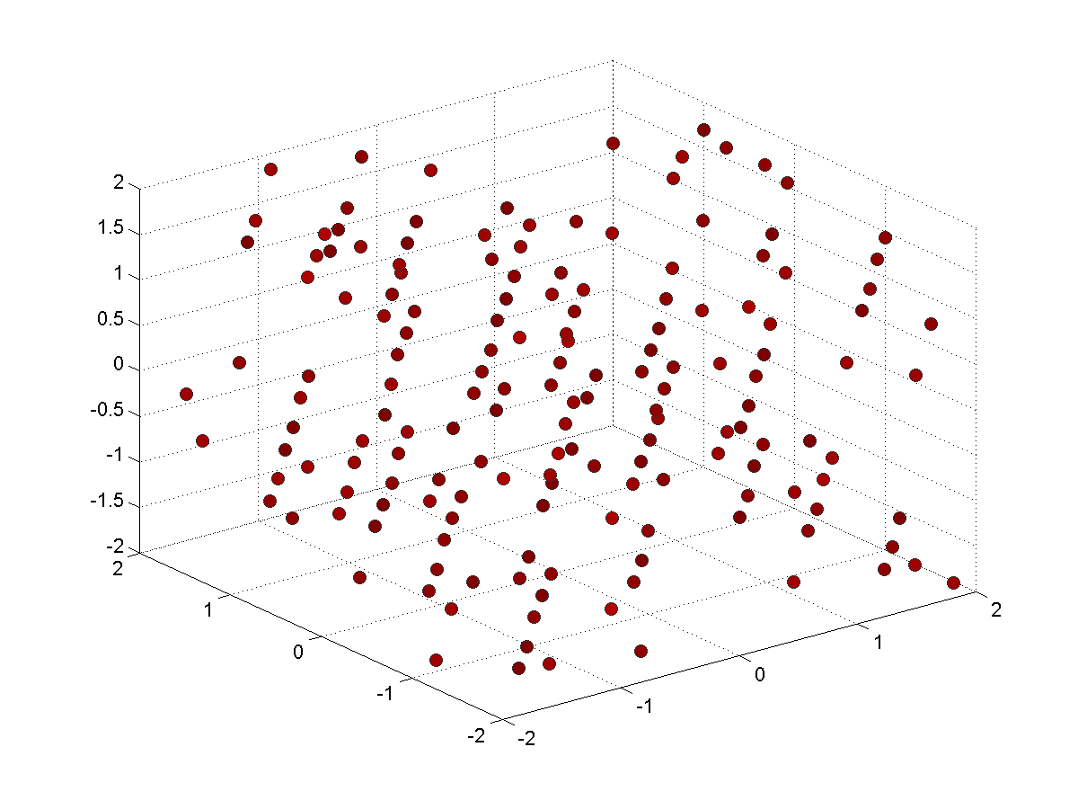

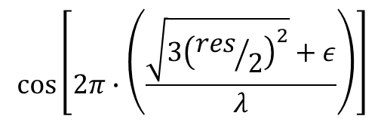
AFV Peak Tracking Solution
Use Ambiguity Function Method as evaluation criterion in an AFV Peak Tracking (APT) Algorithm
Filter peaks based on the worst-case AF value possible given the search resolution, carrier wavelength, and maximum noise/error per measurement
2D
3D
$${AF}_{worst}\left(res,λ,ε\right)≅$$
$$cos⁡\left[2π∙\left(\frac{\sqrt{3{\left({res}/2\right)}^{2}}+ε}{λ}\right)\right]$$

Slide 46
AFV Peak Tracking Solution
Where does peak “tracking” come into play?
Peaks are only identified once (per initialization)
At each time step, update every identified baseline peak according to tracking result
  Ensures that peaks appear to remain ‘stationary’
Re-evaluate Ambiguity Function Value at updated peak location
Hill climb by steepest ascent to local peak maximum
  Overcomes small tracking inaccuracies
Results in complete mapping of updated peak locations and Ambiguity Function Values
Filter updated peak locations based on worst-case AF value until only one peak remains
  Can use fixed ambiguities from previous epoch as a sanity check
Notes:
Existing solutions: that is the extent of the method…identify, take highest peak, done…oftentimes highest peak isn’t the correct peak

Slide 47
AFV Peak Tracking Solution
Combine multiple observation epochs in a Peak Tracking and Filtering algorithm to solve for relative baselines
✓
Immune to cycle slips
Reference satellites do not matter because the actual fixed values of the ambiguities do not matter
Changing reference satellites every epoch may actually help mitigate unmodeled errors like multipath
✓
✓

Slide 48
Outline
Motivation and Problem Statement
  Overview of GPS Observables
Precise Relative Tracking with GPS
  Technical Methodology
  Dual-Receiver Error Mitigation
  Temporal Observation Model
  Relative Tracking Algorithm
Software Architecture
  Experimental Prototype
  Evaluation and Results
Precise Relative Localization with GPS
  Ambiguity Function Method
  AFV Peak Tracking (APT) Solution
  Evaluation and Results
Future Work and Conclusions
Motivation and Problem Statement
  Overview of GPS Observables
Precise Relative Tracking with GPS
  Technical Methodology
  Dual-Receiver Error Mitigation
  Temporal Observation Model
  Relative Tracking Algorithm
Software Architecture
  Experimental Prototype
  Evaluation and Results
Precise Relative Localization with GPS
  Ambiguity Function Method
  AFV Peak Tracking (APT) Solution
  Evaluation and Results
Future Work and Conclusions

Slide 49
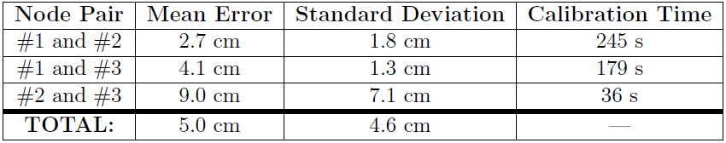
Results
Static Baselines
  Co-located: CORRECT peak determined after 382 seconds
  5-cm Separation: CORRECT peak determined after 367 seconds
  9-ft Separation: CORRECT peak determined after 200 Seconds
  380-ft Separation: CORRECT peak determined after 167 Seconds
  Peak lock never lost after correct determination
Stationary Running Track Experiment

Slide 50
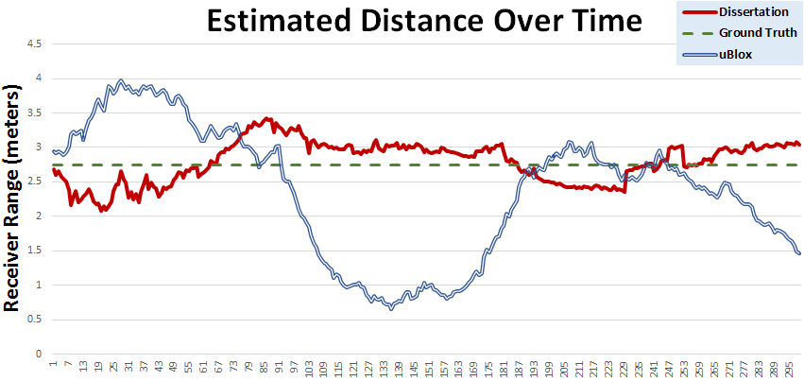
Results
Low-Dynamic Kinematic Baselines
*As seen from reference

Slide 51
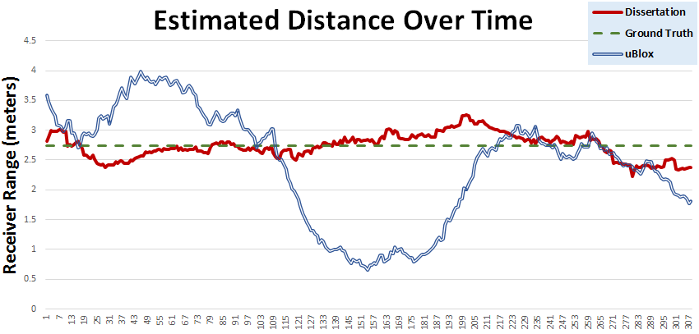
Results
Low-Dynamic Kinematic Baselines
*Direct Determination

Slide 52
Results
Mean: 26.2cm
St. Dev: 15.3cm
Reference:
Mean: 16.9cm
St. Dev: 12.3cm
Direct:
Notes:
Mean for ublox was 89cm

Slide 53



Results
Low-Dynamic Kinematic Baselines
Nodes 1 and 2
Nodes 1 and 3
Nodes 2 and 3

Slide 54
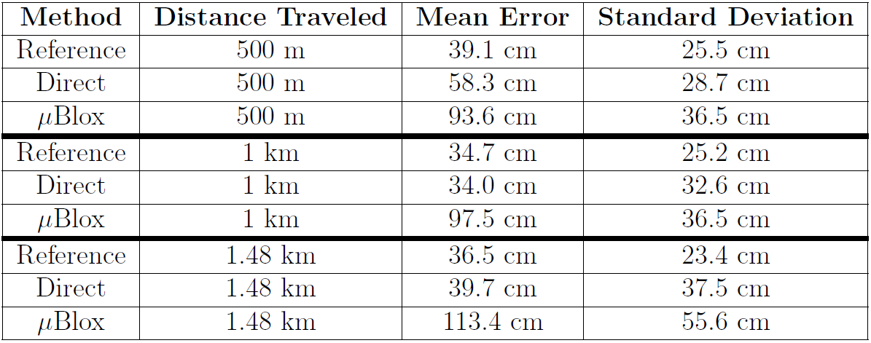
Results
High-Dynamic Kinematic Baselines

Slide 55
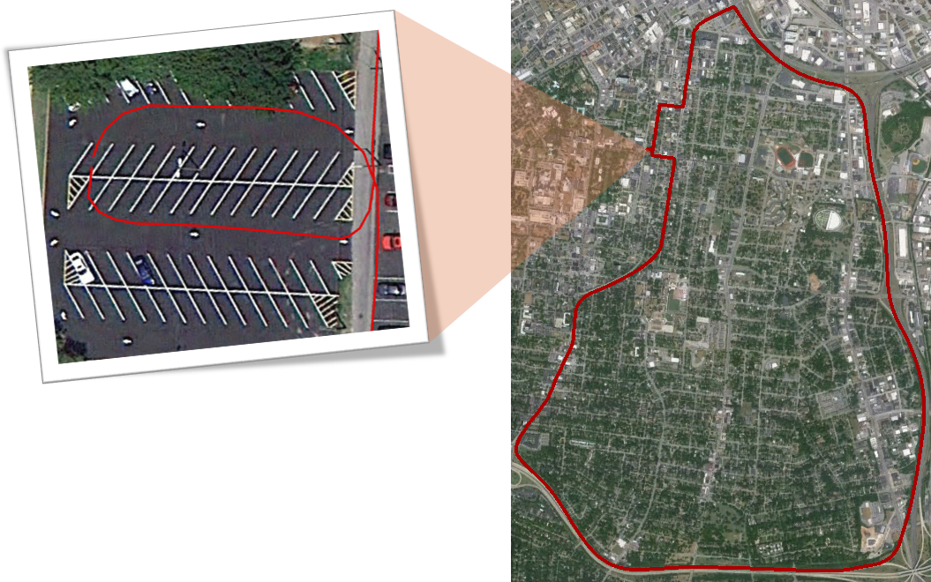
Results
High-Dynamic Kinematic Baselines

Slide 56
Outline
Motivation and Problem Statement
  Overview of GPS Observables
Precise Relative Tracking with GPS
  Technical Methodology
  Dual-Receiver Error Mitigation
  Temporal Observation Model
  Relative Tracking Algorithm
Software Architecture
  Experimental Prototype
  Evaluation and Results
Precise Relative Localization with GPS
  Ambiguity Function Method
  AFV Peak Tracking (APT) Solution
  Evaluation and Results
Future Work and Conclusions
Motivation and Problem Statement
  Overview of GPS Observables
Precise Relative Tracking with GPS
  Technical Methodology
  Dual-Receiver Error Mitigation
  Temporal Observation Model
  Relative Tracking Algorithm
Software Architecture
  Experimental Prototype
  Evaluation and Results
Precise Relative Localization with GPS
  Ambiguity Function Method
  AFV Peak Tracking (APT) Solution
  Evaluation and Results
Future Work and Conclusions

Slide 57
Future Work
Success of initial peak identification is highly dependent on the search cube size and location
  Determine better initial baseline estimates before carrying out search
  Develop “smarter” peak searching algorithm for faster execution and larger search space sizes
Increase robustness of technique in difficult GPS environments such as highly-dense tree cover and urban canyons
Research better ways of removing short-term tracking bias
  Enable fewer real-time re-initializations and erroneous peak locks
Carry out network-wide localization step to increase overall system accuracy using overdetermined system of relative location vectors

Slide 58
Conclusions
Overarching goal was to dramatically increase the precision of relative localization using only low-cost, single-frequency GPS receivers
System design enables real-time results without explicit calibration, stationary requirements, or post-facto analysis
Novel Contributions
Better modeling and correction of dual-receiver error sources
Creation of a Temporal Double-Differencing model to track changes in satellite-receiver range through time
Development of a precise 3D relative tracking algorithm
Creation of an AFM-based Peak Tracking algorithm (APT) for identifying and tracking likely 3D baseline candidates between pairs of receivers
Combination of the highly accurate tracking results with the APT algorithm to allow motion-enabled, unsurveyed receivers to determine the relative baselines between them in an impromptu, ad-hoc fashion
Synthesis of these contributions into a working prototype on mobile Android devices for testing and validation
Notes:
Better modeling and correction of dual-receiver error sources unique to the two-receiver localization case, stemming primarily from ill-synchronized local receiver clocks,
Creation of a new observation model called the Temporal Double-Differencing model which is able to use independent satellite observations from two receivers to create a set of unambiguous, highly-accurate carrier phase equations representing the relative motion of a pair of receivers through time and space,
Development of a tracking algorithm that produces pairwise 3D location vectors between a local node and any number of remote receivers without requiring a reference node, reference satellite, stationary setup or calibration phase, or any a priori knowledge of the locations of one or more of the participating receivers,
Use of highly accurate tracking results in a robust algorithm that allows for motion-enabled, unsurveyed receivers to determine the relative baselines between them in an impromptu, ad-hoc fashion, and
Synthesis of the aforementioned research results in a working prototype on mobile Android devices for testing and validation.

Slide 59
Institute for Software Integrated Systems
Vanderbilt University
Questions?
“Precise Real-Time Relative Localization Using Single-Frequency GPS”
Supported by a Google Research Award, the National Science Foundation, and DARPA
Will Hedgecock
Ph.D. Candidate
Dissertation Defense
March 4, 2014

