Slide 1


High-Precision Relative Positioning with GPS
Institute for Software
Integrated Systems
Vanderbilt University
Will Hedgecock
WithIT Seminar, September 26, 2013

Slide 2
Outline
Motivation
Requirements and Overview
GPS Measurement Observables and Terminology
Technical Methodology
Future Work
Experimental Implementation
Results (Demo)

Slide 3

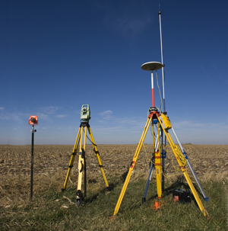
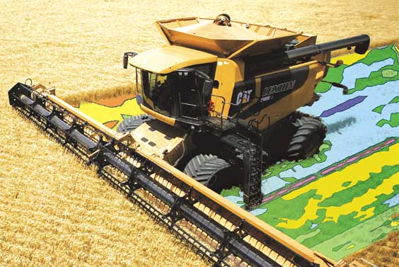
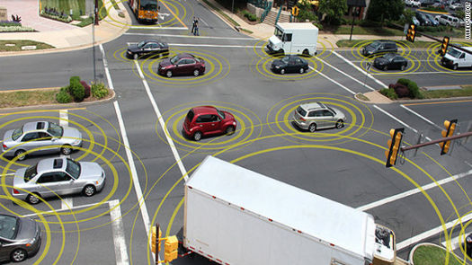
Motivation
Many WSN applications rely on highly-accurate sensor node locations in which ONLY the relative positions of the nodes are required
GPS provides absolute coordinates anywhere in the world, but sub-meter accuracy is unobtainable without military-grade or prohibitively-expensive differential GPS units
Autonomous Driving
Land Surveying
Formation Flying
Precision Agriculture

Slide 4
Outline
Motivation
Requirements and Overview
GPS Measurement Observables and Terminology
Technical Methodology
Future Work
Experimental Implementation
Results (Demo)
Motivation
Requirements and Overview
GPS Measurement Observables and Terminology
Technical Methodology
Future Work
Experimental Implementation
Results (Demo)

Slide 5
Requirements
Centimeter-precision accuracy for a scalable network of nodes
No stationary calibration or data collection phase
No explicit reference station or hub
Our Approach
Use GPS satellites to provide centimeter-scale relative position accuracy in a cooperating network of sensor nodes via raw data sharing and pairwise node localization

Slide 6
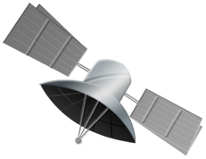


Slide 7
Outline
Motivation
Requirements and Overview
GPS Measurement Observables and Terminology
Technical Methodology
Future Work
Experimental Implementation
Results (Demo)
Motivation
Requirements and Overview
GPS Measurement Observables and Terminology
Technical Methodology
Future Work
Experimental Implementation
Results (Demo)

Slide 8
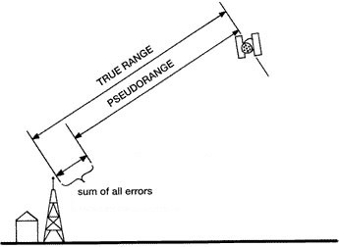
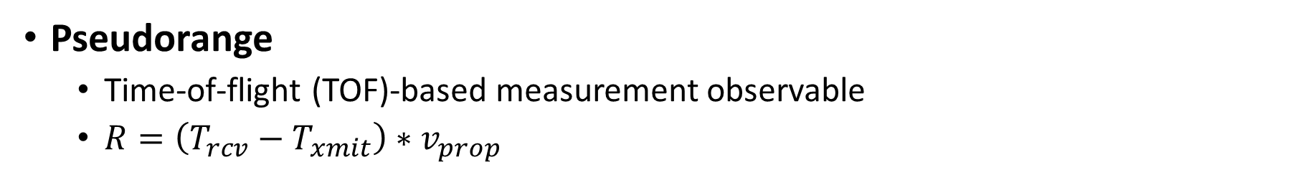
Observables and Terminology
Pseudorange
  Time-of-flight (TOF)-based measurement observable
  $R=\left(T_{rcv}−T_{xmit}\right)∗v_{prop}$
$$PR=c·\left(T_{rcv}−T_{xmit}\right)+c·t_{bias}$$

Slide 9
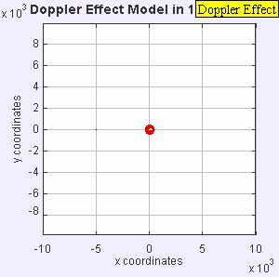
Observables and Terminology
Doppler Shift

Slide 10
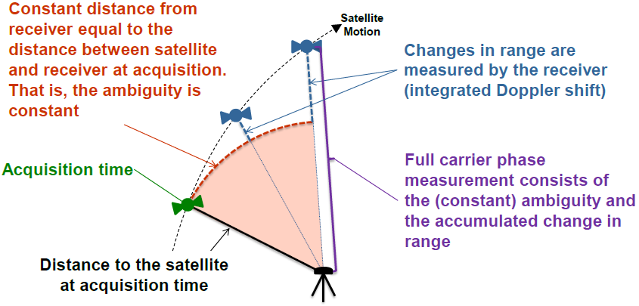
Observables and Terminology
Carrier Phase

Slide 11
Outline
Motivation
Requirements and Overview
GPS Measurement Observables and Terminology
Technical Methodology
Future Work
Experimental Implementation
Results (Demo)
Motivation
Requirements and Overview
GPS Measurement Observables and Terminology
Technical Methodology
Future Work
Experimental Implementation
Results (Demo)

Slide 12
Related Work
Real-Time Kinematic (RTK) Navigation
“RTK uses measurements of the phase of the signal′s carrier wave, rather than the information content of the signal, and relies on a single reference station to provide real-time corrections, providing up to centimeter-level accuracy” --Wikipedia
“RTK uses measurements of the phase of the signal′s carrier wave, rather than the information content of the signal, and relies on a single reference station to provide real-time corrections, providing up to centimeter-level accuracy” --Wikipedia
“RTK uses measurements of the phase of the signal′s carrier wave, rather than the information content of the signal, and relies on a single reference station to provide real-time corrections, providing up to centimeter-level accuracy” --Wikipedia
Centimeter-precision accuracy for a scalable network of nodes
No stationary calibration or data collection phase
No explicit reference station or hub

Slide 13
Methodology
Five-Step Approach
Characterize and correct for previously unexplored or ignored sources of error specific to the two-receiver localization case
Extend well-known observation models to include between-epoch data without requiring a reference satellite
Use the new observation models in a GPS tracking algorithm to enable robust relative dead reckoning through a significant period of time
Use the tracking results to mathematically reverse any relative receiver motions such that the observation models collapse to the stationary case
Combine multiple epochs of ‘collapsed’ satellite observations in an Ambiguity Function Method (AFM) algorithm to solve for relative baselines

Slide 14
Technique
Approach Step #1
Characterize and correct for previously unexplored or ignored sources of error specific to the two-receiver localization case
Known Errors:
  Satellite and receiver clock biases
  Atmospheric signal delays
  Antenna phase center offsets
  Satellite orbital errors
  Multipath
  Carrier wave cycle slips

Slide 15
Technique
Approach Step #1
Characterize and correct for previously unexplored or ignored sources of error specific to the two-receiver localization case
  Significant uncharacterized error in the geometrical differences arising from measurements taken at slightly different times:
  Range errors in the satellite observations due to physically different signal propagation path lengths
  Inconsistent satellite orbital position estimations
  Differing amounts of Earth rotation experienced during potentially different signal propagation times

Slide 16
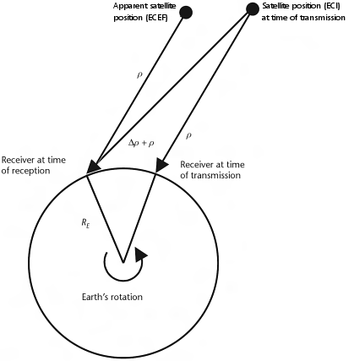
Technique
Approach Step #1
Characterize and correct for previously unexplored or ignored sources of error specific to the two-receiver localization case
  Solved via full extrapolation of observation data to a common receive epoch and updating the satellite positions to the locations at which they must have been when transmitting the corresponding signal that would have been received at the common epoch

Slide 17

Technique
Approach Step #1

Slide 18
Technique
Approach Step #1

Slide 19
Technique
Approach Step #1

Slide 20
Technique
Approach Step #1

Slide 21
Technique
Approach Step #1

Slide 22
Technique
Approach Step #1

Slide 23
Technique
Approach Step #1

Slide 24
Technique
Approach Step #1
Hedgecock, W., M. Maroti, J. Sallai, P. Volgyesi, and A. Ledeczi, "High-Accuracy Differential Tracking of Low-Cost GPS Receivers", ACM 11th International Conference on Mobile Systems, Applications, and Services (MobiSys '13), Taipei, Taiwan, ACM, 06/2013.

Slide 25
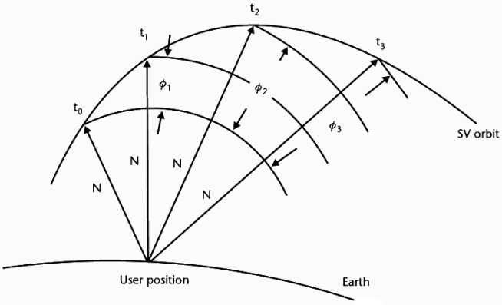


Technique
Approach Step #2
Extend well-known observation model to include between-epoch data without requiring a reference satellite

Slide 26
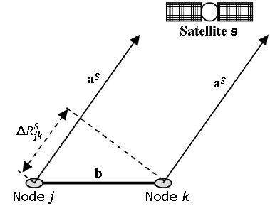
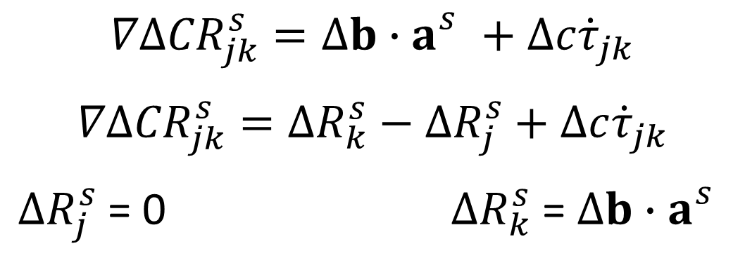
Technique
Approach Step #3
Use the temporal double-differenced observations in a GPS tracking equation to enable robust relative dead reckoning through a significant period of time
$$∇Δ{CR}_{jk}^{s}=Δb∙a_{}^{s}+Δc{\dot{τ}}_{jk}$$
$$∇Δ{CR}_{jk}^{s}=ΔR_{k}^{s}−ΔR_{j}^{s}+Δc{\dot{τ}}_{jk}$$
$ΔR_{j}^{s}$ = 0 $ΔR_{k}^{s}$ = $Δb∙a_{}^{s}$

Slide 27
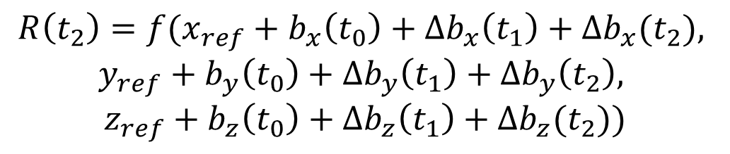
Technique
Approach Step #4
Use the tracking results to mathematically reverse any relative receiver motions such that the observation models collapse to the stationary case
$$R\left(t_{0}\right)=f(x_{ref}+b_{x}\left(t_{0}\right), y_{ref}+b_{y}\left(t_{0}\right), z_{ref}+b_{z}\left(t_{0}\right))$$
$$R\left(t_{1}\right)=f(x_{ref}+b_{x}\left(t_{0}\right)+∆b_{x}(t_{1}), y_{ref}+b_{y}\left(t_{0}\right)+∆b_{y}(t_{1}), z_{ref}+b_{z}\left(t_{0}\right)+∆b_{z}(t_{1}))$$
$$R\left(t_{2}\right)=f(x_{ref}+b_{x}\left(t_{0}\right)+∆b_{x}\left(t_{1}\right)+∆b_{x}(t_{2}),$$
$$y_{ref}+b_{y}\left(t_{0}\right)+∆b_{y}\left(t_{1}\right)+∆b_{y}\left(t_{2}\right),$$
$$z_{ref}+b_{z}\left(t_{0}\right)+∆b_{z}\left(t_{1}\right)+∆b_{z}(t_{2}))$$

Slide 28
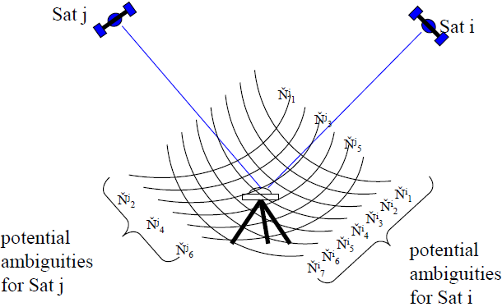
Technique
Approach Step #5
Combine multiple epochs of ‘collapsed’ satellite observations in an Ambiguity Function Method (AFM) algorithm to solve for relative baselines
At the correct position, the sum of the distances from the receiver to the nearest integer ambiguity will be minimized

Slide 29
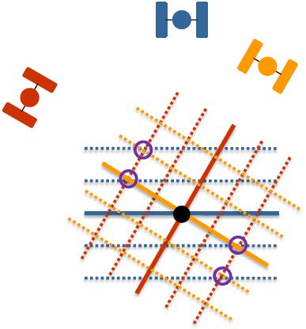
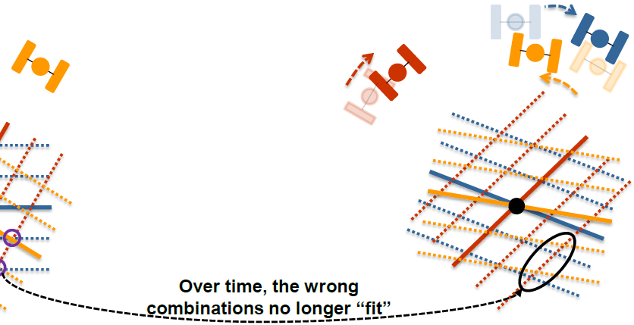
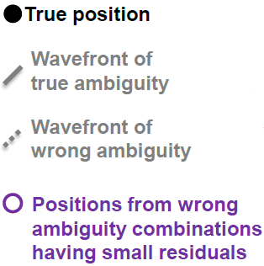
Technique
Approach Step #5
Combine multiple epochs of ‘collapsed’ satellite observations in an Ambiguity Function Method (AFM) algorithm to solve for relative baselines
*Modified from Dr. Mark Petovello’s ION GNSS 2013 Presentation: “RTK GNSS Positioning”

Slide 30
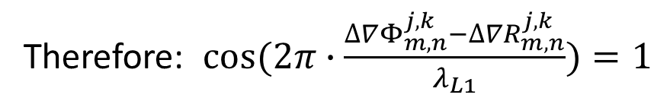
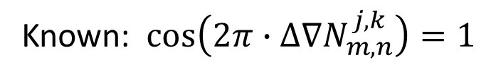
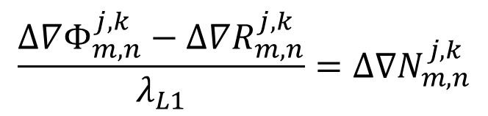

Technique
Approach Step #5
Combine multiple epochs of ‘collapsed’ satellite observations in an Ambiguity Function Method (AFM) algorithm to solve for relative baselines
$$∆∇Φ_{m,n}^{j,k}=∆∇R_{m,n}^{j,k}+∆∇N_{m,n}^{j,k}λ_{L1}$$
$$\frac{∆∇Φ_{m,n}^{j,k}−∆∇R_{m,n}^{j,k}}{λ_{L1}}=∆∇N_{m,n}^{j,k}$$
Known: $\cos\left(2π∙∆∇N_{m,n}^{j,k}\right)=1$
Therefore: $cos⁡(2π∙\frac{∆∇Φ_{m,n}^{j,k}−∆∇R_{m,n}^{j,k}}{λ_{L1}})=1$

Slide 31

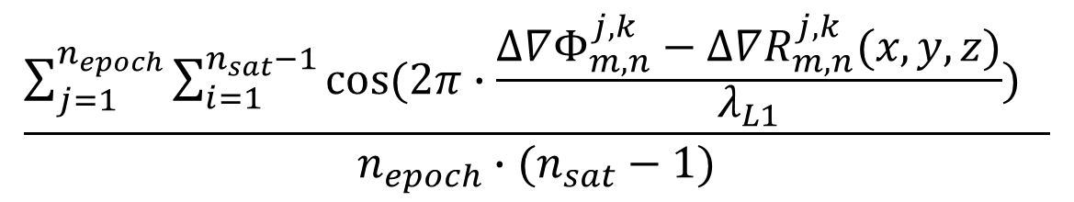
Technique
Approach Step #5
Combine multiple epochs of ‘collapsed’ satellite observations in an Ambiguity Function Method (AFM) algorithm to solve for relative baselines
$$\frac{\sum_{j=1}^{n_{epoch}}{\sum_{i=1}^{n_{sat}−1}{cos⁡(2π∙\frac{∆∇Φ_{m,n}^{j,k}−∆∇R_{m,n}^{j,k}(x,y,z)}{λ_{L1}}) }} }{n_{epoch}∙(n_{sat}−1)}$$
$$=AF(x,y,z)$$
Immune to carrier phase cycle slips!

Slide 32
Outline
Motivation
Requirements and Overview
GPS Measurement Observables and Terminology
Technical Methodology
Future Work
Experimental Implementation
Results (Demo)
Motivation
Requirements and Overview
GPS Measurement Observables and Terminology
Technical Methodology
Future Work
Experimental Implementation
Results (Demo)

Slide 33
Future Work
We only solved half of the problem
Initial baseline determination and re-initialization upon loss of satellite locks
Results from tracking algorithm will allow for baseline calculation to collapse to the stationary case
Multiple epochs of data will provide much needed GPS satellite constellation changes for the removal of unlikely ambiguity sets
This combination should enable rapid on-the-fly (OTF) ambiguity resolution, as well as verification
Extension of successful methodology to include cooperative network adjustments for both increased precision and faster ambiguity resolution

Slide 34
Outline
Motivation
Requirements and Overview
GPS Measurement Observables and Terminology
Technical Methodology
Future Work
Experimental Implementation
Results (Demo)
Motivation
Requirements and Overview
GPS Measurement Observables and Terminology
Technical Methodology
Future Work
Experimental Implementation
Results (Demo)

Slide 35
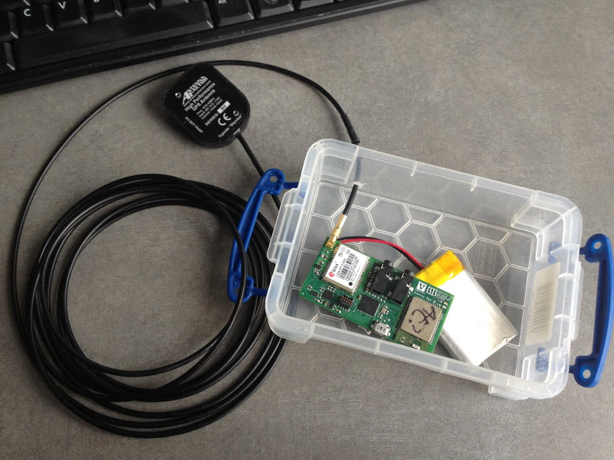
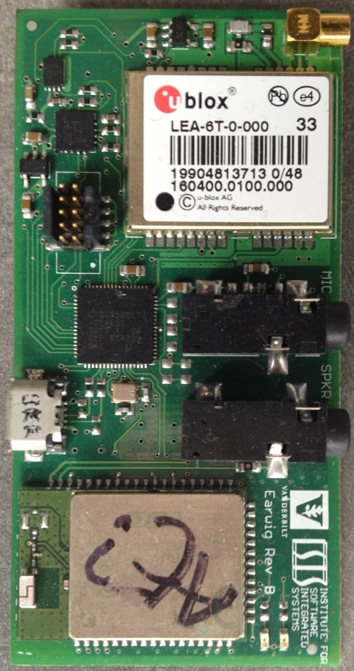
Implementation
Hardware Architecture

Slide 36
Implementation
Software Architecture
Distributed, Multi-Agent System
Software agent-based system comprising distinct, distributed agents running on physically separate devices and communicating over a network
“Software Agent”: A computer program whose purpose is to act on behalf of or provide a data resource for a standalone application
  Background service capable of providing localization services to a requesting application
“Multi-Agent”: The system comprises multiple distinct software agents to provide functionality
“Distributed”: The multiple agents are disseminated among separate and unique devices

Slide 37
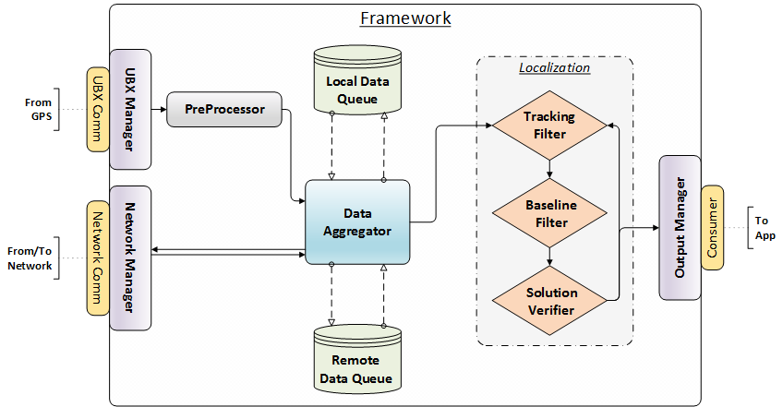
Implementation
Software Architecture

Slide 38
Outline
Motivation
Requirements and Overview
GPS Measurement Observables and Terminology
Technical Methodology
Future Work
Experimental Implementation
Results (Demo)
Motivation
Requirements and Overview
GPS Measurement Observables and Terminology
Technical Methodology
Future Work
Experimental Implementation
Results (Demo)

Slide 39
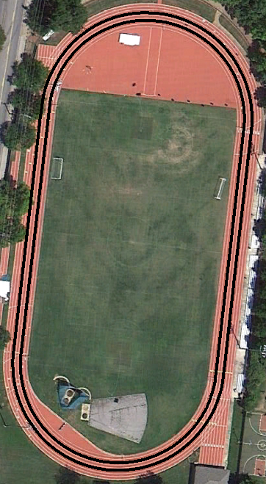
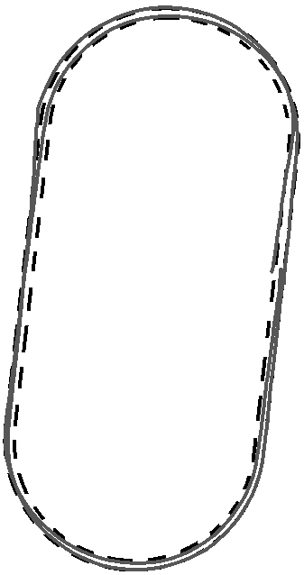

Results

Slide 40
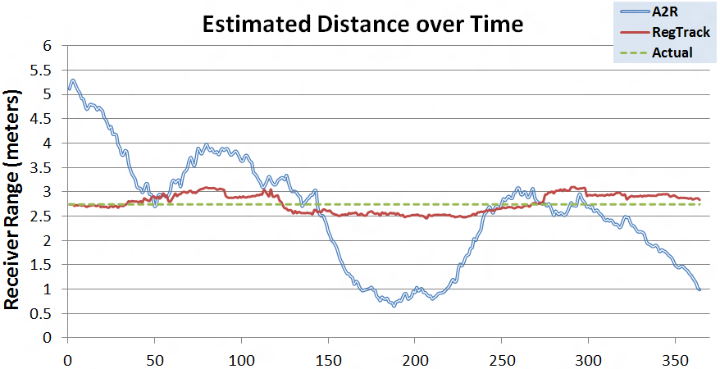
Results

Slide 41
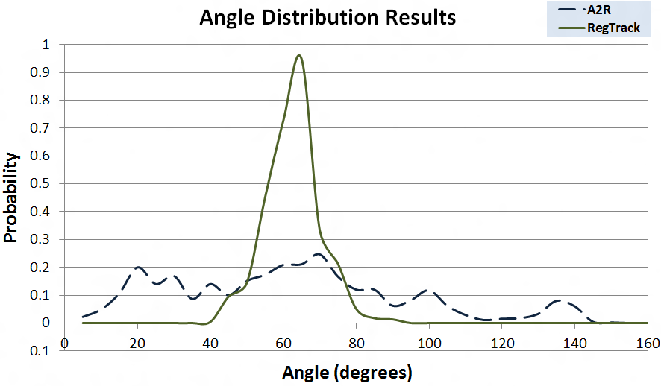
Results

Slide 42
Questions?
Institute for Software
Integrated Systems
Vanderbilt University
Will Hedgecock
WithIT Seminar, September 26, 2013

