Slide 1


RegTrack
Institute for Software
Integrated Systems
Vanderbilt University
Relative GPS Tracking
“High-Accuracy Differential Tracking of Low-Cost GPS Receivers”
Will Hedgecock
Miklos Maroti
Janos Sallai
Peter Volgyesi
Akos Ledeczi

Slide 2
Outline
Motivation
Requirements and Overview
Technical Methodology
Experimental Implementation
Results (Demo)
Conclusions and Future Work

Slide 3

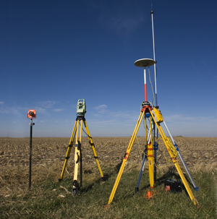
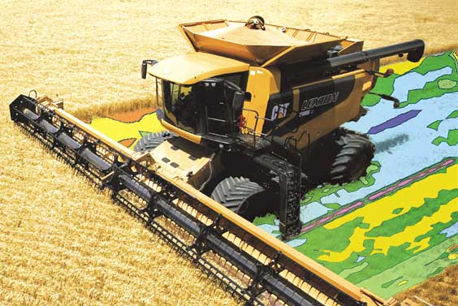
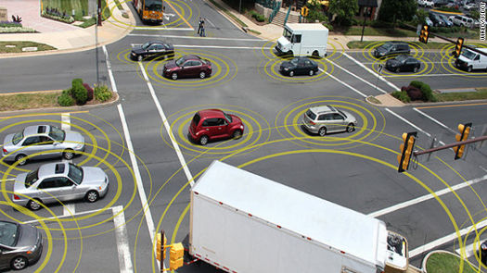
Motivation
Many WSN applications rely on highly-accurate sensor node locations in which ONLY the relative positions of the nodes are required
GPS provides absolute coordinates anywhere in the world, but sub-meter accuracy is unobtainable without military-grade or prohibitively-expensive differential GPS units
Autonomous Driving
Land Surveying
Formation Flying
Precision Agriculture

Slide 4
Requirements
Centimeter-precision accuracy for a scalable network of nodes
No stationary calibration or data collection phase
No explicit reference station or hub
Our Approach
Use GPS satellites to provide centimeter-scale relative position accuracy in a cooperating network of sensor nodes via raw data sharing and pairwise node localization

Slide 5
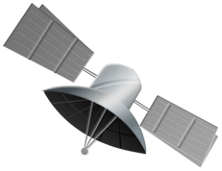


Slide 6
Methodology
Three-fold Approach
Characterize and correct for previously unexplored or ignored sources of error specific to the two-receiver localization case
Extend well-known observation models to include between-epoch data without requiring a reference satellite
    Temporal double-difference
    Dual-epoch, double-difference
Use the new observation model in a GPS tracking algorithm to enable robust relative dead reckoning through a significant period of time

Slide 7
Technique
Approach Step #1
Characterize and correct for previously unexplored or ignored sources of error specific to the two-receiver localization case
Known Errors:
  Satellite and receiver clock biases
  Atmospheric signal delays
  Antenna phase center offsets
  Satellite orbital errors
  Multipath
  Carrier wave cycle slips

Slide 8
Technique
Approach Step #1
Characterize and correct for previously unexplored or ignored sources of error specific to the two-receiver localization case
  Significant uncharacterized error in the geometrical differences arising from measurements taken at slightly different times:
  Range errors in the satellite observations due to physically different signal propagation path lengths
  Inconsistent satellite orbital position estimations
  Differing amounts of Earth rotation experienced during potentially different signal propagation times

Slide 9
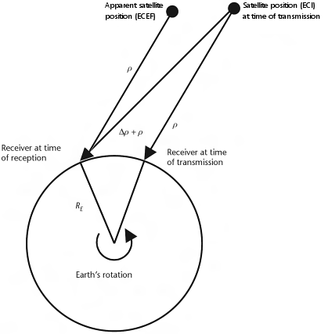
Technique
Approach Step #1
Characterize and correct for previously unexplored or ignored sources of error specific to the two-receiver localization case
  Solved via full extrapolation of observation data to a common receive epoch and updating the satellite positions to the locations at which they must have been when transmitting the corresponding signal that would have been received at the common epoch

Slide 10

Technique
Approach Step #1

Slide 11
Technique
Approach Step #1

Slide 12
Technique
Approach Step #1

Slide 13
Technique
Approach Step #1

Slide 14
Technique
Approach Step #1

Slide 15
Technique
Approach Step #1

Slide 16
Technique
Approach Step #1

Slide 17
Technique
Approach Step #1

Slide 18
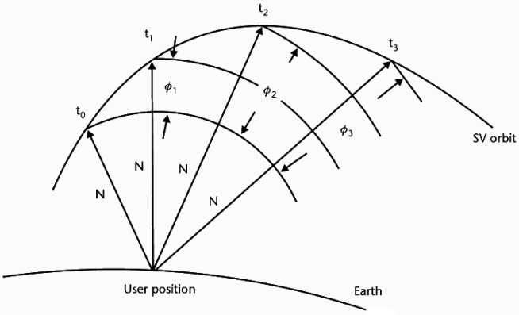


Technique
Approach Step #2
Extend well-known observation model to include between-epoch data without requiring a reference satellite

Slide 19
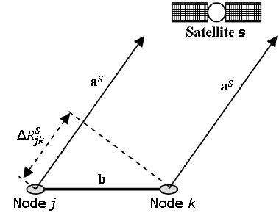
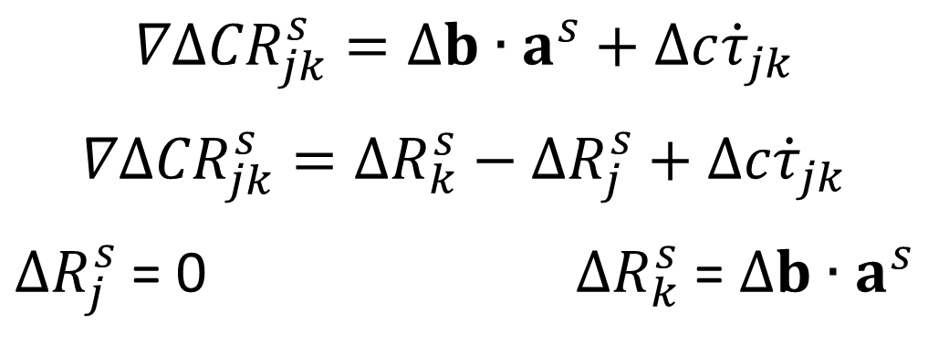
Technique
Approach Step #3
Use the temporal double-differenced observations in a GPS tracking equation to enable robust relative dead reckoning through a significant period of time
$$∇Δ{CR}_{jk}^{s}=Δb∙a_{}^{s}+Δc{\dot{τ}}_{jk}$$
$$∇Δ{CR}_{jk}^{s}=ΔR_{k}^{s}−ΔR_{j}^{s}+Δc{\dot{τ}}_{jk}$$
$ΔR_{j}^{s}$ = 0 $ΔR_{k}^{s}$ = $Δb∙a_{}^{s}$

Slide 20
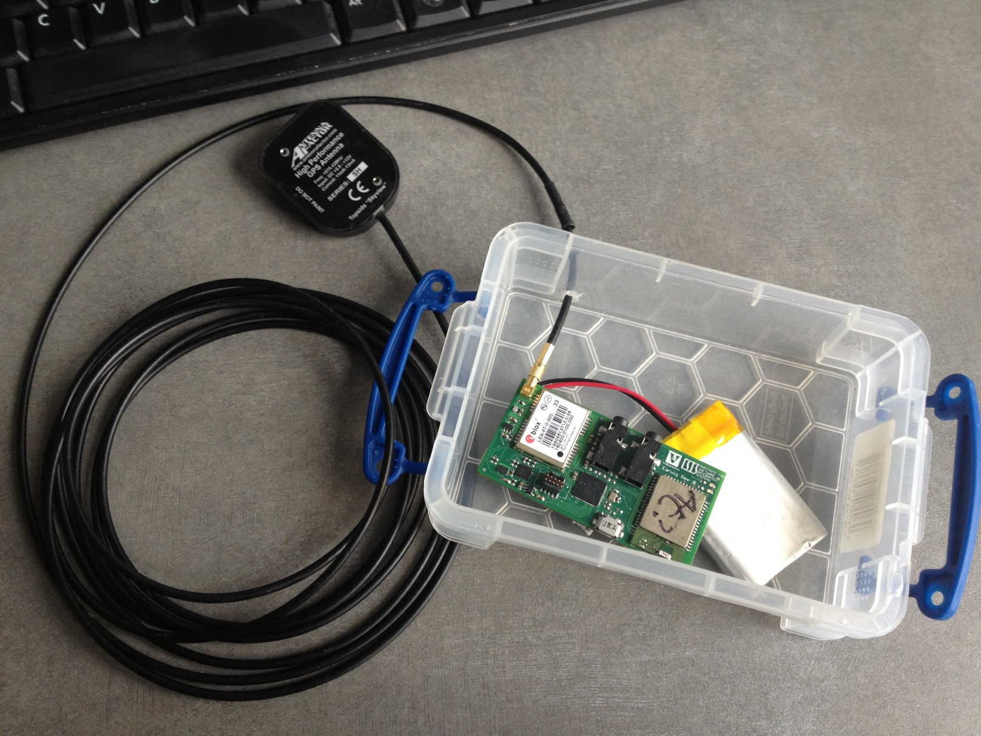
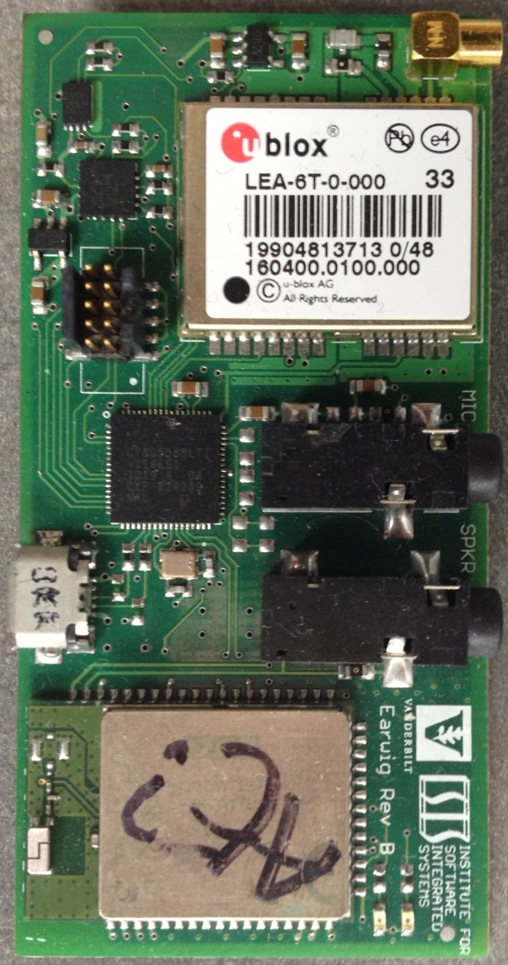
Implementation

Slide 21
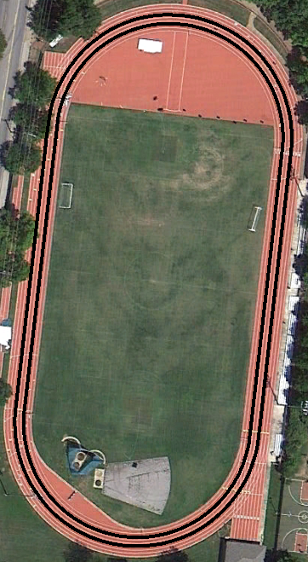
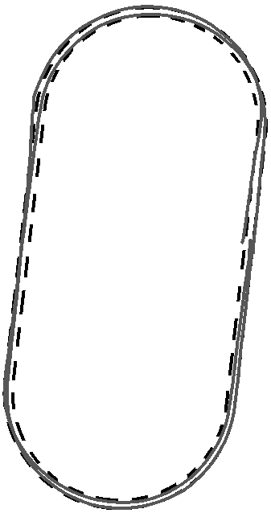
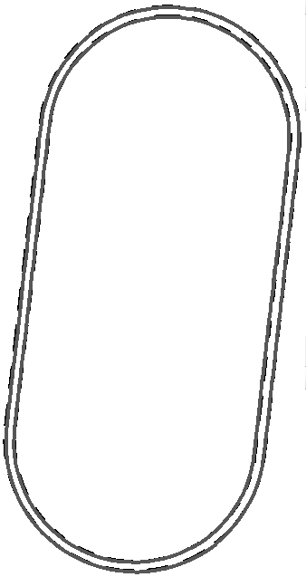
Results

Slide 22
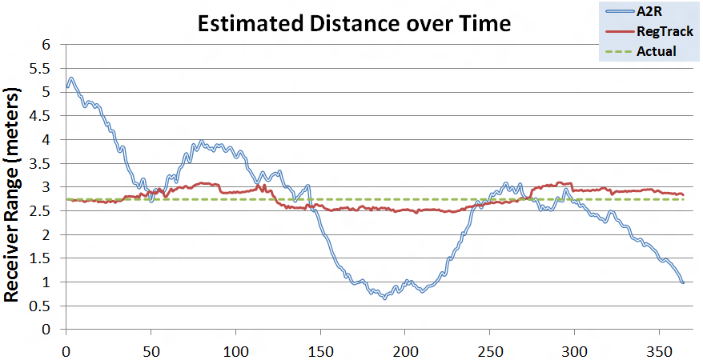
Results

Slide 23
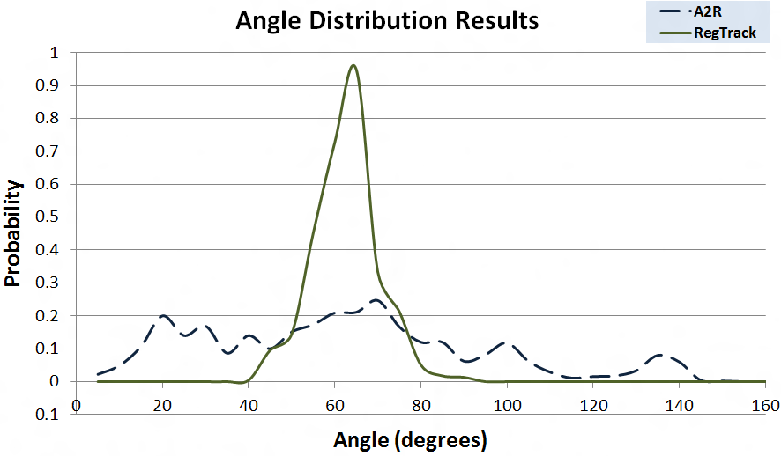
Results

Slide 24
Future Work
We only solved half of the problem
Initial baseline determination and re-initialization upon loss of satellite locks
Results from tracking algorithm will allow for baseline calculation to collapse to the stationary case
Multiple epochs of data will provide much needed GPS satellite constellation changes for the removal of unlikely ambiguity sets
This combination should enable rapid on-the-fly (OTF) ambiguity resolution, as well as verification
Extension of successful methodology to include cooperative network adjustments for both increased precision and faster ambiguity resolution

Slide 25
Questions?
Institute for Software
Integrated Systems
Vanderbilt University
“High-Accuracy Differential Tracking of Low-Cost GPS Receivers”
Will Hedgecock
Miklos Maroti
Janos Sallai
Peter Volgyesi
Akos Ledeczi

Slide 26
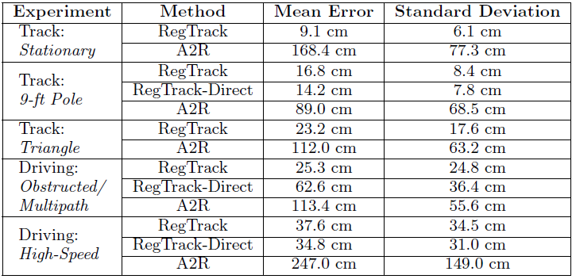
Results

Slide 27
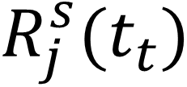
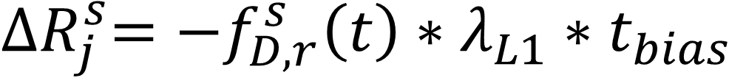

Technique
Approach Step #1
Characterize and correct for previously unexplored or ignored sources of error specific to the two-receiver localization case
  Full extrapolation of observation data to a common receive epoch:
Estimate receiver clock bias using simple least squares optimization
Calculate satellite-receiver range at actual time of transmission/reception:
Determine satellite range change during receiver bias from system time:
Update observations with this change in range
Iteratively solve for the transmission time of the signal that would have been received exactly at the epoch:

