Slide 1


Institute for Software Integrated Systems
Vanderbilt University
Precise Relative Localization and Tracking of Low-Cost GPS Nodes
Will Hedgecock
Ph.D. Candidate
Akos Ledeczi
Associate Professor
Google, December 10, 2013

Slide 2
Outline
Localization Research at ISIS
  Shooter Localization
  Radio Interferometric Localization
Motivation
Relative Localization with GPS
  Problem Statement
  GPS Overview
  Technical Methodology
  Experimental Implementation
  Evaluation and Results

Slide 3
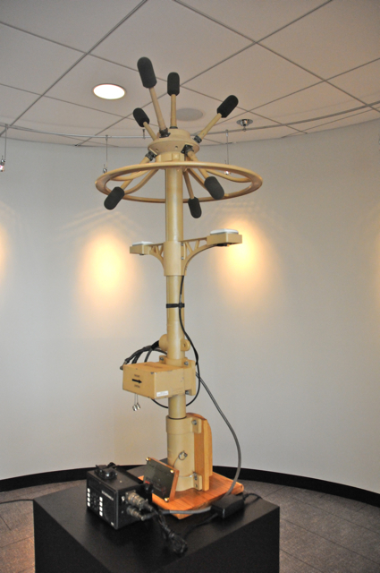
Traditional Acoustic Shooter Localization
Microphone array
  Exact position
  Perfect time sync
Observations:
  Shockwave TOA and AOA
  Muzzle blast TOA and AOA
  Shockwave-muzzle blast TDOA
A simple analytical formula gives shooter position (bearing and range), but not trajectory.
Disadvantages:
  Relies on line-of-sight
  Centralized: single point of failure
  Big, expensive (although there are wearable versions now)
  Not very accurate
Boomerang by Raytheon BBN Technologies

Slide 4
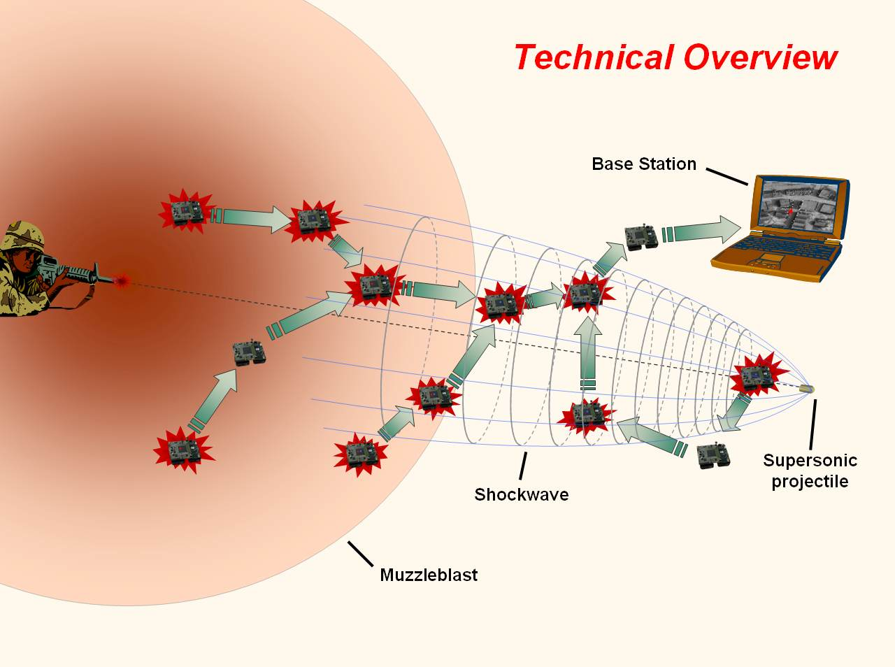
Wireless Sensor Network-Based
Countersniper System
4

Slide 5
Novel Contributions
Networked sensor fusion based on consistency function:
  Multipath elimination
  Multiple simultaneous shot resolution
  High accuracy
Weapon classification
Shockwave length-based trajectory estimation
Smartphone-based system

Slide 6
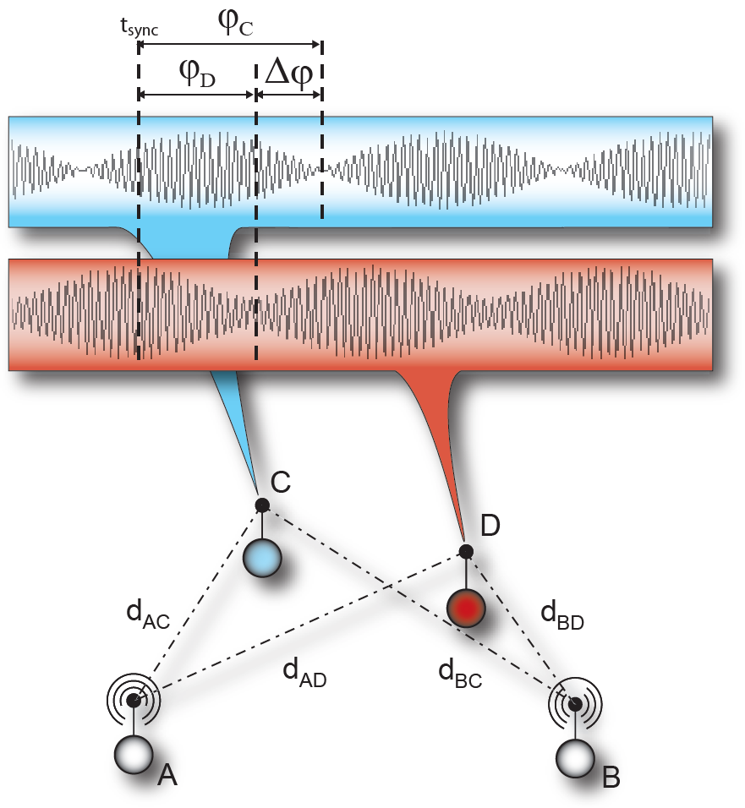
Radio Interferometric Positioning (RIPS)
Radio Interferometric Ranging
Two nodes transmit sinusoid signals ~300Hz apart in the 400MHz range
The generated interference signal has a ~300Hz envelope
The phase difference of the signal strength signal at two receivers is proportional to a linear combination of pair wise ranges
Implemented in low-cost COTS sensor nodes, no extra hardware required
Sensor Network Localization
A network of at least six nodes provides enough range measurements (equations) to compute relative locations
Multiple successful demonstrations
In a 150x150m field with 16 nodes, the average location accuracy: 4cm
Unprecedented accuracy and range in wireless sensor networks
Doppler Shift-based Sensor Node Tracking
Using a 400MHz signal, the Doppler shift induced by a node moving at 1m/s is ~1.3Hz
Using the same interferometric ranging technique this tiny frequency change can be measured and used to track the moving node
Best Paper Award at ACM Sensys, the most prestigious WSN conference
phase offset / 2π ∙ λ =
(d_{AD} − d_{BD} + d_{BC} − d_{AC}) mod λ
RF Bearing Estimation
Placing together three of the four nodes involved in a radio interferometric range measurement to form a quasi antenna array, the measured phase on the fourth node determines the bearing
A single antenna is utilized to measure RF bearing

Slide 7
Outline
Localization Research at ISIS
  Shooter Localization
  Radio Interferometric Localization
Motivation
Relative Localization with GPS
  Problem Statement
  GPS Overview
  Technical Methodology
  Experimental Implementation
  Evaluation and Results
Localization Research at ISIS
  Shooter Localization
  Radio Interferometric Localization
Motivation
Relative Localization with GPS
  Problem Statement
  GPS Overview
  Technical Methodology
  Experimental Implementation
  Evaluation and Results

Slide 8
Motivation
For shooter localization it is good to have <1m error in sensor locations
Multipath kills RIPS and it is too slow when high accuracy is needed
While we were busy doing radio interferometric localization, GPS became cheaper and less power hungry. Still not accurate enough for some applications though…
Shooter localization needs precise knowledge of sensor geometry, but absolute location accuracy is not that important
Other such applications:
  Land surveying, precision agriculture
  Coordinated movement of UAVs and UGVs
  Driverless cars: collision avoidance, platoon formation when there is no LOS
  etc.
Differential GPS and RTK have various disadvantages

Slide 9
Outline
Localization Research at ISIS
  Shooter Localization
  Radio Interferometric Localization
Motivation
Relative Localization with GPS
  Problem Statement
  GPS Overview
  Technical Methodology
  Experimental Implementation
  Evaluation and Results
Localization Research at ISIS
  Shooter Localization
  Radio Interferometric Localization
Motivation
Relative Localization with GPS
  Problem Statement
  GPS Overview
  Technical Methodology
  Experimental Implementation
  Evaluation and Results

Slide 10
Requirements
Centimeter-precision accuracy for a scalable network of nodes
No stationary calibration or data collection phase
No explicit reference station or hub
Our Approach
Use GPS satellites to provide relative position information for a cooperating network of sensor nodes via raw data sharing and pairwise node tracking and localization

Slide 11
Outline
Localization Research at ISIS
  Shooter Localization
  Radio Interferometric Localization
Motivation
Relative Localization with GPS
  Problem Statement
  GPS Overview
  Technical Methodology
  Experimental Implementation
  Evaluation and Results
Localization Research at ISIS
  Shooter Localization
  Radio Interferometric Localization
Motivation
Relative Localization with GPS
  Problem Statement
  GPS Overview
  Technical Methodology
  Experimental Implementation
  Evaluation and Results

Slide 12
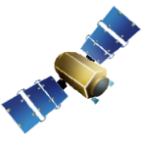
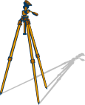
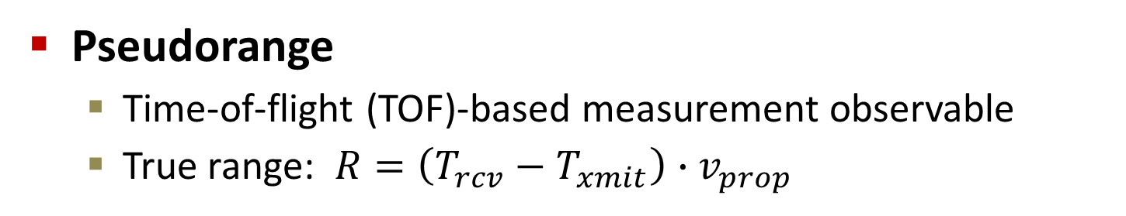
GPS Overview
Pseudorange
  Time-of-flight (TOF)-based measurement observable
  True range: $R=\left(T_{rcv}−T_{xmit}\right)∙v_{prop}$
Pseudorange
Error
True Range
$$PR=c·\left(T_{rcv}−T_{xmit}\right)+c·t_{bias}+ε$$

Slide 13
GPS Overview
Carrier Phase
Satellite orbit
Reported carrier
phase measurements
Constant ambiguity
value
=
Accumulated Doppler
Shift
Full carrier
range
Satellite lock
acquired
Satellite distance
at time of lock

Slide 14
Related Work
Real-Time Kinematic (RTK) Navigation
“RTK uses measurements of the phase of the signal′s carrier wave, rather than the information content of the signal, and relies on a single reference station to provide real-time corrections, providing up to centimeter-level accuracy”
--Wikipedia
“RTK uses measurements of the phase of the signal′s carrier wave, rather than the information content of the signal, and relies on a single reference station to provide real-time corrections, providing up to centimeter-level accuracy”
--Wikipedia
“RTK uses measurements of the phase of the signal′s carrier wave, rather than the information content of the signal, and relies on a single reference station to provide real-time corrections, providing up to centimeter-level accuracy”
--Wikipedia
Centimeter-precision accuracy for a scalable network of nodes
No stationary calibration or data collection phase
No explicit reference station or hub

Slide 15
Outline
Localization Research at ISIS
  Shooter Localization
  Radio Interferometric Localization
Motivation
Relative Localization with GPS
  Problem Statement
  GPS Overview
  Technical Methodology
  Experimental Implementation
  Evaluation and Results
Localization Research at ISIS
  Shooter Localization
  Radio Interferometric Localization
Motivation
Relative Localization with GPS
  Problem Statement
  GPS Overview
  Technical Methodology
  Experimental Implementation
  Evaluation and Results

Slide 16
Methodology
Centimeter-precision accuracy
No stationary calibration or data collection phase
No explicit reference station or hub
✓
Problem
Stationary calibration historically required because receiver motion adds at least 3 unknowns per time step
Solution
Use extremely accurate tracking results to mathematically account for relative receiver motions such that the number of unknowns does not grow over time

Slide 17
Methodology
✓
Centimeter-precision accuracy
No stationary calibration or data collection phase
No explicit reference station or hub
✓
Problem
Relative tracking is usually handled by multi-modal filtering techniques (e.g. joint GPS/IMU Kalman filter)
Precise errors specific to the multi-receiver case are often neglected in standard pre-processing algorithms
Solution
Correct observations for sources of error specific to dual-receiver localization, and create new methods for relative tracking using GPS alone

Slide 18
Methodology
✓
Centimeter-precision accuracy
No stationary calibration or data collection phase
No explicit reference station or hub
✓
✓
Problem
Standard baseline determination techniques use observation models that require either a reference receiver, a reference satellite, or both
Solution
Use local receiver as implicit reference station and create a relative localization procedure that either lacks a reference satellite or overcomes its limitations

Slide 19
Technique
Step #1
Characterize and correct for errors specific to the two-receiver localization case
  Significant uncharacterized error in the geometrical differences arising from measurements taken at slightly different times:
  Range errors in the satellite observations due to physically different signal propagation path lengths
  Inconsistent satellite orbital position estimations
  Differing amounts of Earth rotation experienced during potentially different signal propagation times

Slide 20

Dual-Receiver Error Sources

Slide 21
Dual-Receiver Error Sources

Slide 22
Dual-Receiver Error Sources

Slide 23
Dual-Receiver Error Sources

Slide 24
Dual-Receiver Error Sources

Slide 25
Dual-Receiver Error Sources
Notes:
Solved via full extrapolation of observation data to a common receive epoch and updating the satellite positions to the locations at which they must have been when transmitting the corresponding signal that would have been received at the common epoch

Slide 26

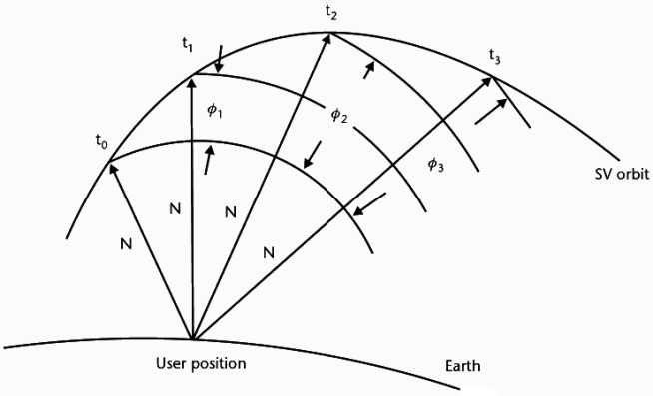

Technique
Step #2
Extend well-known carrier phase observation model to include temporal data

Slide 27
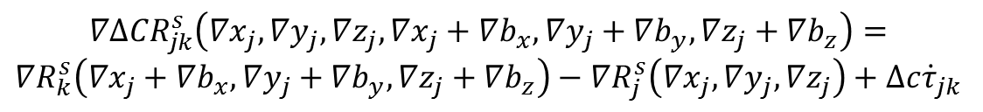
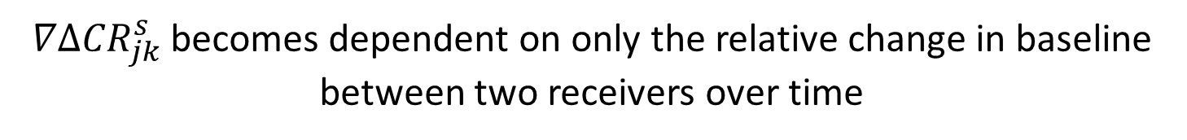
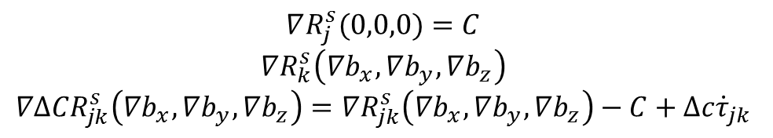
Technique
Step #3
Use the temporal double-differenced observations in a GPS tracking equation to enable robust relative dead reckoning through a significant period of time
$$∇Δ{CR}_{jk}^{s}\left(∇x_{j},∇y_{j},∇z_{j},∇x_{k},∇y_{k},∇z_{k}\right)=∇R_{k}^{s}\left(∇x_{k},∇y_{k},∇z_{k}\right)−{∇R}_{j}^{s}\left(∇x_{j},∇y_{j},∇z_{j}\right)+Δc{\dot{τ}}_{jk}$$
$$∇Δ{CR}_{jk}^{s}\left(∇x_{j},∇y_{j},∇z_{j},∇x_{j}+∇b_{x},∇y_{j}+∇b_{y},∇z_{j}+∇b_{z}\right)=$$
$$∇R_{k}^{s}\left(∇x_{j}+∇b_{x},∇y_{j}+∇b_{y},∇z_{j}+∇b_{z}\right)−∇R_{j}^{s}\left(∇x_{j},∇y_{j},∇z_{j}\right)+Δc{\dot{τ}}_{jk}$$
$$∇R_{j}^{s}(0,0,0)=C$$
$$∇R_{k}^{s}\left(∇b_{x},∇b_{y},∇b_{z}\right)$$
$$∇Δ{CR}_{jk}^{s}\left(∇b_{x},∇b_{y},∇b_{z}\right)=∇R_{jk}^{s}\left(∇b_{x},∇b_{y},∇b_{z}\right)−C+Δc{\dot{τ}}_{jk}$$
$∇Δ{CR}_{jk}^{s}$ becomes dependent on only the relative change in baseline between two receivers over time
Notes:
First step: function of six coordinate changes
Second step: make function of reference, j
Third step: make everything relative to node j (therefore, subtract j out)

Slide 28
Technique
Step #3
Use the temporal double-differenced observations in a GPS tracking equation to enable robust relative dead reckoning through a significant period of time
Implemented a proof-of-concept earlier this year
Resulted in tracking with centimeter-scale precision over both significant time periods and baseline lengths
Hedgecock, W., M. Maroti, J. Sallai, P. Volgyesi, and A. Ledeczi, "High-Accuracy Differential Tracking of Low-Cost GPS Receivers", ACM 11th International Conference on Mobile Systems, Applications, and Services (MobiSys '13), Taipei, Taiwan, ACM, 06/2013.
Suffered from baseline initialization and re-initialization after loss-of-lock problems
Notes:
First step: function of six coordinate changes
Second step: make function of reference, j
Third step: make everything relative to node j (therefore, subtract j out)

Slide 29
Technique
Step #4
Combine multiple observation epochs in a filtering algorithm to solve for relative baselines
At the correct position, the residual distances to the nearest integer ambiguity will be minimized
Ambiguity Function Method (AFM)-based solution

Slide 30
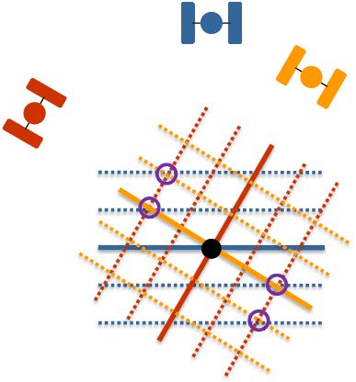
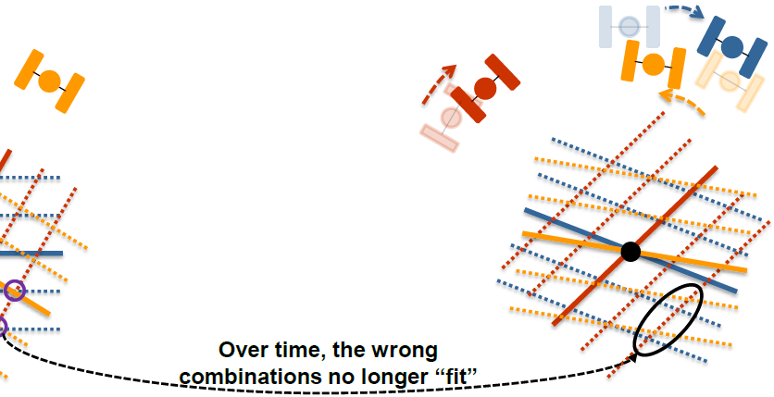
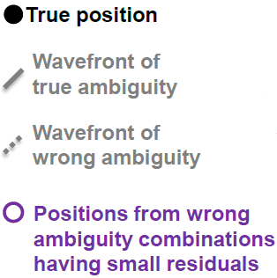
Ambiguity Function Method
*Adapted from Dr. Mark Petovello’s ION GNSS 2013 Presentation: “RTK GNSS Positioning”

Slide 31

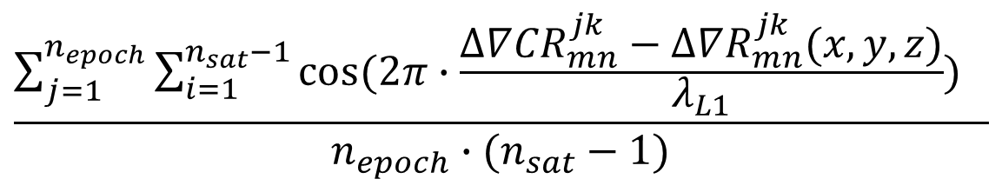
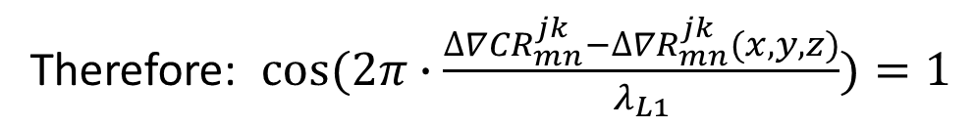
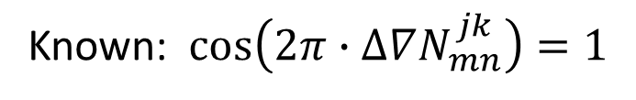
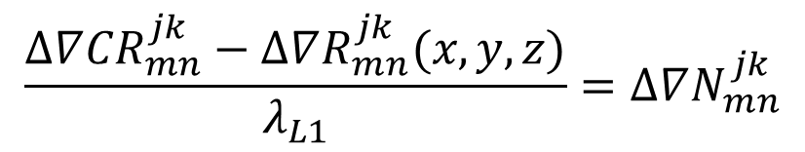
Ambiguity Function Method
$$∆∇{CR}_{mn}^{jk}(x,y,z)=∆∇R_{mn}^{jk}(x,y,z)+∆∇N_{mn}^{jk}λ_{L1}$$
$$\frac{∆∇{CR}_{mn}^{jk}−∆∇R_{mn}^{jk}(x,y,z)}{λ_{L1}}=∆∇N_{mn}^{jk}$$
Known: $\cos\left(2π∙∆∇N_{mn}^{jk}\right)=1$
Therefore: $cos⁡(2π∙\frac{∆∇{CR}_{mn}^{jk}−∆∇R_{mn}^{jk}(x,y,z)}{λ_{L1}})=1$
$$\frac{\sum_{j=1}^{n_{epoch}}{\sum_{i=1}^{n_{sat}−1}{cos⁡(2π∙\frac{∆∇{CR}_{mn}^{jk}−∆∇R_{mn}^{jk}(x,y,z)}{λ_{L1}}) }} }{n_{epoch}∙(n_{sat}−1)}$$
$$=AF(x,y,z)$$
Immune to carrier phase cycle slips!

Slide 32
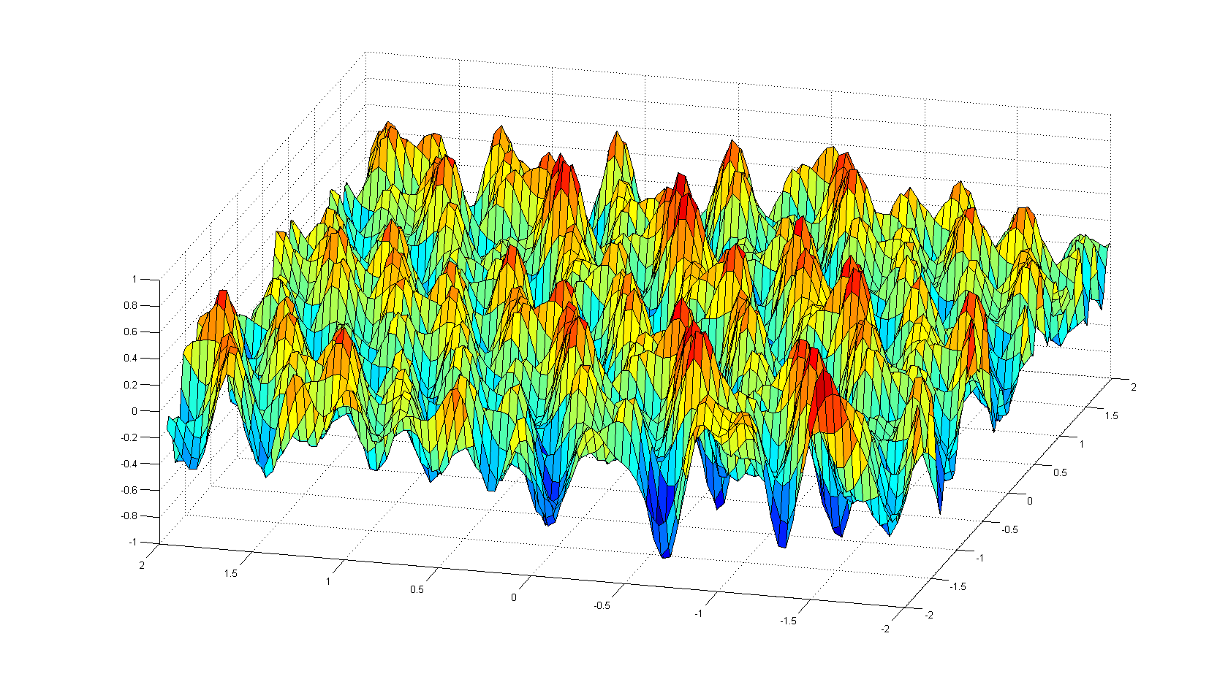
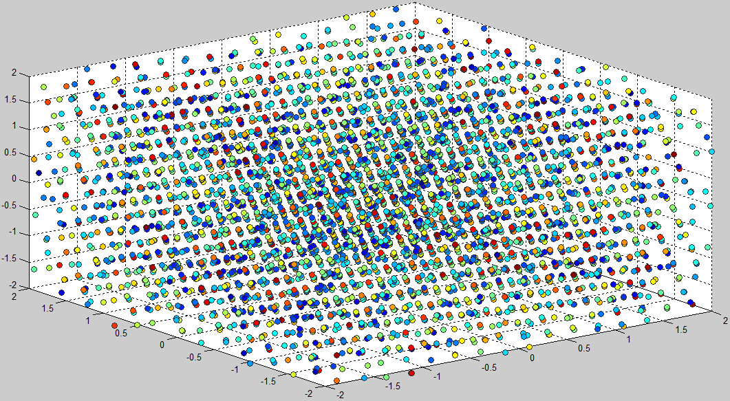
Technique
Step #4
Use Ambiguity Function Method as evaluation criterion in a Peak Ambiguity Tracking Solution (PATS)
View search grid as a 3D heat map where the AF value at each point represents its fitness as a potential baseline candidate
2D
3D

Slide 33
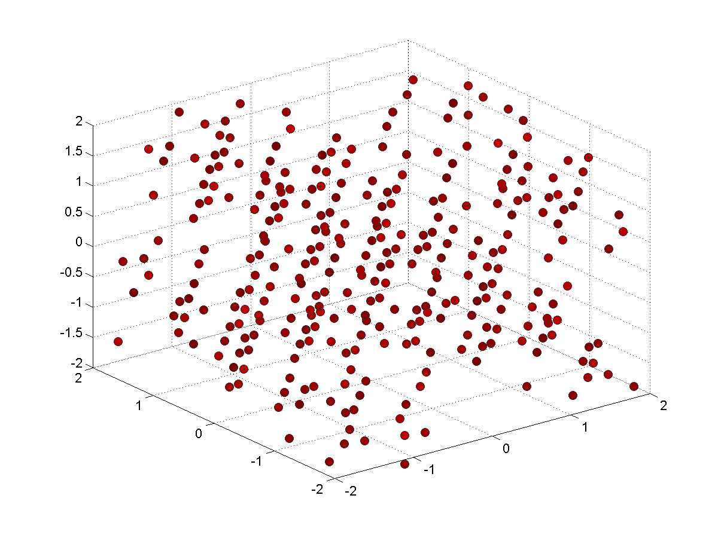
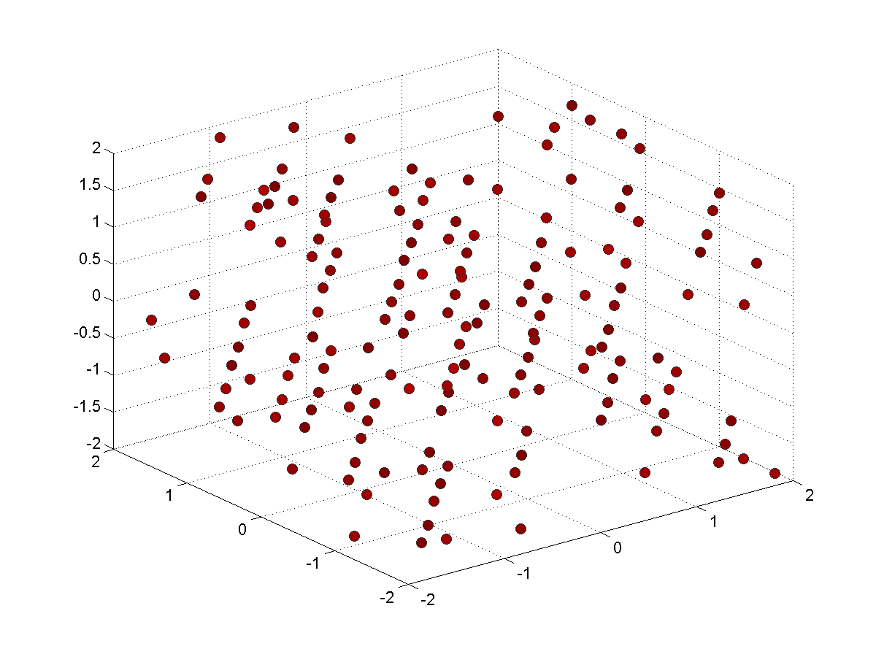

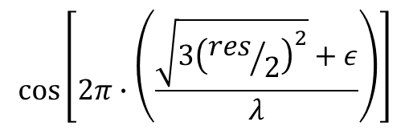
Technique
Step #4
Use Ambiguity Function Method as evaluation criterion in a Peak Ambiguity Tracking Solution (PATS)
Filter peaks based on the worst-case AF value possible given the search resolution, carrier wavelength, and maximum noise/error per measurement
2D
3D
$${AF}_{worst}\left(res,λ,ε\right)≅$$
$$cos⁡\left[2π∙\left(\frac{\sqrt{3{\left({res}/2\right)}^{2}}+ε}{λ}\right)\right]$$

Slide 34
Peak Ambiguity Tracking Solution
Where does peak “tracking” come into play?
Peaks are only identified once (per initialization)
At each time step, update every identified baseline peak according to tracking result
  Ensures that peaks appear to remain ‘stationary’
Re-evaluate Ambiguity Function Value at updated peak location
Hill climb by steepest ascent to local peak maximum
  Overcomes small tracking inaccuracies
Results in complete mapping of updated peak locations and Ambiguity Function Values
Filter updated peak locations based on worst-case AF value until only one peak remains
  Can use fixed ambiguities from previous epoch as a sanity check
Notes:
Existing solutions: that is the extent of the method…identify, take highest peak, done…oftentimes highest peak isn’t the correct peak

Slide 35
Peak Ambiguity Tracking Solution
Combine multiple observation epochs in a Peak Tracking and Filtering algorithm to solve for relative baselines
✓
Immune to cycle slips
Reference satellites do not matter because the actual fixed values of the ambiguities do not matter
Changing reference satellites every epoch may actually help mitigate unmodeled errors like multipath
✓
✓

Slide 36
Outline
Localization Research at ISIS
  Shooter Localization
  Radio Interferometric Localization
Motivation
Relative Localization with GPS
  Problem Statement
  GPS Overview
  Technical Methodology
  Experimental Implementation
  Evaluation and Results
Localization Research at ISIS
  Shooter Localization
  Radio Interferometric Localization
Motivation
Relative Localization with GPS
  Problem Statement
  GPS Overview
  Technical Methodology
  Experimental Implementation
  Evaluation and Results

Slide 37
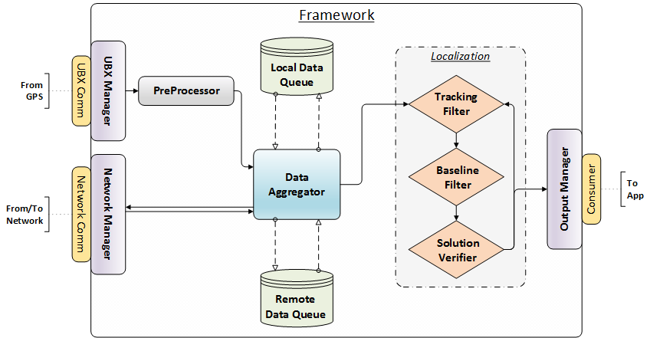
Implementation
Software Architecture

Slide 38
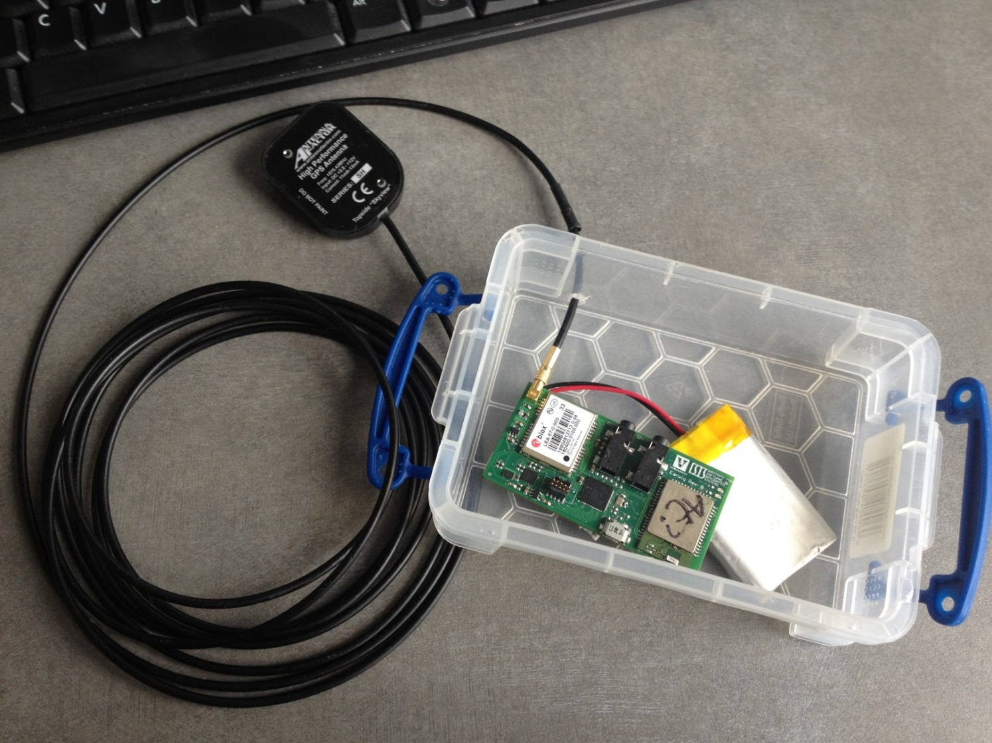
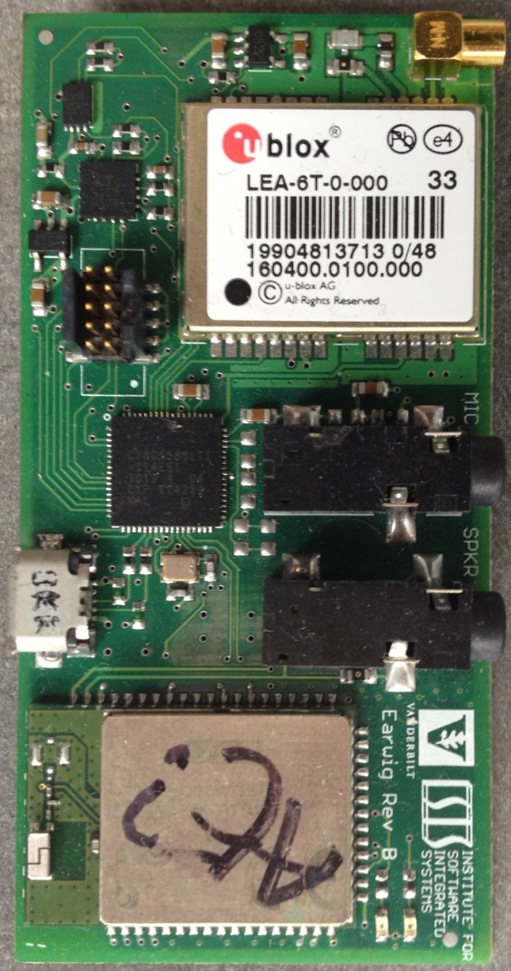
Implementation
Hardware Architecture

Slide 39
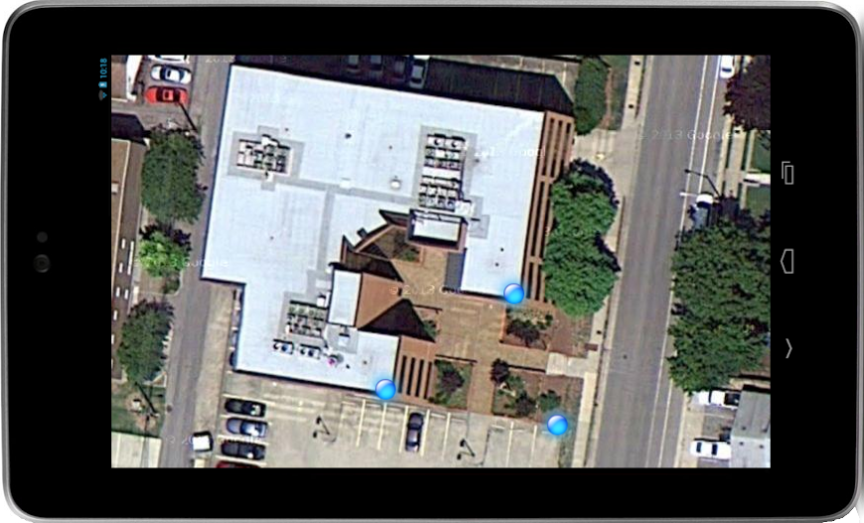
Implementation
Hardware Architecture
HTC One Phones
Nexus 7 Tablets

Slide 40
Outline
Localization Research at ISIS
  Shooter Localization
  Radio Interferometric Localization
Motivation
Relative Localization with GPS
  Problem Statement
  GPS Overview
  Technical Methodology
  Experimental Implementation
  Evaluation and Results
Localization Research at ISIS
  Shooter Localization
  Radio Interferometric Localization
Motivation
Relative Localization with GPS
  Problem Statement
  GPS Overview
  Technical Methodology
  Experimental Implementation
  Evaluation and Results

Slide 41
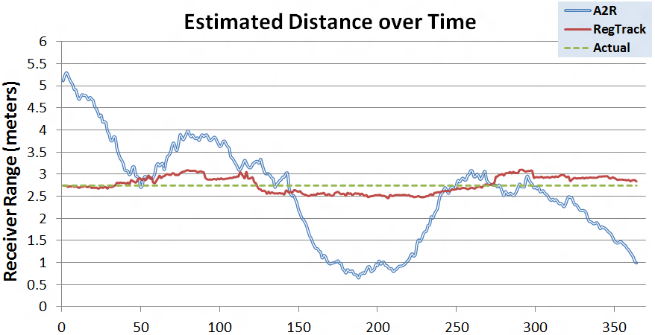
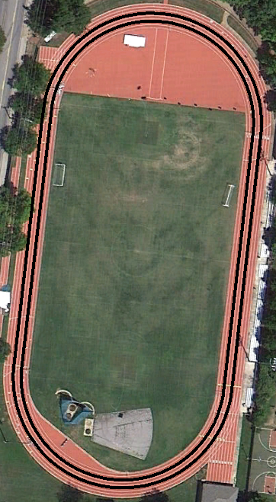
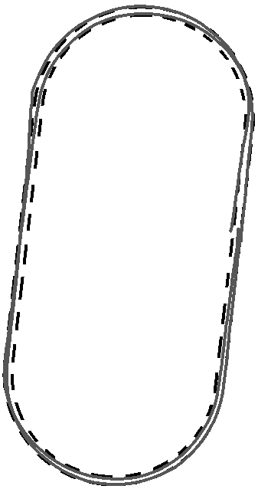
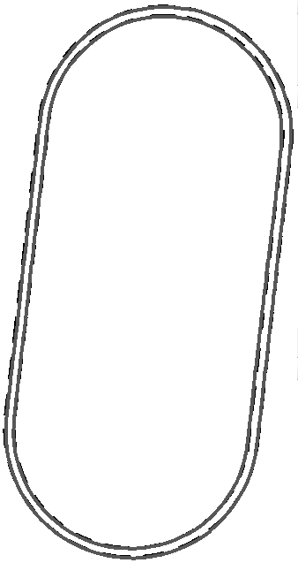
Results
Tracking Algorithm

Slide 42
Results
PATS Baseline Solution
Static Baselines
  Co-located: CORRECT peak determined after 382 seconds
  5-cm Separation: CORRECT peak determined after 367 seconds
  9-ft Separation: CORRECT peak determined after 200 Seconds
  380-ft Separation: CORRECT peak determined after 167 Seconds
  Peak lock never lost after correct determination
Low-Dynamic Kinematic Baselines
  9-ft Separation with Varying Direction Vector: SOMETIMES CORRECT peak determined (~60 seconds)
  Varying Baseline Separation from 0 to 184 feet: CORRECT peak determined after <60 Seconds
High-Dynamic Kinematic Baselines
  Initial baseline determination TBD
  Speed of reacquisition after loss of lock TBD
Notes:
Note that these times are for the initial baseline determination
After loss of lock, system falls back on tracking results as shown in video (still very accurate)
Minimizes search space upon satellite lock reacquisition

Slide 43
Results
PATS Baseline Solution
Interpretation of results
If a correct peak lock is acquired and never lost, we have achieved the highest level of precision possible as dictated by the accuracy of the receiver’s measurement mechanics
  For the μBlox receivers used, this equates to ~1-2cm of precision
Increased precision could be achieved via a network-wide correction step, following directly from the results described here
Relative motion is highly beneficial to speeding up determination of the correct baseline peak
  This should scale with increasing relative velocities
The accuracies indicated here are based on 3D baselines
  The vertical component of GPS-based localization techniques is historically less accurate than the horizontal components

Slide 44
Future Work
Success of initial peak identification is highly dependent on the search cube size and location
  Determine better initial baseline estimates before carrying out search
  Develop “smarter” peak searching algorithm for faster execution and larger search space sizes
Increase robustness of technique in difficult GPS environments such as highly-dense tree cover and urban canyons

Slide 45
Institute for Software Integrated Systems
Vanderbilt University
Questions?
“Precise Relative Localization and Tracking of Low-Cost GPS Nodes”
Supported by a Google Research Award, the National Science Foundation, and DARPA
Will Hedgecock
Ph.D. Candidate
Akos Ledeczi
Associate Professor
Google, December 10, 2013

