Slide 1

Centimeter-Scale Relative Node Localization Using Low-Cost, Single-Frequency GPS Receivers
Vanderbilt University
Department of Electrical Engineering
Qualifying Exam Presentation
Will Hedgecock
Thursday, November 15, 2012

Slide 2
Outline
GPS Overview
Measurement Observables
Sources of Error
Observation Models
Point Positioning
Relative Positioning
Extended Methods
Ph.D. Proposal
Future Work
Conclusion

Slide 3
GPS Overview
Brief History
Satellite-based, one-way radio navigation system commissioned in 1973[1]
  Fully operational on April 27, 1995
Controlled by the US Department of Defense and operated by the US Air Force
Originally planned for continuous, worldwide military use
  Civilian access restricted to lower precision by Selective Availability (SA)
  Generated significant research involving methods of overcoming correlated errors to increase accuracy
Accuracy has continued to improve with additional signal frequencies, the removal of SA in 2000, and expansion of the satellite constellation to 31 active satellites

Slide 4
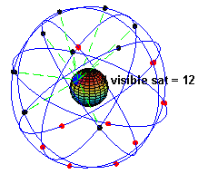

GPS Overview
System Segments
Space Segment
  11 hour, 58 minute orbital period
  ~20,000 km above surface of Earth
Control Segment
  Keeps satellites functioning correctly and produces the navigation messages transmitted by each satellite
User Segment
  Includes all GPS receiver hardware
Notes:
-GPS system is divided into 3 separate segments
-Space, orbit is one sidereal day which means the satellites cross the same path relative to the stars, same time crossing big dipper every night
-Navigation messages responsible for informing us how to figure out the positions of the satellites at any given time and correct for any satellite-based clock biases

Slide 5
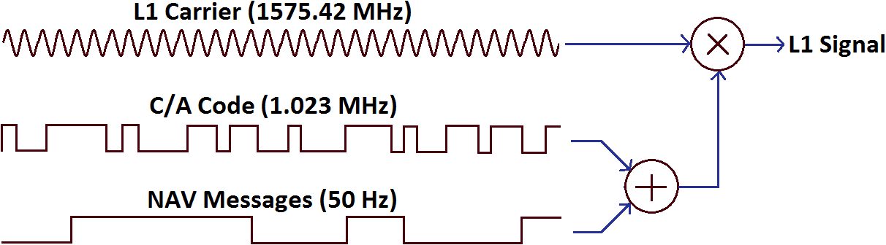
GPS Overview
Signal Composition
Originally consisted of identical messages transmitted on 2 different frequencies (L1/L2)
Each signal comprises 3 components:
  Carrier sine wave
  Pre-defined Pseudorandom Noise (PRN) code, specific to that satellite
  Navigation message with information pertaining to that satellite
Navigation message is encoded on top of the PRN code using a modulo-2 adder
Resulting bits are used to modulate the carrier wave using Binary Phase Shift Keying (BPSK)

Slide 6
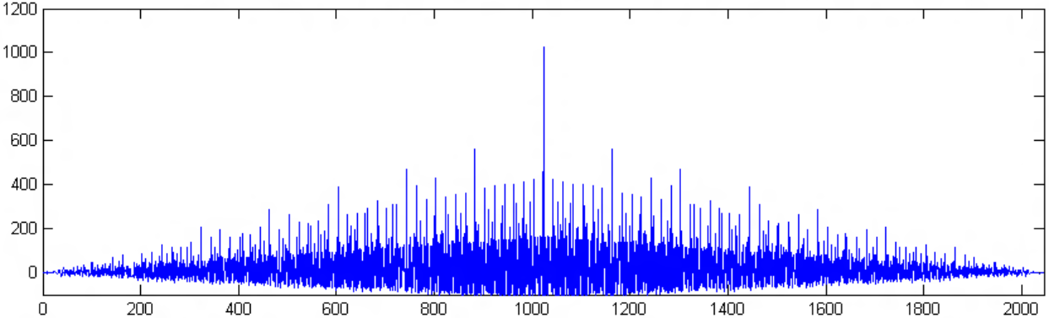
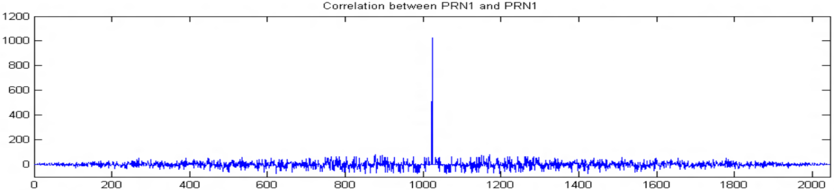
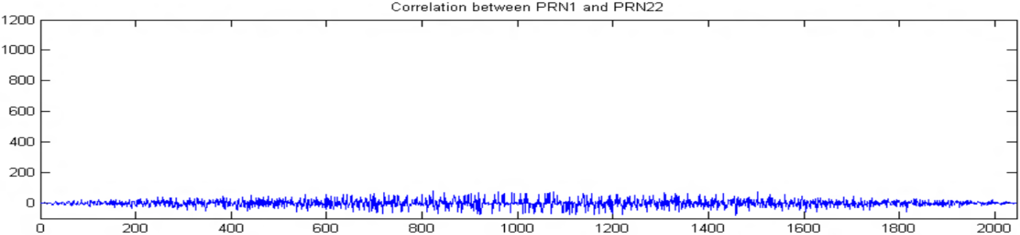
GPS Overview
Signal Composition
Non-Gold code Autocorrelation Results[4]
PRN codes form basis of satellite ranging process
1,023 bit long sequences repeated every millisecond[2]
  Carefully chosen “Gold codes” which have extremely small cross-correlation profiles within the set
Gold codes have the property that they are 1 when properly auto-correlated to within 1 bit and approximately 0 otherwise
Gold code Autocorrelation Results
Gold code Cross-Correlation Results
Notes:
Correlation is carried out by adding +1 for every matching bit in a 1,023 bit window and a -1 for every different bit, then dividing by 1,023
Not normalized results (not divided by window length)
PRN codes have the effect of “spreading” the satellite data over a wider frequency range[5]
BPSK of a 1.023 MHz signal on a 1575.42 MHz carrier results in 1575.42 ± 1.023 MHz = 2.046 MHz centered on the L1 carrier frequency
Spreading allows for Code Division Multiple Access via Direct Sequence Spread Spectrum modulation of the carrier signal
Signal reconstruction via reversing the operations used to create the composite signal
Carrier wipe-off, code wipe-off, navigation signal
Properties: Spectrally flat, resistant to jamming, low signal-to-noise level hampers interception, useful for timing determination

Slide 7
GPS Overview
Satellite Augmentation Systems
Additional set of geostationary satellites that transmit satellite clock corrections as well as ionospheric delay estimates over predefined geographic regions[6]
Can also be used as additional GPS ranging satellites, since they transmit their own PRN codes
Wide Area Augmentation System (WAAS) in the United States
  Satellite positions are less precisely known but are almost geostationary, so we can use their Doppler information to our advantage

Slide 8
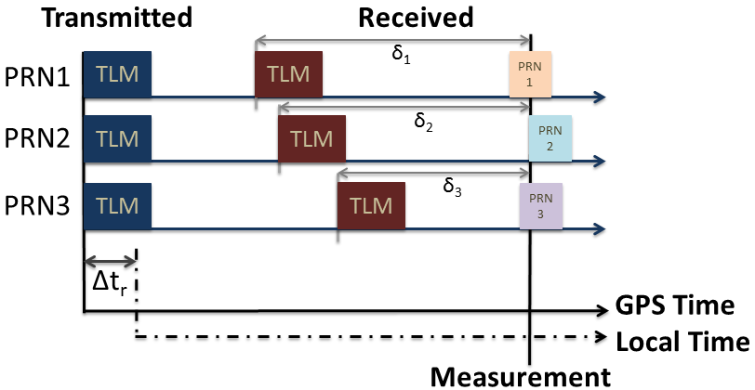
Measurement Observables
Pseudorange
Manufactured from the Time-of-Flight of the radio signal times the speed of light[7]
  Requires clock synchronization to GPS time to better than 1 ms
Time-of-Flight is determined based on the amount of shift required to align (correlate) an internally-generated PRN sequence to the same received PRN sequence
“Pseudo” due to the local receiver’s clock offset from GPS time

Slide 9
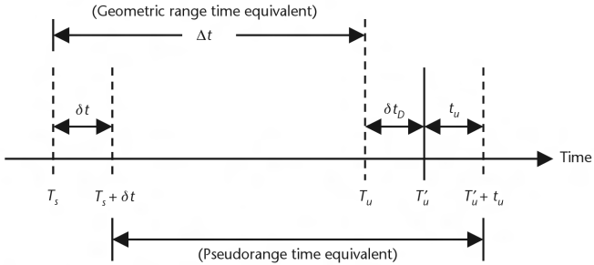
Measurement Observables
Pseudorange
[8]

Slide 10
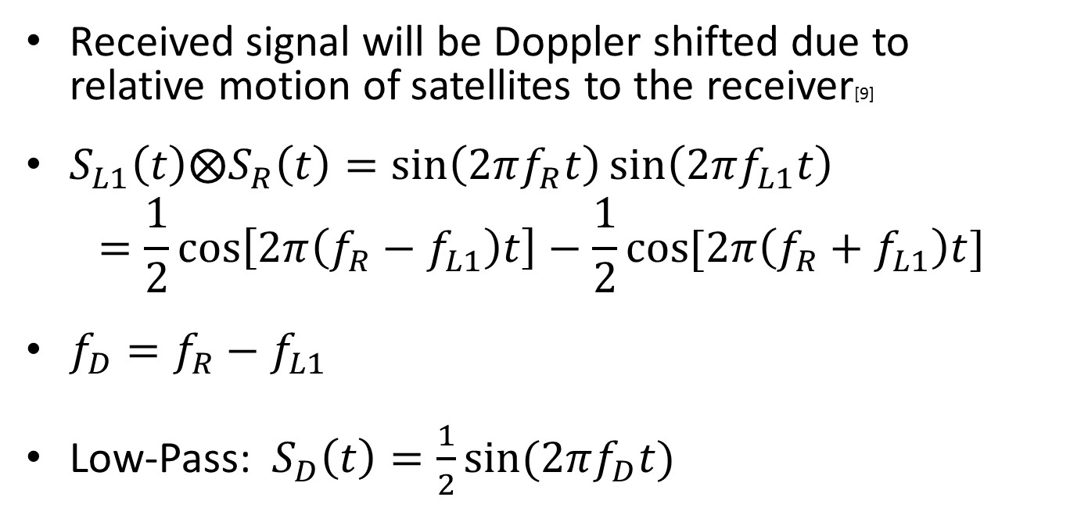
Measurement Observables
Doppler Shift
Received signal will be Doppler shifted due to relative motion of satellites to the receiver[9]
$S_{L1}\left(t\right)⨂S_{R}\left(t\right)=\sin\left(2πf_{R}t\right)\sin\left(2πf_{L1}t\right)$
$=\frac{1}{2}\cos\left[2π\left(f_{R}−f_{L1}\right)t\right]−\frac{1}{2}\cos{[2π\left(f_{R}+f_{L1}\right)t]}$
$f_{D}=f_{R}−f_{L1}$
Low-Pass: $S_{D}\left(t\right)=\frac{1}{2}\sin{(2πf_{D}t)}$

Slide 11
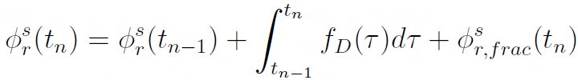
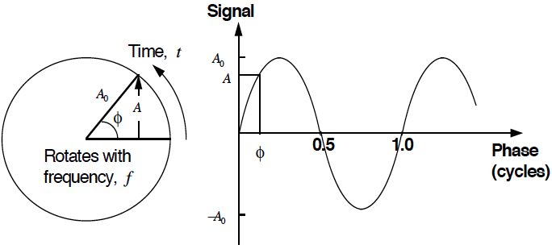
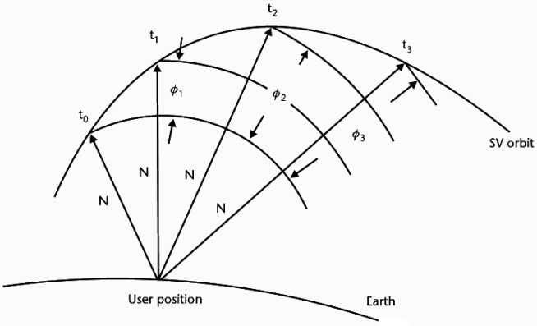
Measurement Observables
Carrier Phase
Formed from the integration of the beat signal described in the previous slide over the measurement interval[3]
  Simple counter set to 0 at initialization and incremented by 1 for every positive zero crossing of the beat signal
Formation modeled by:
Carrier Range Concept

Slide 12
Sources of Error
Several sources of error affect the propagation time of the radio signal from satellite to receiver
  Satellite clock bias
  Receiver clock bias
  Satellite Orbital Errors
  Tropospheric Delay
  Ionospheric Delay
    Ionospheric Divergence
  Relativistic Effects
  Antenna Phase Center Offsets
  Multipath
  Carrier Cycle Slips
  Receiver Measurement Noise

Slide 13
Observation Models
Equations
Pseudorange
Carrier Range
Doppler Shift

Slide 14
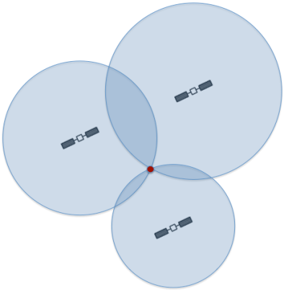
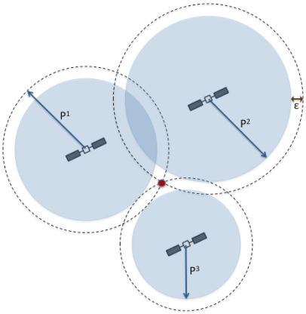
Point Positioning
Least Squares Positioning
Trilateration
Trilateration
with Error
Due to the error sources previously described, the spheres of possibility will not intersect at one and only one point
With >3 satellites, we have an over-determined system of non-linear equations
In such cases, the optimal solution can be found using a least squares optimization routine
  In this case, we are optimizing the amount of residual error between the measurement observables and the calculated observables given a set of coordinate parameters
  We include receiver clock error as an estimable parameter because it introduces uniform error into all observations for a given epoch

Slide 15
Point Positioning
Differential/Augmented GPS
Both are differential techniques: DGPS is ground-based, A-GPS is satellite-based[10]
A reference receiver with a known location is able to measure the error in its received signal by comparing the signal to its ideal
Receivers in the vicinity can correct their received observations based on any set of correction values estimated and transmitted by the reference node
  This is limited to “short-baseline” situations
  This only removes satellite-side errors

Slide 16






Relative Positioning
Differencing Operations
The main idea involves performing linear mathematical operations on similar observations from two or more different receivers to remove correlated errors
  Single-Difference: Observation difference to satellite s between receivers j and k
  Double-Difference: Difference of single-differences to satellites m and n
  Triple-Difference: Difference of double-differences between two consecutive epochs
$ρ_{r}^{s}=$ Range between r and s
$τ_{r}=$ Receiver r clock bias
$M_{r}^{s}=$ Multipath between r and s
$B_{r}^{s}=$ Ambiguity between r and s
$ε_{L}=$ Receiver noise
$L_{r}^{s}=$ Carrier range observable

Slide 17
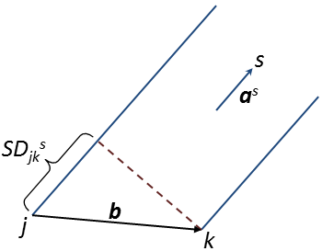
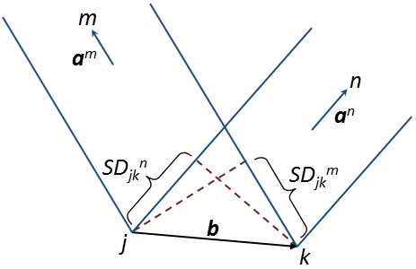
Relative Positioning
Differential/Real-Time Kinematic GPS
Differential techniques involve computing a baseline vector between a known reference receiver and a roving receiver[8]
  Usually uses the pseudorange as the primary observable
  Single-Difference Example:
  Double-Difference Example:

Slide 18
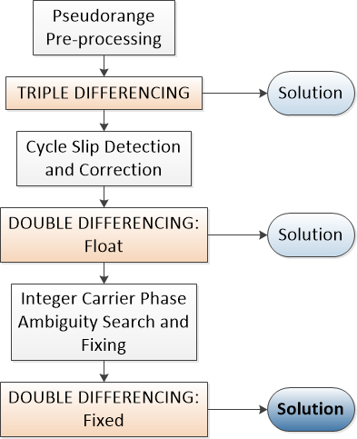
Relative Positioning
Differential/Real-Time Kinematic GPS
Real-Time Kinematic (RTK) techniques are usually more continuous and involve a calibration phase by which carrier phase ambiguities can be resolved[11]
  Usually uses the carrier phase as the primary observable

Slide 19
Extended Methods
Error Modeling
Some error sources cannot be removed by simple differencing techniques
  Antenna phase center offset
  Multipath
  Receiver Noise
Some antenna manufacturers have attempted to characterize their average antenna phase biases
Significant research has been carried out on multipath characterization
  Wavelets
Receiver noise can be modeled as different colors

Slide 20
Extended Methods
Carrier Phase Ambiguity Resolution
Carrier phase measurements are much less susceptible to “unmodelable errors” such as multipath and receiver noise[8]
Use of this observable greatly increases achievable precision
Significant research has gone into ambiguity resolution methods[12]
  Decorrelation methods (LAMBDA)
  Ambiguity Function Method (AFM), Fast Ambiguity Resolution Approach (FARA), Least Squares Ambiguity Search Technique
Enables transition from float to fixed solutions
  After resolution, observation fixing is remarkably simple: add the carrier ambiguities to the carrier phase observations and solve

Slide 21
Ph.D. Proposal
Purpose:
Use GPS satellites to provide centimeter-scale accuracy in the relative localization of networked sensor nodes
A different use case for the GPS signals and observables as outlined in this presentation and in the Area Paper.

Slide 22
Ph.D. Proposal
Motivation:
The use of GPS in mobile deployments, such as automated driving of cars, formation flying of unmanned air vehicles, or the localization of sensor nodes, where high-accuracy relative coordinates are needed is impractical with the current state of the art in GPS technology
Low-cost receivers exhibit large errors on the order of tens of meters
High-accuracy devices are prohibitively expensive, reaching into the thousands for survey-grade equipment
Most precision applications require lengthy calibration and data collection times before achieving their desired accuracy
  Not ideal for real-time deployments or impromptu setups
Existing solutions require reference stations or hubs and cannot operate in a truly distributed sense
Research will comprise at least five distinct contributions to GPS localization, as follows.

Slide 23
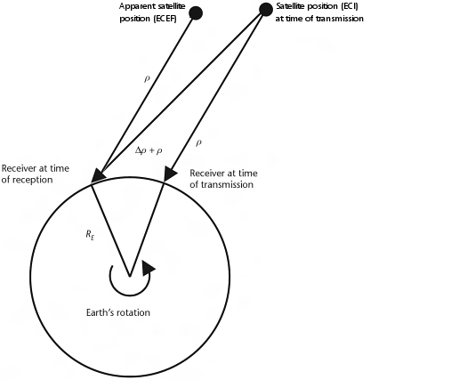
Ph.D. Proposal
Contribution #1
Contribute to the accepted GPS observable models by further characterizing previously unexplored or ignored sources of error
Notable sources of unaccounted error in the relative case due to the Sagnac Effect and its corresponding corrections

Slide 24
Ph.D. Proposal
Contribution #1

Slide 25
Ph.D. Proposal
Contribution #1

Slide 26
Ph.D. Proposal
Contribution #1

Slide 27
Ph.D. Proposal
Contribution #1

Slide 28
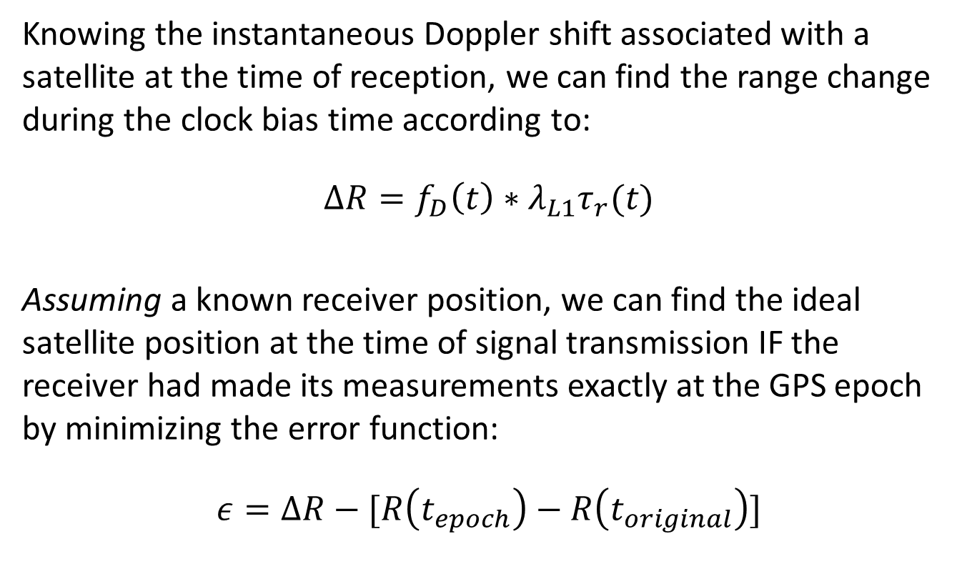
Ph.D. Proposal
Contribution #1
Knowing the instantaneous Doppler shift associated with a satellite at the time of reception, we can find the range change during the clock bias time according to:
$$ΔR=f_{D}\left(t\right)∗λ_{L1}τ_{r}(t)$$
Assuming a known receiver position, we can find the ideal satellite position at the time of signal transmission IF the receiver had made its measurements exactly at the GPS epoch by minimizing the error function:
$$ε=ΔR−[R\left(t_{epoch}\right)−R\left(t_{original}\right)]$$

Slide 29
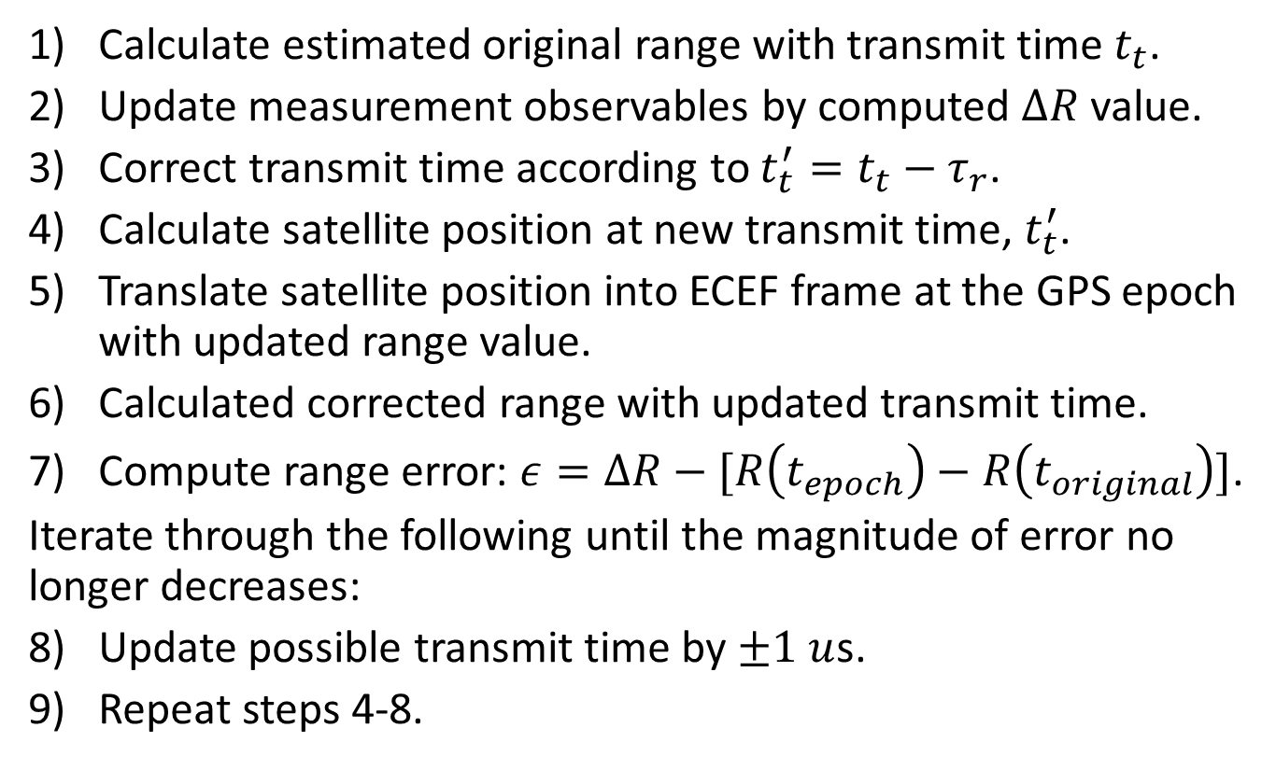
Ph.D. Proposal
Contribution #1
Calculate estimated original range with transmit time $t_{t}$.
Update measurement observables by computed $ΔR$ value.
Correct transmit time according to $t_{t}^{′}=t_{t}−τ_{r}$.
Calculate satellite position at new transmit time, $t_{t}^{′}$.
Translate satellite position into ECEF frame at the GPS epoch with updated range value.
Calculated corrected range with updated transmit time.
Compute range error: $ε=ΔR−[R\left(t_{epoch}\right)−R\left(t_{original}\right)]$.
Iterate through the following until the magnitude of error no longer decreases:
Update possible transmit time by $±1 u$s.
Repeat steps 4-8.

Slide 30
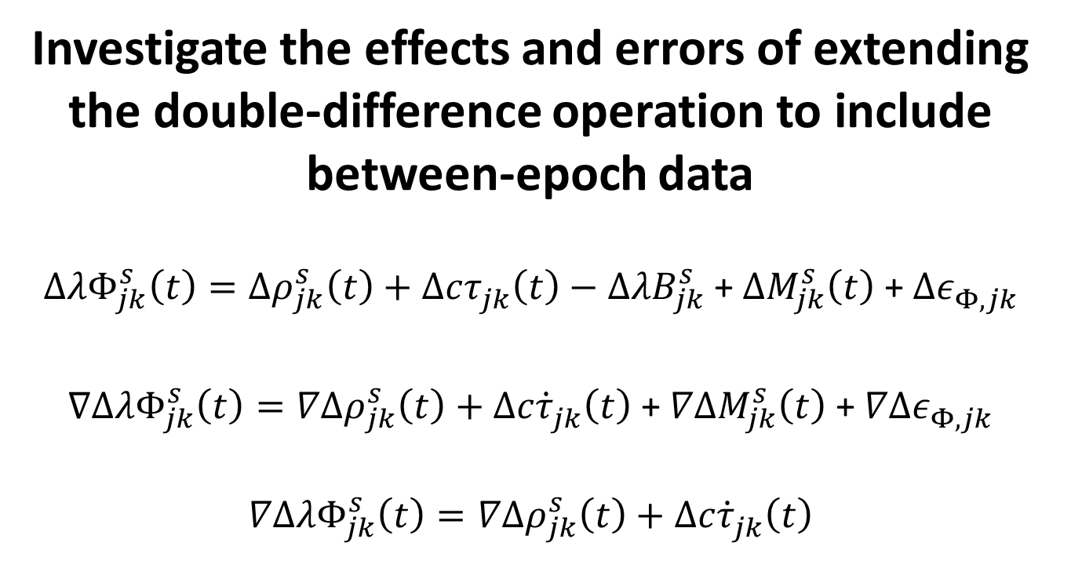
Ph.D. Proposal
Contribution #2
Investigate the effects and errors of extending the double-difference operation to include between-epoch data
$ΔλΦ_{jk}^{s}\left(t\right)=Δρ_{jk}^{s}\left(t\right)+Δcτ_{jk}^{}\left(t\right)−ΔλB_{jk}^{s}$ +$ΔM_{jk}^{s}\left(t\right)$ +$Δε_{Φ,jk}^{}$
$∇ΔλΦ_{jk}^{s}\left(t\right)=∇Δρ_{jk}^{s}\left(t\right)+Δc{\dot{τ}}_{jk}^{}\left(t\right)$ + $∇ΔM_{jk}^{s}\left(t\right)$ +$∇Δε_{Φ,jk}^{}$
$$∇ΔλΦ_{jk}^{s}\left(t\right)=∇Δρ_{jk}^{s}\left(t\right)+Δc{\dot{τ}}_{jk}^{}\left(t\right)$$

Slide 31
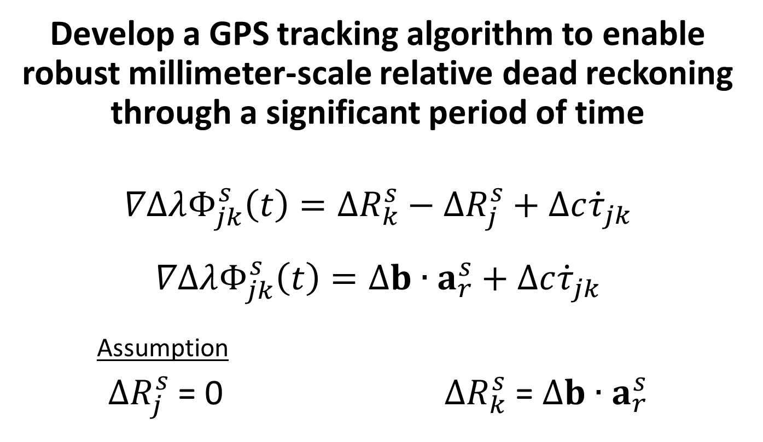
Ph.D. Proposal
Contribution #3
Develop a GPS tracking algorithm to enable robust millimeter-scale relative dead reckoning through a significant period of time
$$∇ΔλΦ_{jk}^{s}\left(t\right)=ΔR_{k}^{s}−ΔR_{j}^{s}+Δc{\dot{τ}}_{jk}$$
$$∇ΔλΦ_{jk}^{s}\left(t\right)=Δb∙a_{r}^{s}+Δc{\dot{τ}}_{jk}$$
Assumption
$ΔR_{j}^{s}$ = 0 $ΔR_{k}^{s}$ = $Δb∙a_{r}^{s}$

Slide 32
Ph.D. Proposal
Contribution #4
Extend or modify the LAMBDA method to rapidly solve for double-differenced integer ambiguities for receivers in motion and without known positions on the fly
Results from tracking algorithm will allow for baseline calculation to collapse to the stationary case
Multiple epochs of data will provide much needed GPS satellite constellation changes for the removal of unlikely ambiguity sets
This combination should enable rapid on-the-fly (OTF) ambiguity resolution, as well as verification

Slide 33
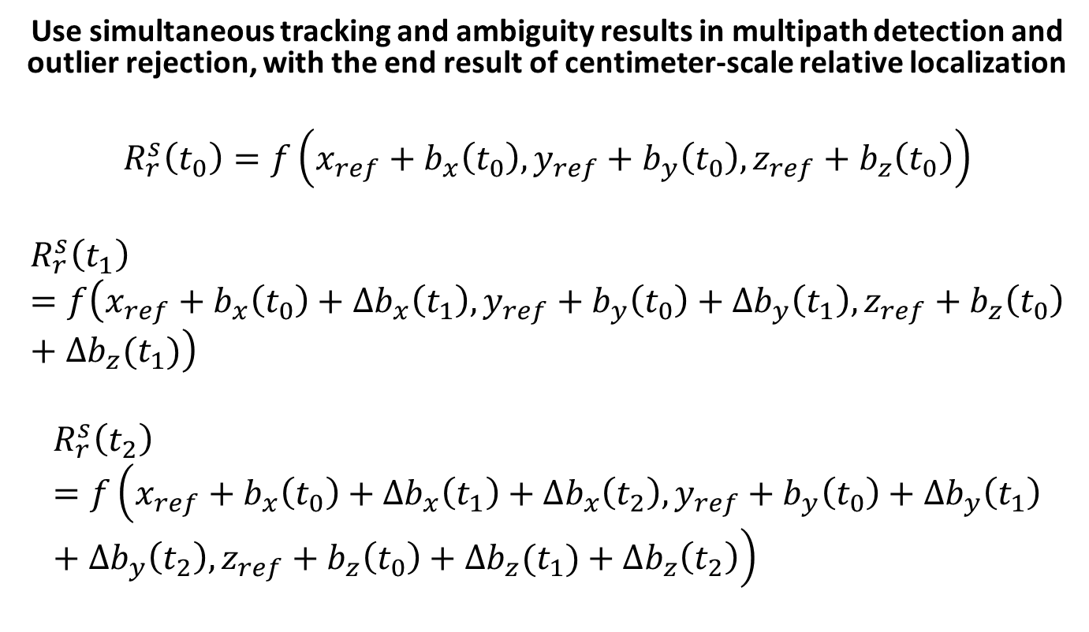
Ph.D. Proposal
Contribution #5
  Use simultaneous tracking and ambiguity results in multipath detection and outlier rejection, with the end result of centimeter-scale relative localization
$$R_{r}^{s}\left(t_{0}\right)=f\left(x_{ref}+b_{x}\left(t_{0}\right),y_{ref}+b_{y}\left(t_{0}\right),z_{ref}+b_{z}\left(t_{0}\right)\right)$$
$$R_{r}^{s}\left(t_{1}\right)=f\left(x_{ref}+b_{x}\left(t_{0}\right)+Δb_{x}\left(t_{1}\right),y_{ref}+b_{y}\left(t_{0}\right)+Δb_{y}\left(t_{1}\right),z_{ref}+b_{z}\left(t_{0}\right)+Δb_{z}(t_{1})\right)$$
$$R_{r}^{s}\left(t_{2}\right)=f\left(x_{ref}+b_{x}\left(t_{0}\right)+Δb_{x}\left(t_{1}\right)+Δb_{x}\left(t_{2}\right),y_{ref}+b_{y}\left(t_{0}\right)+Δb_{y}\left(t_{1}\right)+Δb_{y}\left(t_{2}\right),z_{ref}+b_{z}\left(t_{0}\right)+Δb_{z}(t_{1})+Δb_{z}\left(t_{2}\right)\right)$$

Slide 34
Future Work
Extension of successful methodology to include cooperative network adjustments for both increased precision and faster ambiguity resolution

Slide 35
Conclusions
Overarching goal is to dramatically increase the precision of relative localization using only low-cost, single-frequency GPS receivers
System design to enable real-time results without calibration, stationary requirements, or post-facto analysis
Extend the applicability of GPS as a high-precision localization resource to time-, power-, and resource-constrained applications such as impromptu surveying, unmanned vehicle coordination, or wireless sensor network localization

Slide 36
References
[1] Bradford W. Parkinson. GPS Eyewitness: The Early Years. GPS World 5, pages 32-45, September 1994.
[2] U.S. Department of Homeland Security. NAVSTAR GPS User Equipment Introduction, September 1996.
[3] Geoffrey Blewitt. Basics of the GPS Technique: Observation Equations. Geodetic Applications of GPS, 1997.
[4] Darren Sessions. GPS Tutorial #2: Signals and Messages. Available at http://www.kemt.fei.tuke.sk/predmety/KEMT559_SK/ GPS/GPS_Tutorial_2.pdf
[5] Maxim Integrated Products. An introduction to spread-spectrum communications. Application Note 1890 (AN1890), February 2003.
[6] U.S. Department of Transportation Federal Aviation Administration. Specification for the Wide Area Augmentation System (WAAS). 2892bC2a.DOC, DTFA01-96-C-00025 Modification 0011, FAA-E-2892b Change 1, August 2001.

Slide 37
References
[7] Marco Rao and Gianluca Falco. Code tracking and pseudoranges. GNSS Solutions – Inside GNSS: Engineering Solutions from the Global Navigation System Community, January/February 2012. Available at http://www.insidegnss.com/node/2898.
[8] Elliott D. Kaplan and Christopher J. Hegarty. Understanding GPS: Principles and Applications. Artech House, Inc. Norwood, MA, USA. Second Edition, 2006.
[9] Darius Plausinaitis. GPS Signal Acquisition. GPS Signals and Receiver Technology MM11, Danish GPS Center, Aalborg University, Denmartk, 2009.
[10] NASA Jet Propulsion Laboratory. The NASA Global Differential GPS System. NASA, September 2009, Available at: http://www.gdgps.net/system-desc/index.html
[11] Chris Rizos. Principles and practice of GPS surveying. The University of New South Wales, Sydney, Australia, May 2000. Available at: http://www.gmat.unsw.edu.au/snap/gps/gps_survey/principles_gps.htm
[12] Peter J. G. Teunissen. Least-squares estimation of the integer GPS ambiguities. In IAG General Meeting, Section IV – Theory and Methodology, Beijing, China, 1993.

Slide 38
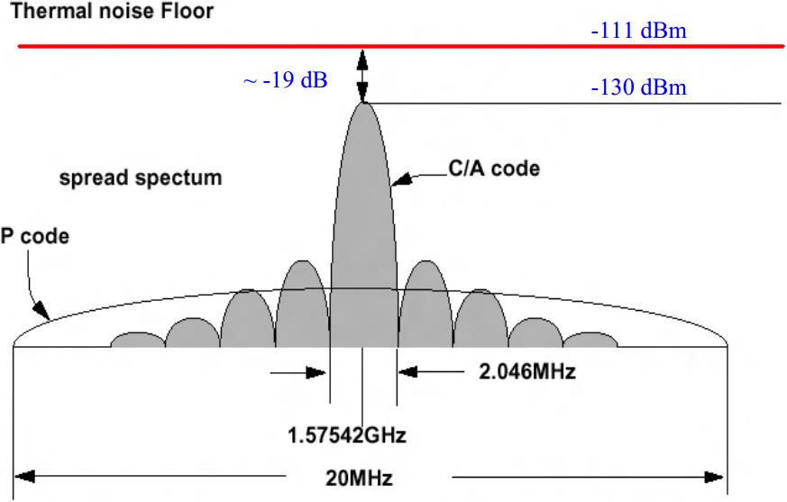
GPS Overview
Signal Composition
[4]

Slide 39
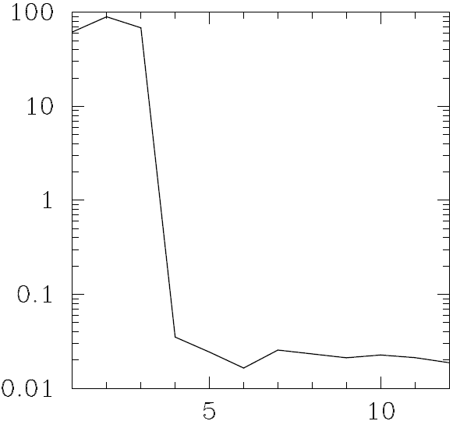
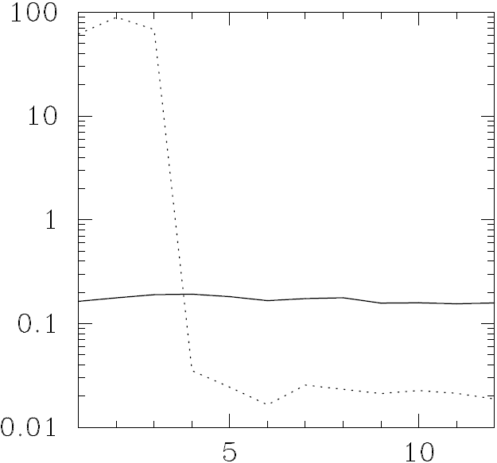
Ph.D. Proposal
Contribution #4

Slide 40
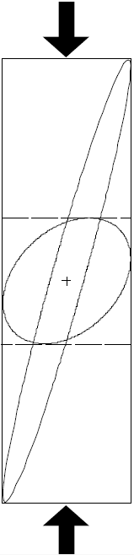
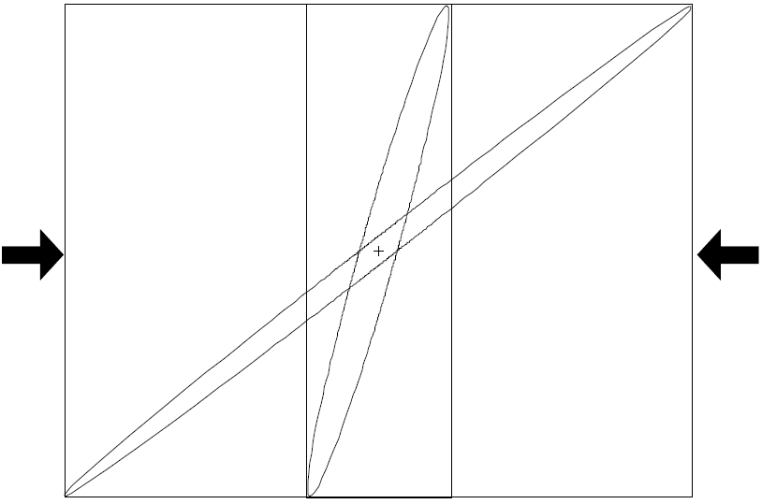
Ph.D. Proposal
Contribution #4

Slide 41
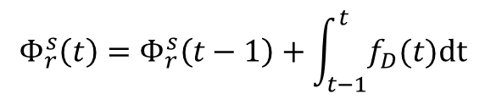
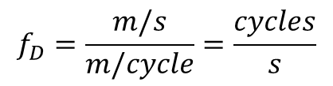
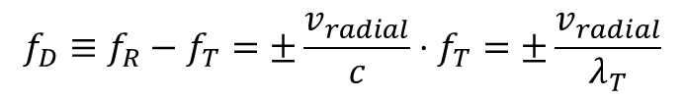

For Miklos
Doppler Shift/Carrier Phase
When $∥v^{s}−v_{r}∥ ≪c$: $f_{R}=\left\{\begin{aligned}\left(1+\frac{v_{radial}}{c}\right)⋅f_{T} if moving toward \\ \left(1−\frac{v_{radial}}{c}\right)⋅f_{T} if moving away\end{aligned}\right.$
$$f_{D}≡f_{R}−f_{T}=±\frac{v_{radial}}{c}⋅f_{T}=±\frac{v_{radial}}{λ_{T}}$$
$$f_{D}=\frac{m/s}{m/cycle}=\frac{cycles}{s}$$
$$Φ_{r}^{s}\left(t\right)=Φ_{r}^{s}\left(t−1\right)+\int_{t−1}^{t}{f_{D}(t)dt}$$

