Slide 1

Mobile Air Quality Monitoring and Web-Based Visualization
Vanderbilt University
Department of Electrical Engineering
Thesis Presentation
Will Hedgecock
Wednesday, December 2, 2009

Slide 2
Outline
Motivation and Background
Hardware Architecture
System Architecture
Communications Methods
Dynamic Calibration
Model Reconstruction
GPS Smoothing Algorithm
Web-Based Visualization Client
Data Retrieval Methods
Future and Related Works
Conclusion

Slide 3
Motivation
Air Pollution is one of the leading causes of respiratory health problems in the world
Over 50% of world population is “urban”[1]
In U.S., there are only 5,000 total active sensing stations run by the EPA covering 3.8 million square miles[2]
Pollution is highly location-dependent as well as time-specific
  Characterized by a single Air Quality Index (AQI) value for an entire sensing region over 1 day[3]
Notes:
-Project motivated by and addresses a need to rememdy the global problem of air pollution
-Actual figure is 50.6% according to UN Population Division, thus up to cities to take initiative to start working to decrease pollution
-Need for this project due to fact that pollution information is very sparse, inaccurate, and low-resolution
-In order to really start fixing the problem, we need to know more about it

Slide 4
Background
Desire to create a mobile network of monitors such that a high-resolution picture of air pollution for any location is available at any given time
Continuation of work started in 2007 based on a Microsoft Research grant
Feasibility of the approach was demonstrated and 5 actual prototype sensors were designed and manufactured*
  Measured CO, NO2, and O3,
  as well as air temperature and
  relative humidity
*P. Volgyesi, A. Nadas, X. Koutsoukos, and A. Ledeczi. Air quality
monitoring with sensormap. IPSN, pages 529–530, 2008.

Slide 5
Hardware Architecture
Three sensing modalities
Detects motion (used for power consumption)
Stores up to 6 hours 50 minutes of data
Provides power and charges battery
Used in data transmission
Provides location information
(at 1Hz)
Notes:
-Battery life only a few hours, but when mounted on vehicle, not a limiting factor
-Flash is 16 Mbits
-GPS is 20-channel
-Explain LCD
-Explain microcontroller (including flash storage and USB protocol)

Slide 6
Sensor Node Improvements
2 Problems:
  1) Noisy Power Supply Grid when LCD circuitry is functioning
    Due to charge pump increasing +3.3V power supply to +5V for LCD
    Minimized by connecting an additional 2.2µF bypass capacitor at source (totalling 12.2µF capacitance)
  2) Inability to hold GPS lock when LCD circuitry is functioning
    Due to excessive electromagnetic interference from LCD inhibiting stabile communication links with satellites
    Overcome by purchasing external antennae for GPS units
Notes:
-First was discovered due to the second one
-Antennae positioned far away from GPS so that the interference is minimized…works for the prototypes, but need to find a more robust GPS solution for future models which have better shielding and are more resistant to electromagnetic interference

Slide 7
Firmware
Written in C using Small Device C Compiler (SDCC)
Synchronously coordinates responsibilities of the node including polling gas sensors and communicating with base stations over Bluetooth or USB
  Operates a software-defined frequency of 0.833Hz
  Polls Sensors, reads temperature and humidity, updates status of battery, GPS lock, and USB, stores information to Flash memory, and sends over USB or Bluetooth if applicable
  Includes watchdog timer to prevent lockup
Notes:
-SDCC is open-source and free – able to publish our code under GNU Public License which is good for letting other researchers and developers use it and improve upon it as well as design upgrades and plug-ins for the system
-0.833Hz is 1 cycle every 1.2 seconds
-Watchdog timer forces interrupt every 10 seconds if not reset, does not overwrite memory contents

Slide 8
Firmware (continued)
Recognizes when unit is not in motion and turns off power-hungry components
  A counter is set to 60 every time the accelerometer detects motion; when counter reaches 0 (72 seconds), node is deemed stationary
Stores pollution data and is responsible for retrieving it later
  98 bytes per sample
  4,095 usable memory pages of 512 bytes each
  Total of 20,475 samples able to be stored which is approximately 6 hours and 50 minutes
Notes:
-Motion detected by MEMS accelorometer, turns off GPS, Bluetooth, and LCD
-Talk about GPS warm-start so turning off it okay if stopped
-Talk about Flash memory

Slide 9
System Architecture
In addition to mobile nodes, system also includes clients, a server cloud, and external data sources
Operation is as follows:
  Node data arrives at server with sensor information, geographic location, a timestamp, and the node ID
  Packets are decomposed into a time-ordered stream for each modality
  GPS readings are abstracted to <location, duration> pairs
  Data from all sensor platforms are combined into virtual sensors whose spatial and temporal sampling rate is equal to the sum of the constituent parts
  Finally, discrete measurements from all sensors are used to reconstruct an overall pollution function for a given location
Notes:
-External sources include Weather information, traffic information, and data from 5,000 EPA sensors
-In decomposition, suspicious or duplicate readings can be removed or flagged

Slide 10
Sensor Node Communication
Future node iterations will replace the Bluetooth module with a GSM modem
Four modes of communication between the sensor nodes and the server:
  1) Periodic Upload: The node uploads all data stored since the last upload event
  2) Triggered Push: Some external event causes the node to immediately transmit its data
  3) Triggered Pull: Server actively requests data from sensor upon some external event
  4) Periodic Status Update: Location, amount of data collected, and sensor status
Notes:
-Periodic Upload: based on the node’s resource capabilities (battery life, memory size) and can be dynamically adjusted based on needs or application
-Triggered Push: gas concentrations rising above some threshold level, enables real-time alerts of potentially hazardous situations
-Triggered Pull: For instance a severe weather alert, also used extensively in web-based visualization whenever a user desires to see the most up-to-date realtime or continuously streaming data for a given sensor
-Periodic Status:

Slide 11
Server Implementation
Will be implemented as a server cloud with access based on geographic location
  Increases robustness and fault tolerance while decreasing the bottleneck of many clients to one server
Database management handled by SQL Server 2008 with OpenGIS extensions[4]
Clustering useful in this application due to location-aware nature of the system
  Client access to specific servers is possible using IP Address geolocating services such as GeoLite City[5]
  Nodes have access to specific servers because their on-board GPS allows them to know where they are located and choose the closest server from a built-in database
Notes:
-OpenGIS is open-source database format allowing other users and developers to have a basic framework to use when interfacing with the system
-SQL Server achieves high performance through clustering
-GeoLite City by MaxMind

Slide 12
Server-Client Communication
Uses new open-source platform called APE (AJAX Push Engine)[6]
  Uses epoll-driven HTTP server written in C on top of Database Management software
  Only requires Javascript for client-side use
  Uses “push” technology to deliver desired information to “subscribed” clients
A single persistant connection to the APE server is required per client
GPS coordinate bounds of viewing area are used to subscribe the client to nodes and pollution information within those bounds
Since SQL Server is used as database framework (allows querying), users can subscribe to subsets of data, decreasing unnecessary network traffic even further
Notes:
-APE allows over 100,000 clients per server without delay
-Decreases network traffic from polling and unnecessary updates
-Only traffic due to important updates
-Single node update results in many client updates
-Subscribe to data or just node location information

Slide 13
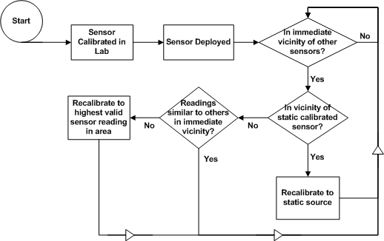
Dynamic Calibration
Notes:
-Area of huge amount of ongoing research in this project
-Currently, accurate calibration of gas sensors requires recalibrating very often with intensive accuracy checks
-Unlikely to happen initially, initially just relative, still useful for “Green Trip Planner” and model reconstruction
-Initially calibrate in lab, the keep calibrated to each other
-Later when enough nodes on network, calibrate to accurate external sensor data
-End goal of the above algorithm
-Most responsive sensor in group is best calibrated because they only get less responsive over time

Slide 14
Model Reconstruction[7]
Goal is to reconstruct a space-time signal from the irregular spatiotemporal samples available
Would like to find a nonlinear signal model consisting of a union of subspaces
  Reconstructions will be sparse in terms of representations within the model
  Reconstructed functions will be linear combinations of only a few basis or frame functions
  Transmission will be fast and cheap
Algorithm is still being developed
  Not necessary for the rest of the project research; thus, simply viewed in black-box form throughout the work
Notes:
-Very active area of research

Slide 15
GPS Smoothing
We have witnessed GPS location errors of up to 200 meters in testing
  Especially at low-speed or stationary situations
  Not acceptable in this application as we need a precise estimation of sensor location
Smoothing implemented via modified version of Cumulative Displacement Filter[8]
  Relies on assumption that the relative displacements between GPS readings are more accurate than the readings themselves
Our modifications take into account the fact that GPS accuracy increases with speed, and abrupt changes in location, azimuth, and speed are unlikely

Slide 16
GPS Smoothing (continued)
GPS data is stored such that positions can be estimated from past, present, and future readings
Filter works by projecting positions onto a linear regression built from the normalized sum of displacements from each position in the history to the next
Also disallows position
changes when the device is
thought to be stopped judging
from the accelerometer, speed
estimations from the GPS
receiver, and sporadic readings
Notes:
-when the speed of the device decreases past a certain threshold or upon detection of obvious outliers

Slide 17
Web Client Overview
Enables users to not only access raw data, but also visualize pollution functions in a manner similar to Weather Channel radar maps
Users can interact with map to retrieve various desired data
Several practical health-related applications are available
Targeted information can be obtained for specific geographic location at any time past or present
The implementation takes pains to account for the specific nature of the system to provide the most efficient, reliable, and robust interface possible

Slide 18
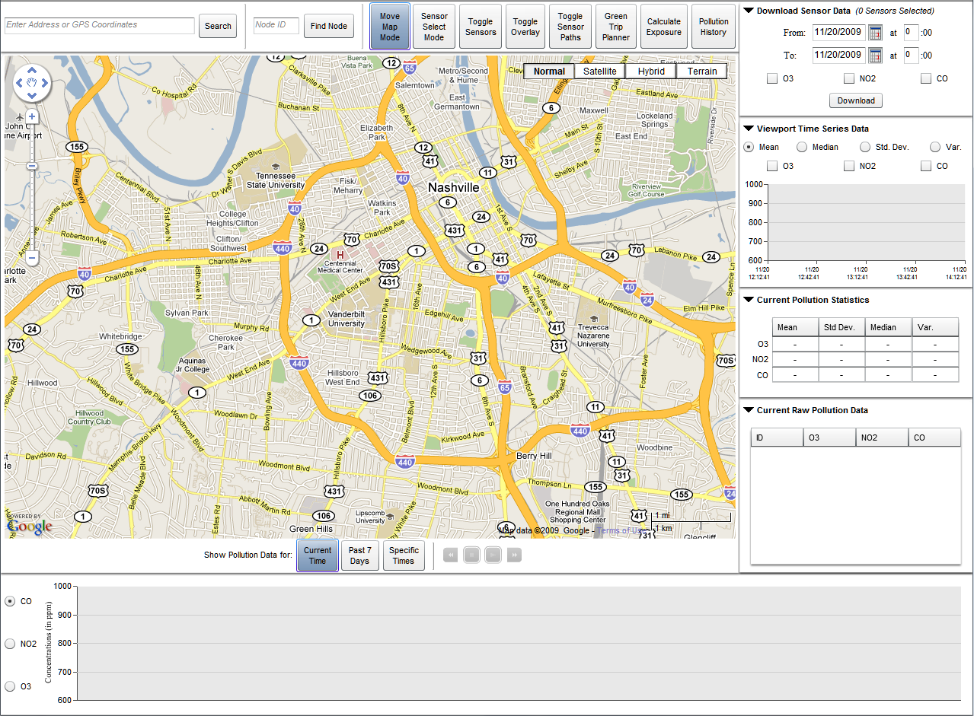
Map Functionality
Notes:
-Go to actual client, show different map types

Slide 19
Marker Clustering
Sensor Nodes displayed as customizable icons depending on type
Potentially hundreds to thousands of markers in viewport
  Looks cluttered / Impossible to choose between markers
  Bogs down the Google Maps system causing client-end delays
Solved via Marker Clustering
  Any markers within 20 pixels of each other are clustered into a single “cluster marker”
  All user events occurring on a cluster marker are simply forwarded to the contained single markers
Marker Clusterer also handles the displaying of markers system-wide
  Only adds markers currently visible in viewport
  Allows 1,000s of markers to show up without any noticeable delay to the user
Notes:
-Currently only have 2 types, mobile and static, customizable for future types allowing different companies/groups to denote different sensors
-Forwarding allows all functionality to be retained without rewriting code

Slide 20
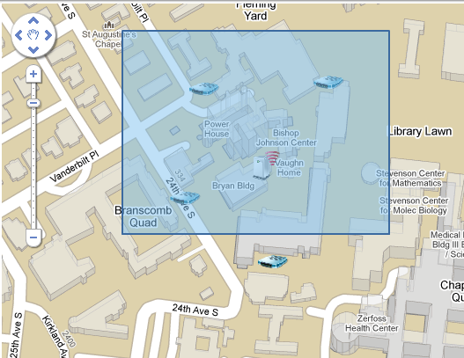
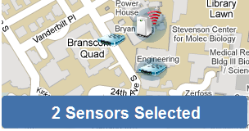
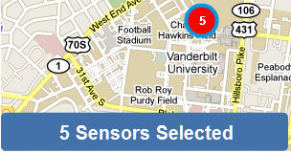
Sensor Selection
May be selected individually or as a group using two different modes
  Uses Marker Clusterer in addition to GPS coordinate bounds of viewport to determine what to select
  Informs user how many nodes have been selected

Slide 21
Sensor Data
Upon selection, various sensor data is available to the user in a collapsible side-panel
Historical data may be downloaded
  Returned as separate XML files for each node
Statistical time series may be viewed for the current viewport
  Mean, median, variance, or standard deviation over the past 2 hours
  Updates every 30 minutes or upon a viewport change
Current statistics are viewable for selected sensors
  Updates in realtime
Raw sensor data is displayed for selected sensors
  Also updates in realtime

Slide 22
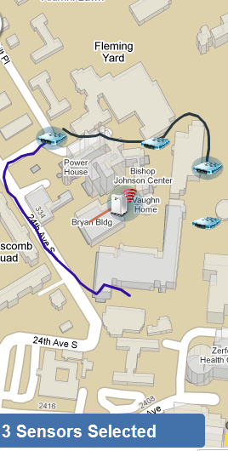
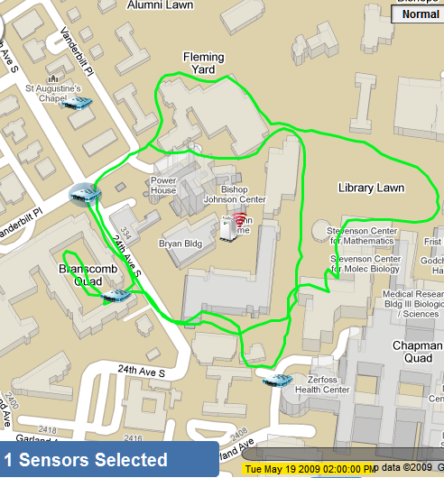
Visualization Overlays
Node Path Histories
  2 hour track of most recent
  GPS locations for the sensor
Pollution Overlays
  Similar to Weather Channel
  radar maps
  Different overlays for each
  sensing modality

Slide 23
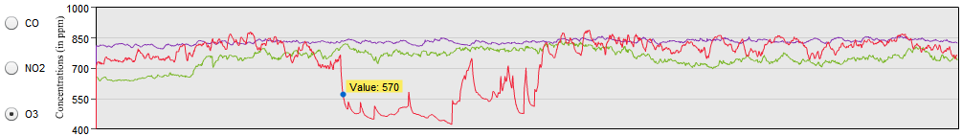
Realtime Data Graph
Two-hour history of raw data for each selected node (for specified modality)
Continuously updates in realtime
  Scrolls to the left such that the right-most point is always the most current value
You can view the actual data value by placing your cursor over the plot
Each of the aforementioned visualization modes uses the same underlying data as a basis; thus, it presents the same data in a variety of ways, making it very efficient without overwhelming the system, user, or the resources available

Slide 24
Data Retrieval Methods
Power and flexibility based on the ability of the system to retrieve not only current data, but any available past data
  Current 7-day history
  Range of past dates/times (maximum of 7 days)
Current realtime data retrieval uses a persistent connection to the APE server as discussed earlier
Histories use same underlying code base, but trick the system into thinking the current time is something other than it is
  Works exactly like current streaming data; it just ignorantly streams past data from the server
  Extremely efficient; does not require any code rewriting or significant data management

Slide 25
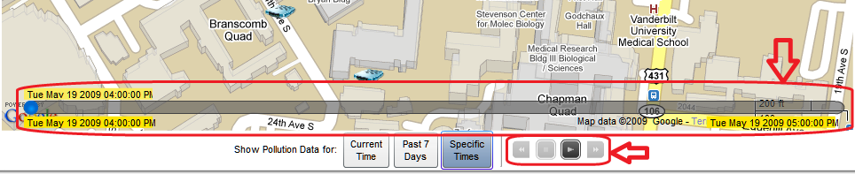
Data Retrieval Methods (cont.)
History modes create “video player”-like display and controls:
Users can “play” histories just like current data in realtime
  Can also speed up play times to see history in an accelerated fashion
  Can skip forward or back to specific dates/times

Slide 26
Data Retrieval Methods (cont.)
Only additionally stored data are the sensor locations for the duration of the history (for direct skipping in history)
Memory resources are conserved by only storing data for sensors visible in current viewport
  Exactly the same technique as the Marker Clusterer
All client functionality is retained in all modes with no sacrifice of speed or efficiency

Slide 27
Additional Applications
Green Trip Planner: Allows user to plan a route from source to destination based on the path of least exposure to a specified pollutant
  Planner uses current pollution model to define areas to avoid between the two locations
  Plans route using built-in Google Maps API taking care to avoid the specified locations
Directions displayed to user with track on map
  User can click to add locations they explicitly want to drive through
  Doing this replans the path using the new additions while trying to retain as little exposure to the pollutants as possible

Slide 28
Additional Applications (cont.)
Past Exposure Estimator: Allows user to estimate past exposure to a specified pollutant given only a single timed GPS track
  Useful for devices such as PDAs or phones with tracking capabilities
  GPS input must be in the form of a GPX formatted file
  Systems maps GPS coordinates to the pollution function at the given time to estimate exposure at each time instant
  Output is an XML file containing information for each GPS coordinate, a list of times when the user experienced pollution beyond some threshold, or average concentration levels over specified time intervals
Notes:
GPX = GPS eXchange Format – device-independent

Slide 29
Future Work
Replace Bluetooth module with integrated GSM/GPS solution
  Cheaper, reduces hardware complexity
  GSM coverage in most countries
Better gas sensors with less temperature-dependence and less loss of calibration upon power cycling
Add CO2, SO2, and PM2.5/PM10 sensors to node
Research and implement pollution reconstruction function
Implement actual dynamic calibration algorithm

Slide 30
Related Works
PEIR Project at UCLA[9]
  Uses cell phones to collect data
Common Sense Project at Intel[10]
Message Project in UK[11]
  Both similar to our approach; however, using different sensing technologies (cell phones, smart dust, static sensors, etc.)
  Our approach does not only collect data, but presents it to users in an intuitive and friendly manner, and it also uses the data for several applications which could have an impact on public health and practical uses in the day to day life of an average user
Notes:
-Cell phones have a tendency to be in people’s pockets and indoors, not great for this type of application
-Also we can have better and more complex sensors on a larger node (like PM)

Slide 31
Conclusions
Overarching goal is to dramatically increase resolution of air pollution information and its impact on public health
This system uses custom-built mobile sensing nodes in a geographically-networked fashion and provides an intuitive method of data retrieval using web-based visualization with a number of novel applications making use of the high-resolution data
Data is available in streaming realtime or as a continuous stream of historical data points
Practical applications use the high-resolution data to offer useful services to the public with the end-goal of having a positive impact on public health in a non-invasive, easy-to-use manner

Slide 32
References
[1] United Nations Population Division. World urbanization prospects: The 2007 revision population database, Sep 2009. Available at http://esa.un.org/unup/index.asp.
[2] Environmental Protection Agency. Air pollution data sources. Available at http://www.epa.gov/air/airpolldata.html, May 2009.
[3] Environmental Protection Agency. Air Quality Index (AQI) - A guide to air quality and your health. Available at http://www.airnow.gov/index.cfm?action=aqibasics.aqi, 2009.
[4] Inc. Open Geospatial Consortium. Opengis standards. Available at http://www.opengeospatial.org/standards, 2009.
[5] MaxMind. Geolite city. Available at http://www.maxmind.com/app/geolitecity, 2009.
[6] APE: AJAX Push Engine. Available at http://www.ape-project.org/, 2009.
[7] Akram Aldroubi. Personal Communication with Akram Aldroubi, 2009.

Slide 33
References
[8] J. Cayzac. The cumulative displacement filter. Available at http://julien.cayzac.name/code/gps/, 2006.
[9] UCLA CENS. Personal environmental impact report. Available at http://peir.cens.ucla.edu/, 2009.
[10] P. M. Aoki, R. J. Honicky, A. Mainwaring, C. Myers, E. Paulos, S. Subramanian, and A. Woodruff. Common sense: Mobile environmental sensing platforms to support community action and citizen science (demonstration). In Adjunct Proceedings, Ubicomp 2008, September 2008.
[11] Imperial College, University of Cambridge, University of Leeds, University of Southampton, and Newcastle University. Message project: Mobile environmental sensing system across grid environments. Available at http://bioinf.ncl.ac.uk/message/, 2008.

